Slide 1
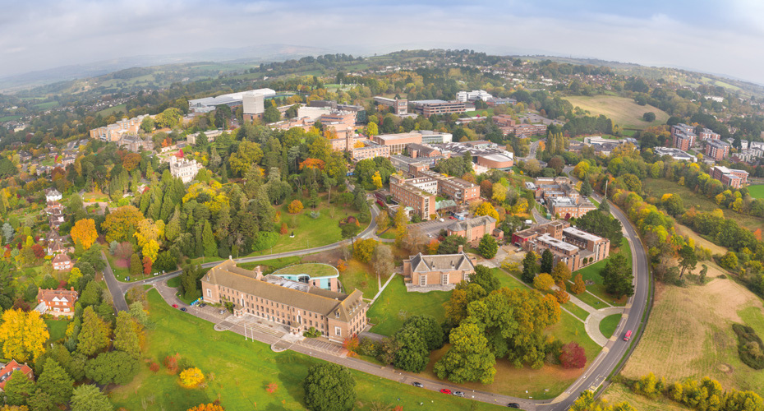


Psychological Professions Network South-West (PPNSW)
Funded by NHSE
Hosted by the University of Exeter
www.ppn.nhs.uk

Slide 2


Who are we?
The Psychological Professions Network South-West (PPNSW) is a regional membership network that brings together psychological professionals, experts by experience, and key stakeholders to shape and support the National Health Service (NHS) commissioned psychological healthcare across the South-West of England.
We are commissioned by NHS England to provide a joined-up voice for the psychological professionals in workforce planning, service development and ensure sustainable growth across the region.
Learn more about the Psychological Professions Network
To learn more about the Psychological Professions South-West, visit our website.

Slide 3
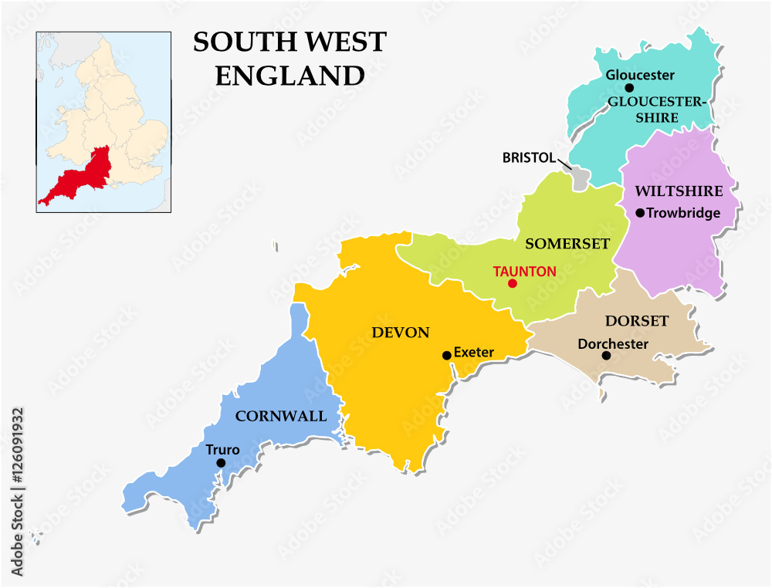
How do we define the Psychological Professions?
The Psychological Professions are a group of more than 20 roles recognised by NHS England and the Psychological Professions Network (PPN). They include professionals trained to apply psychological knowledge and skills in health, social care, and wider settings. A group of psychological professions within the NHS that are not represented by any other professional group within the setting of NHS.
A collective of over 20 professional roles in health and social care applying psychological knowledge, skills and research.
Work spans mental health, physical health, community and prevention services.
Central to NHS Long Term Plan and three shifts: Hospital to Community – Analogue to Digital – Treatment to prevention.
Psychological professions bring together all NHS roles whose core purpose is to apply psychological approaches to improve health, wellbeing and care.
Who are the Psychological Professions? (Video)

Slide 4



Our Work is Focused on Three Key Pillars
Connecting psychological professionals to build a strong, collaborative community.
Influencing national and regional policy by advising workforce planners, commissioners and system leaders.
Supporting the safe and effective development and expansion of both existing and emerging psychological roles.
https://ppn.nhs.uk/south-west

Slide 5



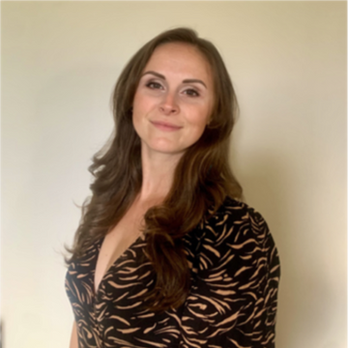

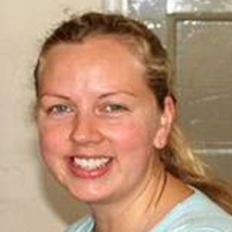
Our Team
PPNSW is led by a diverse, multi-disciplinary and dynamic team with expertise spanning education, health, research, service delivery, leadership and business development. Our collective backgrounds include clinical practice, programme coordination, operational delivery, lived experience and innovation in psychological professions. We are united by a shared commitment to equity, collaboration, and regional transformation in mental health and wellbeing services. Together, we contribute to national and regional developments that promote a sustainable, inclusive and future-focused psychological workforce.
Catherine Gallop
Phil Self
Eve Bampton-Wilton
Sam Strickland
Ghada Sharif-Clack
Co-Chair
Co-Chair
Clinical Programmes Manager
Graduate Research Assistant
Project Coordinator

Slide 6
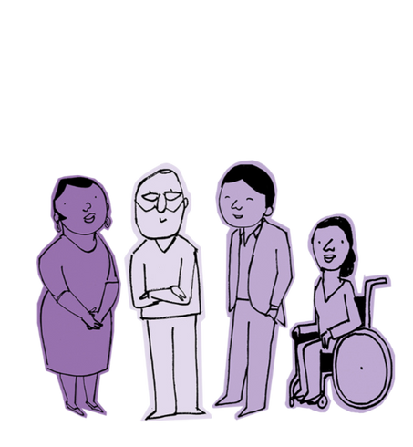

Experts by Experience (EbEs) at the Heart of PPNSW’s Work
Central Philosophy
Co-Creation in Practice
At PPN South-West, we believe that the voices of Experts by Experience are essential to shaping meaningful, inclusive, and impactful psychological healthcare.
EbEs co-design, co-deliver, and co-lead initiatives with us ensuring services are compassionate, relevant, and grounded in lived experience.
Our Commitment
NHS Strategic Alignment
We actively create opportunities for EbEs to influence policy, workforce planning, education, and innovation, amplifying their voice as equal partners in the system of care.
Embedding EbEs aligns with NHS England’s commitment to co-production, equality, and patient-centred transformation across workforce development and service delivery.
https://ppn.nhs.uk/south-west

Slide 7

Our Vision & Values
To transform lives and communities by extending and embedding psychological knowledge and practice across the whole of health and care.
We commit to putting the needs and voices of people at the heart of everything we do and to treating service users, carers, families and staff with kindness, empathy, openness, respect and dignity.
We commit to developing healthy, thriving communities, with a more psychologically informed public.
We commit to using our evidence and expertise boldly to innovate and improve what we do.
We commit to embedding psychological knowledge and practice across the health and care system, so it is better able to meet all a person's needs - psychological, physical and social.
We commit to the psychological professions becoming a united force with a strong and diverse voice, working collaboratively with other professionals of all disciplines.
https://ppn.nhs.uk/south-west

Slide 8



Where does the PPN Sit within the NHS?
The Psychological Professions Network (PPN) operates as a national, multi-professional body. It supports the coordination of the psychological workforce, leadership, digital innovation, and Equity, Diversity and Inclusion (EDI) initiatives across NHS England. This structure ensures strong alignment between national policy and NHS workforce delivery. PPN South-West implements this vision locally through: Strategic stakeholder engagement, Communities of Practice (COP) facilitation, Leadership development – Digital transformation and innovation focused on prevention and system change.
NHSE Strategy and Workforce Directorate (National)
Psychological Professions Oversight (PPN - National)
Regional PPN Teams
https://ppn.nhs.uk/south-west

Slide 9




What are the NHS Three Shifts?
As part of the NHS England long term plan, psychological professions are aligned with three key transformational shifts that shape the future of service delivery and workforce development.
Hospital
Community
Analogue
Digital
Treatment
Prevention
Expanding access to mental health and psychological care within local settings, homes and communities
Using digital tools and technologies to improve efficiency, equity and engagement in psychological services.
Prioritising early intervention, wellbeing promotion, and population-level prevention care.
https://change.nhs.uk/en-GB/projects/three-shifts
https://ppn.nhs.uk/south-west

Slide 10
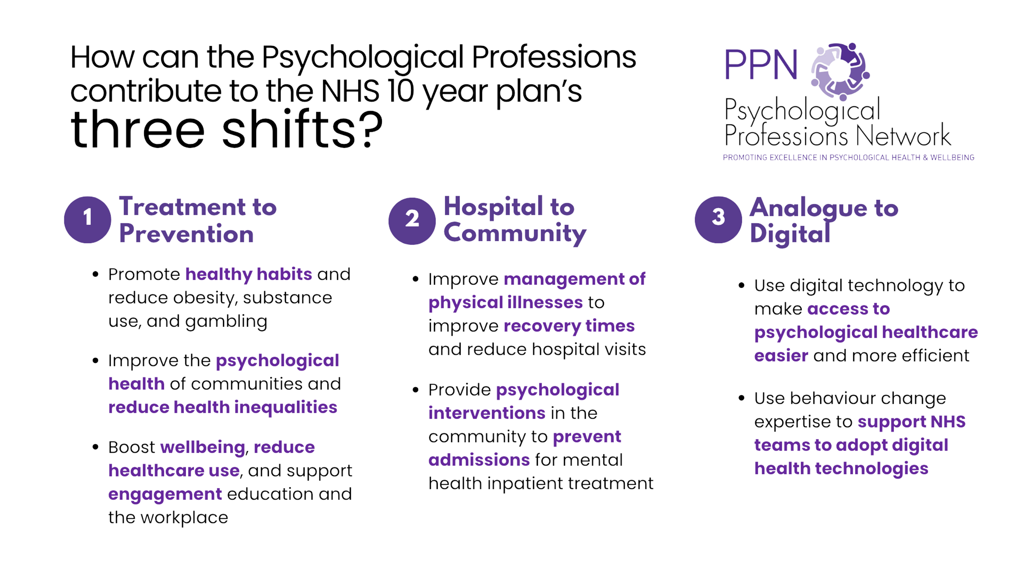

Slide 11
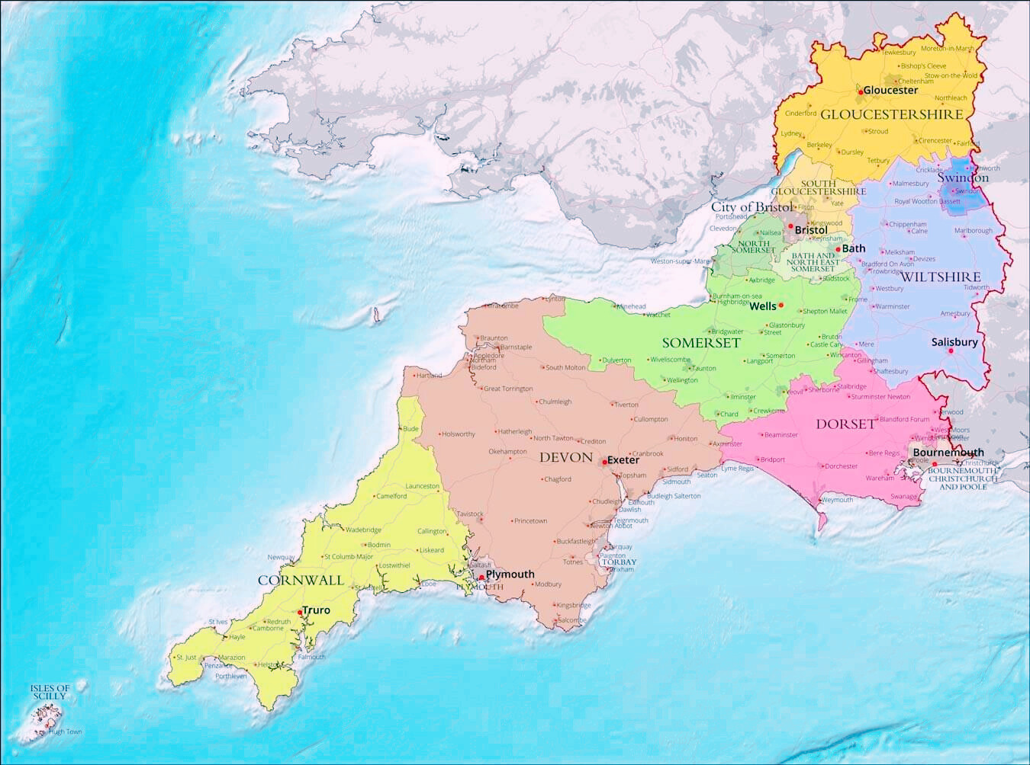

Membership
Membership is free and open to all qualified and trainee psychological professionals, as well as, service managers, commissioners, other clinicians, experts by experience, and anyone else with an interest in the psychological professions and the services they provide and support.
We represent over 20 psychological professions accounting for approximately 70% of the psychological workforce in the South-West; including psychologists, psychological therapists, and psychological practitioners.
4020 PPN SW members in July 2025
https://ppn.nhs.uk/south-west
Image Copyrights: Free World Maps

Slide 12
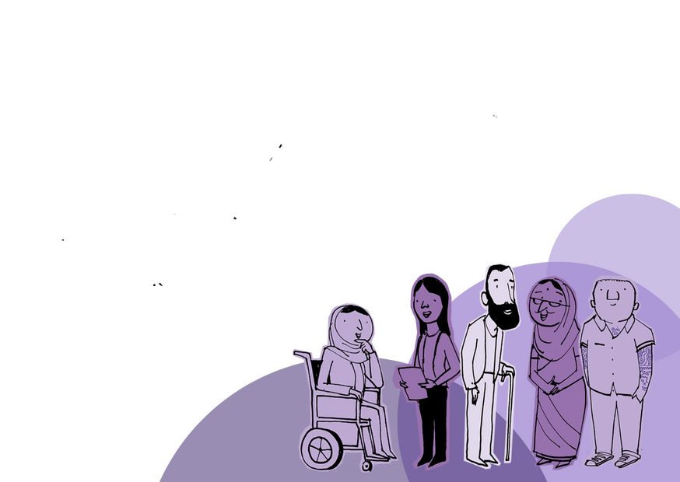
Our Members
Taxonomy of Psychological Professions
Psychological Practitioners
Psychological Therapists
Psychologists
  Psychological Wellbeing Practitioner
  Education Mental Health Practitioner
  Children’s Wellbeing Practitioner
  Mental Health & Wellbeing Practitioner
  Youth Intensive Psychological Practitioner
  Counsellor
  Cognitive Behavioural Therapist
  Adult Psychotherapist
  Family & Systemic Psychotherapist
  Child & Adolescent Psychotherapist
  Medical Psychotherapists*
  Art, Drama, & Music Therapist*
  Psychological Therapists (Other)
  Clinical Psychologist
  Counselling Psychologist
  Health Psychologist
  Forensic Psychologist
  Clinical Associate in Psychology
  Assistant Psychologist
https://ppn.nhs.uk/south-west
*Formally represented in other professional structures (AHPs / Medical)

Slide 13

PPNSW Communities of Practice (COPs)
Communities of Practice (COPs) offer a valuable space for practitioners, trainees, and partners to connect around shared clinical themes and areas of interest. These groups are member-led and supported by the PPN, enabling collaborative learning, peer support and innovation. When you join the network, you are invited to participate in the Communities of Practice that align with your interests or expertise. Members gain access to topic-specific events, discussion boards and exclusive resources.
Clinical Associates in Psychology
Community of Practice (CAP COP)
Aspiring Psychologists
Community of Practice (AP COP)
Education Mental Health Practitioner
Community of Practice (EMHP COP)
Mental Health and Wellbeing Practitioner Community of Practice (MHWP COP)
Children ‘s Wellbeing Practitioner
Community of Practice (CWP COP)
Psychological Wellbeing Practitioner
Community of Practice (PWP COP)
Art, Drama, Music Therapy
Community of Practice
Chief Psychological Professions Officer
Community of Practice (CPPO COP)
Join a Community of Practice here

Slide 14




Why Join Us?
Membership Benefits
A Collaborative Community
Communities of Practice
Joined-Up Voices
A network of psychological professionals in the South-West, working together with stakeholders and experts by experience to maximise the impact of psychological professions for the communities they serve.
Join or launch special interest groups across the region with our support.
Celebrating excellence by sharing good practice, fostering a culture of clinical and professional competency, and raising the profile of our profession.
https://ppn.nhs.uk/south-west

Slide 15




Why Join Us?
Membership Benefits
Shape the Future
Celebrate Our Profession
Innovate and Learn
Stay Informed
Participate in consultations and debates to influence policy and practice alongside peers and commissioners.
Take part in PPN regional events and our annual Psychological Professions Week celebrations.
Access resources and insights into the latest research and innovations in psychological practice.
Access resources and insights into the latest research and innovations in psychological practice.
https://ppn.nhs.uk/south-west

Slide 16

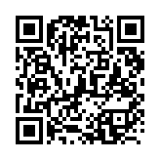
Undergraduates - Why Join?
  Explore the Career Map: Learn about over 20 psychology-related career paths including Clinical Psychology, CBT Therapy, Wellbeing Practitioners, Counselling Psychology, Educational Psychology, Forensic Psychology and more.
  Free Membership for Students: Join as a student members if you are interested in pursuing a career in NHS psychological professions.
  Access to Webinars, Q&As and networking opportunities: Engage with professionals through live sessions and virtual events.
  Join our Aspiring Psychologists Community of Practice: Connect with peers, share experiences and support each other through challenges and career milestones.
  Enhance your CV: Get involved in Communities of Practice, consultations, research, regional events, and co-produced initiatives.
  Stay up to date: Received our newsletter with the latest on jobs, training opportunities, CPD and Psychological Professions events.
Explore the Career Map:
https://ppn.nhs.uk/resources/careers-map

Slide 17

Postgraduates - Why Join?
Whether you are steeping into an impactful NHS career or building on your existing journey, the PPN South-West offers a dynamic platform to grow professionally and connect with others across the psychological professions.
  Join a supportive network of NHS psychological professionals and trainees.
  Explore NHS-aligned roles such as Clinical Associates in Psychology (CAPs), Psychological Therapists, Clinical and Counselling Psychologists and more.
  Stay informed with a fortnightly newsletter featuring job roles, CPD opportunities, and policy updates.
  Get involved in Communities of Practice, consultations, research and regional initiatives.
  Collaborate on national events like Psychological Professions Week and PPN South-West programmes and events.
  Learn about wider NHSE strategic and workforce opportunities and contribute to shaping the future of psychological services.
Explore the Career Map:
https://ppn.nhs.uk/resources/careers-map

Slide 18



Psychology Departments in South-West Universities
Partner with Psychological Professions Network South-West (PPNSW) to support the next generation of NHS Psychological Professionals. Universities play a key role in shaping the future workforce by:
  Promoting diversity across psychological professions.
  Strengthening the evidence in teaching, training, and research.
  Collaborating with NHS partners to address placement challenges and support workforce development.
  Maintaining close links with NHS Trusts and clinical settings to ensure relevant and impactful learning.
  Embedding NHS-aligned career pathways into academic curricula.
  Inviting NHS professionals to deliver guest lectures and mentor students.
  Encouraging student participation in research, consultations and Communities of Practice.
  Highlighting the NHS Psychology Career Map and supporting informed career decisions.
Check out our
Career Map
Your students benefit from:
  Exposure to real-world NHS leadership and career pathways.
  Opportunities to attend local and national events, including Psychological Professions Week.
Collaborate:
ppn-sw@exeter.ac.uk
https://ppn.nhs.uk/south-west

Slide 19

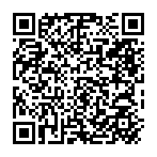

Careers Departments in South-West Universities
Support your students' ambitions to pursue psychology careers in the NHS.
What PPNSW Offers?
  Access to the NHS Psychological Professions Career Map and aligned career guidance.
  Invitations to webinars, insight days, and NHS-hosted networking events.
  Free membership with access to newsletters, featuring NHS psychology job roles, training and policy updates.
  Signposting to communities of Practice, regional consultations and co-produced research opportunities.
Why Partner With Us?
  Provide students with credible, up-to-date guidance on NHS career pathways and entry points.
  Co-create meaningful events and resources that support student decision-making and increase career clarity.
Check-out our Careers Map
Explore our Careers Resources

Slide 20
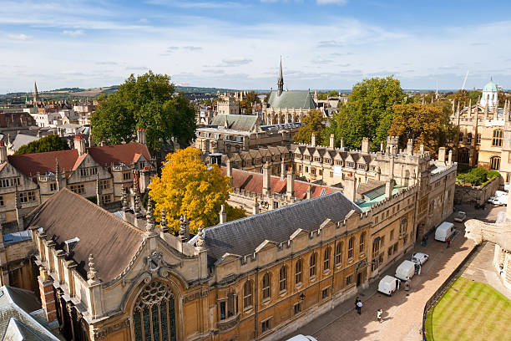





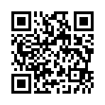
Thank You
ppn-sw@exeter.ac.uk
https://ppn.nhs.uk/south-west
HLS Department, CEDAR, University of Exeter
Register to become a member!

