Slide 1


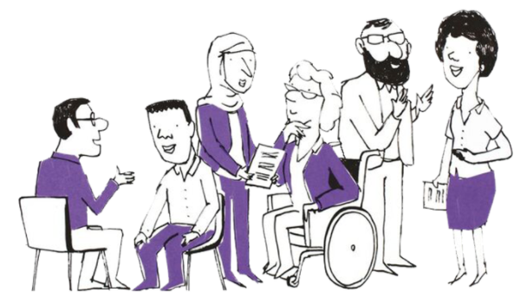

PPN Midlands Lived Experience Event
Wednesday 25th September 2024 12.30pm to 4.30pm

Slide 2



Slide 3

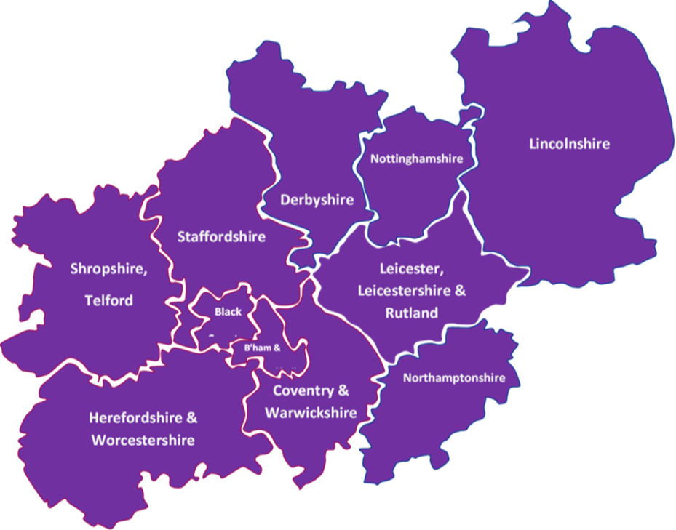
PPN Midlands – a snapshot
Formally established in September 2020
Covers one of the largest geographical patches in England
Has 11 Integrated Care Systems
Has 39 NHS trusts that employ Psychological Professionals
Has 100+ Higher Education Institutes, with over one third providing training with appropriate accreditation for NHS Psychological Professions roles

Slide 4
Some of our achievements to date
Over 2500 members
Over 160 bulletins
First Midlands Psychological Professions Workforce report in 2023
Communities of Practice
CPPO’s; Practitioners; Clinical Associates in Psychology (CAPS); Physical Healthcare; Assistant Psychologists and students
Professional advice to NHS England Workforce, Training & Education team
Developing e-learning resources
- Skills into Practice
- Psychological Practice in Physical Health ‘Fundamentals’
Careers event attendance to promote the profession
Supporting Equality, Diversity and Inclusivity
- Ethnic representation in the workforce
Connecting 11 Integrated Care Systems with Psychological Professions leads
Over 1500 critical friend responses
Project to Connect Midlands Lived Experience Leads
Other workstreams, such as Promoting Mental Health and Wellbeing Practitioners (MHWP) in specialist settings… and more
Communication, Engagement and Connections
Sharing data driven knowledge and supporting learning exchange
Professional advice informing professional practice and process

Slide 5
Showcasing the Midlands

Slide 6



Experts by Experience and CAPs
What are CAPs?
Clinical Associates in Psychology
Relatively new role (2018) in England with the aim of enhancing diversity in the workforce and improve access to evidence-base psychological interventions.
CAPs have specific skills in circumscribed, but high demand, areas of psychological assessment, formulation and intervention
They work under the supervision of a qualified practitioner psychologist (HCPC registered)
Why am I here today?
CAPs in training are employed by NHS psychology teams, and sent to us at Nottingham Trent University to do a Masters in Clinical Associate in Psychology
We are now in our third year of training CAPs – we do not yet have a panel of Experts by Experience on our course, but we want to establish one
Please speak with me today (or get in touch via email to garret.coy@ntu.ac.uk or msc.cap@ntu.ac.uk) if you’d be interested in helping us with this!
Cap photo by Mat Weller on Unsplash

Slide 7
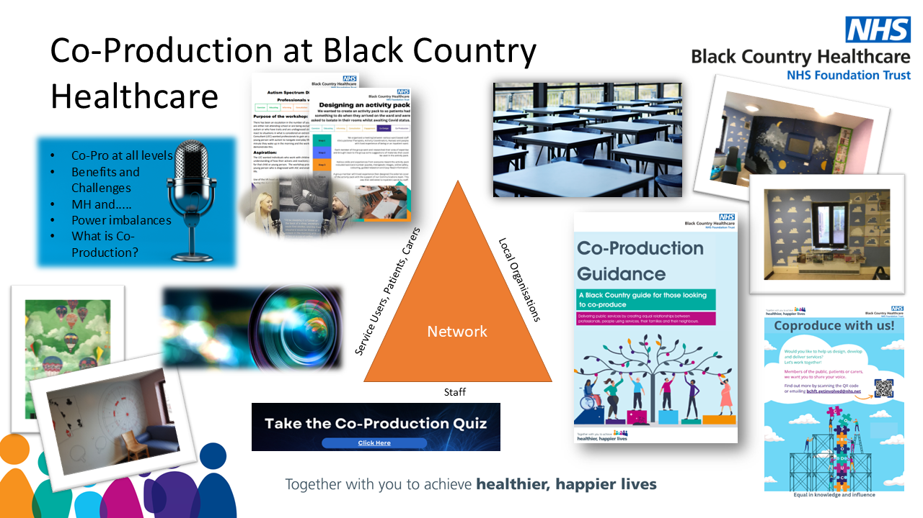

Slide 8


Introduction From A Lived Experience
Amplifying the Voices of Neurodiverse Individuals and Promoting Intersectionality, Equity, and Inclusion in Healthcare
As a British South-Asian female activist navigating the intricate challenges of neurodivergence, my experiences with autism and severe mental illnesses (SMI) have highlighted the unique struggles faced by underrepresented communities like mine. In environments where mental health discussions are often stigmatized or silenced, it becomes essential to advocate for neurodiverse voices and ensure they are heard.
Within marginalized groups, particularly in South-Asian communities, neurodivergence is frequently misunderstood or left unspoken. This cultural silence creates barriers to seeking support and magnifies the daily challenges of individuals like myself—whether it's coping with executive dysfunction, sensory overload, or emotional dysregulation. For us South-Asian feminine, the burden of cultural expectations adds another layer of complexity, making it even harder to express these struggles, often resulting in isolation and a lack of representation.
Intersectionality is key to understanding how neurodivergence intersects with race, gender, and mental health. In healthcare settings, it is critical to prioritize equity and inclusivity. Minoritized ethnic groups often face misdiagnosis or delayed diagnosis, especially with conditions like autism, which can manifest differently in female of colour. This issue is further compounded by the underdiagnosis of co-occurring conditions such as anxiety, depression, and eating disorders.
To achieve true equity, we must foster healthcare environments that are not only sensory-friendly but also culturally competent and trauma-informed. By amplifying the voices of neurodiverse individuals and those with SMI, especially from marginalized communities, we can create a more inclusive, compassionate approach to care. My personal journey has shown me the vital role of intersectionality, and by sharing my story, I hope to contribute to a future where all voices are recognized and supported in healthcare.
Today, we gather for the Experts by Experience (EbEs) collaboration event, under the Psychological Professions Network (PPN), Midlands. Drawing from my lived experience within the NHS mental health services, I truly believe in the power of partnerships between experts by experience and healthcare professionals to enhance learning, improve practice, and ultimately deliver better outcomes for all who seek care.

Slide 9
Lived Experience mapping project
Initial intentions
@PPNMidlands bsmhft.ppnmidlands@nhs.net www.ppn.nhs.uk/midlands

Slide 10

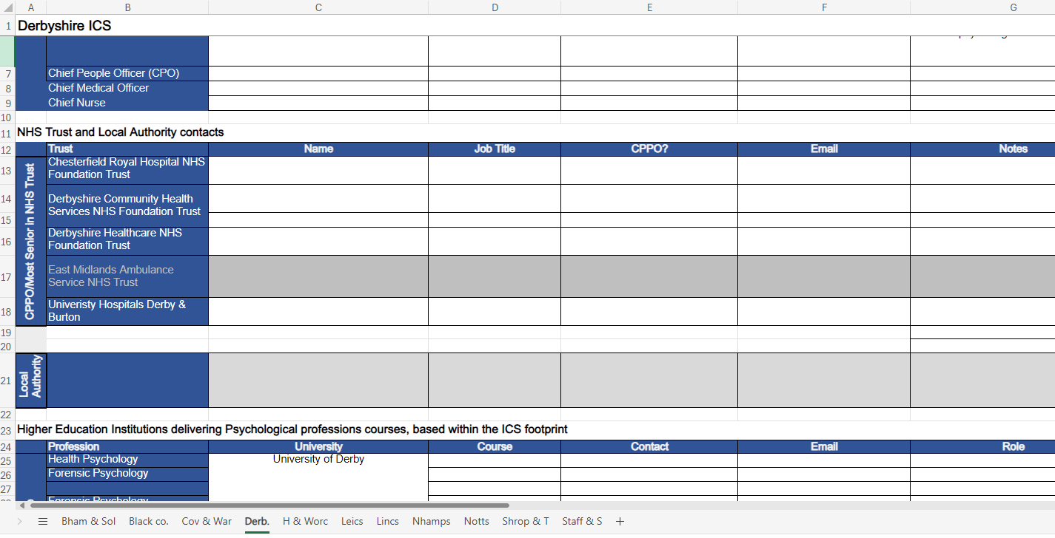
Mapping the Midlands

Slide 11
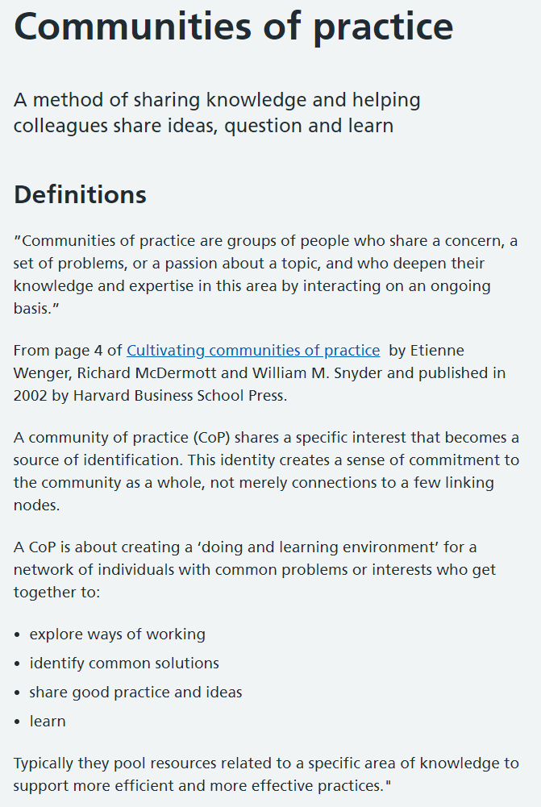
Community of Practice (CoP)
@PPNMidlands bsmhft.ppnmidlands@nhs.net www.ppn.nhs.uk/midlands

Slide 12
Chief Psychological Professions Officers (CPPO)
Practitioners
Psychological Practice in Physical Healthcare
Clinical Associates in Psychology (CAP)
Assistant Psychologists and students
Quarterly/3 per year for 2hrs
Quarterly for 2hrs
Every 2 months for 1hr
In development
Every 2 months / 5 annually for 1.5hrs
Communities of Practice
@PPNMidlands bsmhft.ppnmidlands@nhs.net www.ppn.nhs.uk/midlands

Slide 13
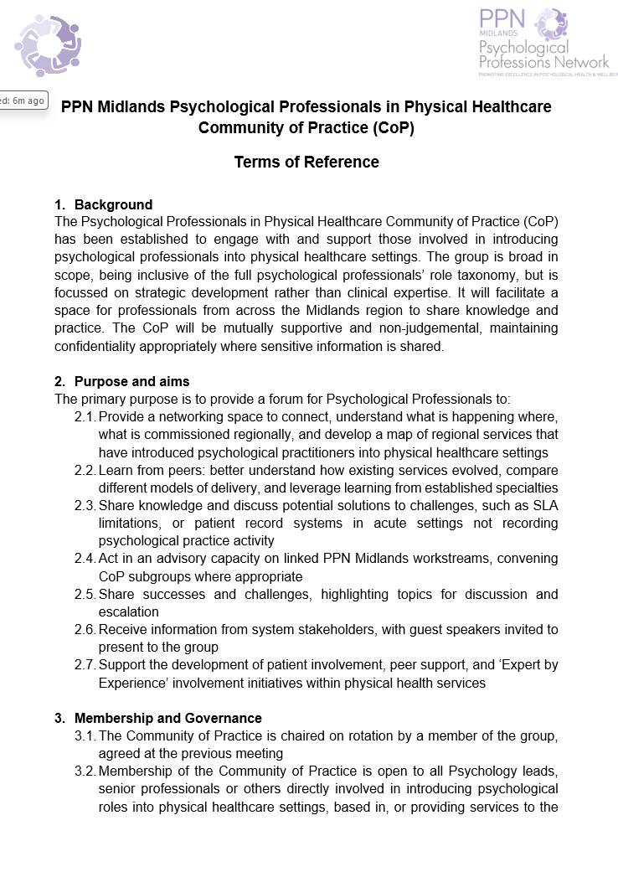
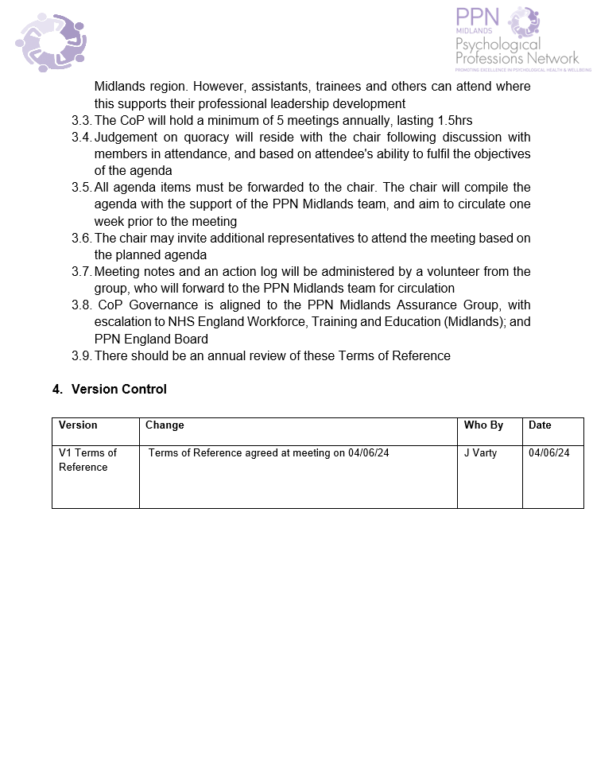
Terms of Reference
A document outlining purpose, aims, scope and responsibilities for how a group of people will work together to achieve a common goal.

Slide 14
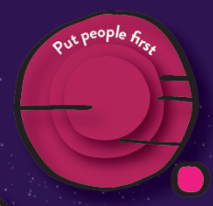



Building a Community to share practice
In groups, identify 3 priorities
Within your conversations consider:
What does equity among members look like?
Who are the right people and how do we reach them?
What might our ambitions for each area be?
People Put people first | Purpose Transform and Innovate | Scope (inc. Geography) Help our communities to thrive | Health inequalities Unite and increase diversity
Green Table | Orange Table | Red Table | Yellow Table

Slide 15
Next steps
@PPNMidlands bsmhft.ppnmidlands@nhs.net www.ppn.nhs.uk/midlands

Slide 16

Thank you for being part of
our PPN Midlands community
National Psychological Professions Week
Details of Midlands sessions to follow soon!

