Slide 1


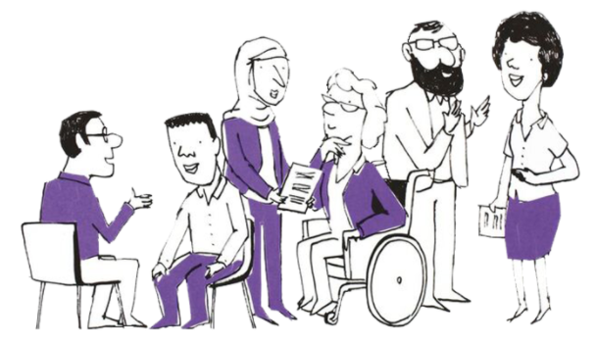

PPN Midlands CoP Co-Chairs and CPPO 4th Anniversary Event
Wednesday 25th September 2024 9.00am to 1pm

Slide 2



Slide 3
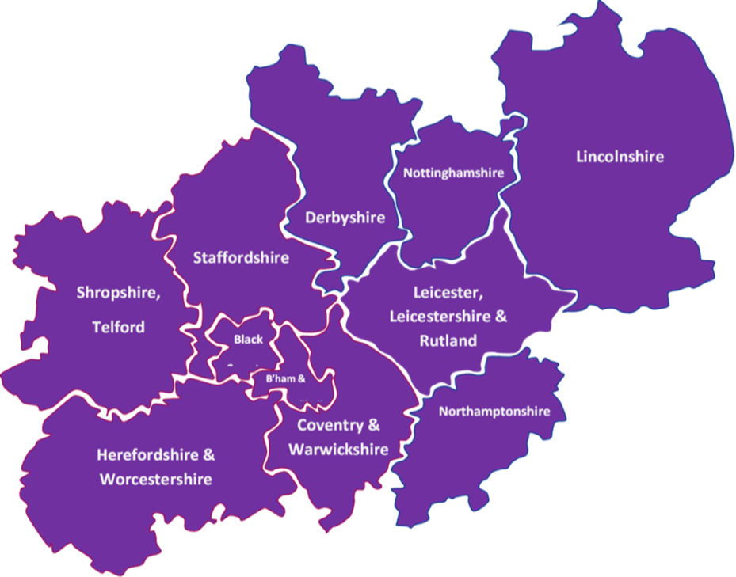
PPN Midlands – a snapshot
Formally established in September 2020
Covers one of the largest geographical patches in England
Has 11 Integrated Care Systems
Has 39 NHS trusts that employ Psychological Professionals
Has 100+ Higher Education Institutes, with over one third providing training with appropriate accreditation for NHS Psychological Professions roles

Slide 4
Some of our achievements to date
Over 2500 members
Over 160 bulletins
First Midlands Psychological Professions Workforce report in 2023
Communities of Practice
CPPO’s; Practitioners; Clinical Associates in Psychology (CAPS); Physical Healthcare; Assistant Psychologists and students
Professional advice to NHS England Workforce, Training & Education team
Developing e-learning resources
- Skills into Practice
- Psychological Practice in Physical Health ‘Fundamentals’
Careers event attendance to promote the profession
Supporting Equality, Diversity and Inclusivity
- Ethnic representation in the workforce
Connecting 11 Integrated Care Systems with Psychological Professions leads
Over 1500 critical friend responses
Project to Connect Midlands Lived Experience Leads
Other workstreams, such as Promoting Mental Health and Wellbeing Practitioners (MHWP) in specialist settings… and more
Communication, Engagement and Connections
Sharing data driven knowledge and supporting learning exchange
Professional advice informing professional practice and process

Slide 5
National Context / Discussion
Midlands CoP Event
25th September 2024
Dr Adrian Whittington, National Clinical Lead for Psychological Professions, NHS England
For Discussion
Notes:
Standard title slide

Slide 6
New government priorities
Darzi Review
10 Year Plan
Long Term Workforce Plan Refresh
Spending Review
Scope of practice for new roles
Service developments
Infected blood psychological service
Staying Safe from Suicide and Self-Harm
Recognised Registers
Blended Learning
Psychological Practitioner Preceptorship
Issues raised by the group
Career pathways and senior roles
Child Mental Health
Recruitment and retention
Autumn Statement 2023 Expansion of NHS Talking Therapies
Next steps for PT-SMHP and MHSTs
Schools of Psychological Professions
Guidance in development

Slide 7
Communities of Practice
Where are we now, and where are we going?
@PPNMidlands bsmhft.ppnmidlands@nhs.net www.ppn.nhs.uk/midlands

Slide 8

Chief Psychological Professions Officers (CPPO)
Practitioners
Psychological Practice in Physical Healthcare
Clinical Associates in Psychology (CAP)
Assistant Psychologists and students
Quarterly/3 per year for 2hrs
Quarterly for 2hrs
Every 2 months / 5 annually for 1.5hrs
Every 2 months for 1hr
In development
Sunny / CPPOs
Anika, Louise
Jen, Johnna
Amma, Molly
James P
Communities of Practice
@PPNMidlands bsmhft.ppnmidlands@nhs.net www.ppn.nhs.uk/midlands

Slide 9
Discussion
Stories are data with soul: sharing CoP themes
Strengths and learnings focussed on participation and engagement
Sustainability and leadership support
@PPNMidlands bsmhft.ppnmidlands@nhs.net www.ppn.nhs.uk/midlands

Slide 10
To consider…
CoP alignment with PPN Midlands Workforce Council?
Development of CoP support resources?
Together we can: our part and your part
PPN core team | CoP members
Support with set-up; ToR, roles, preparation | Chair and administer meetings
Administer CoP joiners and leavers, managing membership lists | Agree topics, organise speakers and prepare agendas
Send calendar invites for CoP meetings (but not attend!) | Organise and administer co-chair pre-meets
Promotion via bulletin; manage queries | *Create links for CoP meetings that require breakout rooms
Manage NHS Futures member permissions, adding joiners and removing leavers
Support with identifying speakers

Slide 11

Thank you for being part of
our PPN Midlands community
National Psychological Professions Week
Details of Midlands sessions to follow soon!

