Slide 1




Slide 2
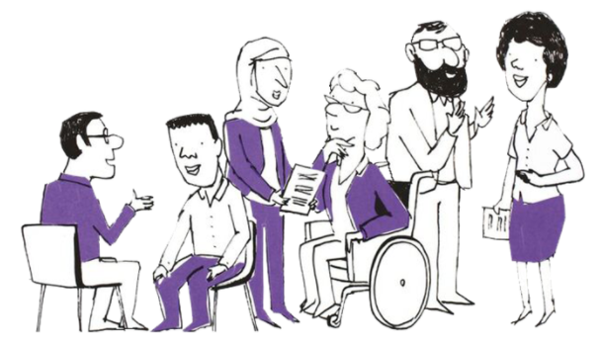

The Role of Parent Carer Peer Support Workers in CYP Mental Health Services
Clare Devanney-Glynn

Slide 3
The Parent Carer Peer Support Worker Role
A Parent Carer Peer Support Worker (PCPSW) in children’s mental health services uses their own lived experience of supporting a child with emotional or mental health difficulties to help other parents and carers who are navigating similar challenges.
They provide parents and carers with:
  Emotional support
  Information
  Empowerment

Slide 4
The Parent Carer Peer Support Worker Role
PCPSW:
  Help parents and carers to navigate services
  Strengthen family resilience
  Work collaboratively with professionals to improve outcomes for children and young people.
Their unique role bridges the gap between families and professionals, ensuring that parents feel heard, supported, and empowered throughout their child’s mental health journey.

Slide 5
The Value of the Role
PCPSW have so much to offer the workforce, giving give a safe, non-judgmental space for other parents and carers to learn from each other.
For services, this is an invaluable way to help boost capacity in the system, building on partnership work with voluntary sector organisations.
Their unique role bridges the gap between families and professionals, ensuring that parents feel heard, supported, and empowered throughout their child’s mental health journey.

Slide 6
How Can This Role Benefit the Workforce?
Improved engagement outcomes
Support clinicians and reduce pressure
Enhance communication and understanding
Promote a compassionate and inclusive culture
Workforce development and retention
Enhanced outcomes for children and young people
All while modelling the power of lived experience as a professional asset

Slide 7
Any Questions?

Slide 8

Thank you
@PPNEngland
www.ppn.nhs.uk
#PPWeek25
#PsychologicalProfessionsWeek2025

