Slide 1




Slide 2

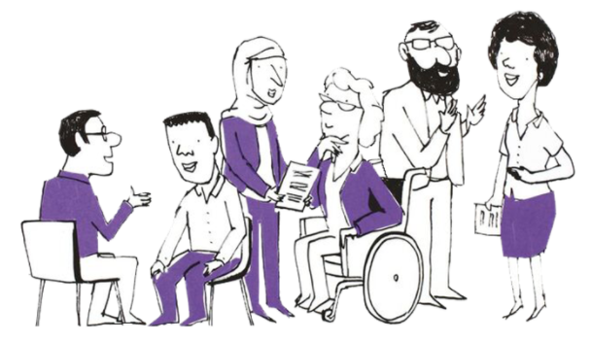

Adapted Low Intensity CBT for Autistic CYP and CYP with LD
Dr Kellie Jacques
Cara Miller

Slide 3
Background and Rationale
Children and Young People’s Psychological Trainings (CYP-PT) Initiative
Launched in 2011 (formerly CYP-IAPT) to improve quality and accessibility of psychological therapies for CYP.
Low-intensity (LI) arm focused on early intervention and workforce development.
Over 10,500 practitioners trained by 2019 (Clark, 2019).

Slide 4
Background and Rationale
Why Focus on Adaptations?
CYP with Autism and Learning/Intellectual Disabilities (LD/ID) experience higher rates of mental health difficulties (Beesdo, Knappe, & Pine, 2009; Hudson, Hall, & Harkness, 2019; Totsika et al, 2022)
Yet they face reduced access to suitable psychological interventions.
No agreed framework for adapted LI-CBT for CYP.
Practitioners often lack confidence, guidance, and supervision when working with these populations.

Slide 5
Research Focus
Overall Aims
To explore how Low-Intensity CBT practitioners can better meet the needs of autistic CYP and CYP with LD, focusing on confidence and current practice adaptations.

Slide 6
Project 1: LI Practitioners' Confidence Working Adaptively with Autistic CYP and CYP with LD

Slide 7
Project 1: LI Practitioners' Confidence
Aims
Determine the levels of confidence of low intensity practitioners at working adaptively with autistic CYP and CYP with LD
Identify factors that are associated with increased and decreased confidence.
Design
Quantitative, cross-sectional, and internet-based questionnaire

Slide 8
Project 1: LI Practitioners' Confidence
Key Variables
Therapy Confidence Scale–Intellectual Disabilities [TCS‐ID] (Dagnan et al.,2015), adapted to working with CYP
Therapy Confidence Scale – Autism Spectrum Disorder [TSC-ASD] (Cooper et al.,2018), adapted to working with CYP
Years of experience, frequency of Clinical Skills Supervision, job role and duration, qualification status, caseload percentage of CYP with LD/autism, CPD/additional training on autism/LD.

Slide 9
Project 1: LI Practitioners' Confidence
Methodology
Participants were recruited through convenience sampling, using established university networks including:
Community of practice forum
CYP-MH training LI supervisors
Programme leads
Study information and a link to the online consent form and questionnaire were shared via email with these networks.
The questionnaire was open ~3 months (21st March- 16th June 2025)
Current trainees​
Alumni networks

Slide 10
Project 1: LI Practitioners' Confidence
Results
Professional Role | Frequency | Percentage
Trainee EMHP | 39 | 32.2
Trainee CWP | 23 | 19.0
Trainee SWP | 3 | 1.7
Qualified EMHP | 35 | 20.7
Qualified CWP | 27 | 22.3
Unqualified SWP | 5 | 4.1
Total | 121 | 100.0

Slide 11
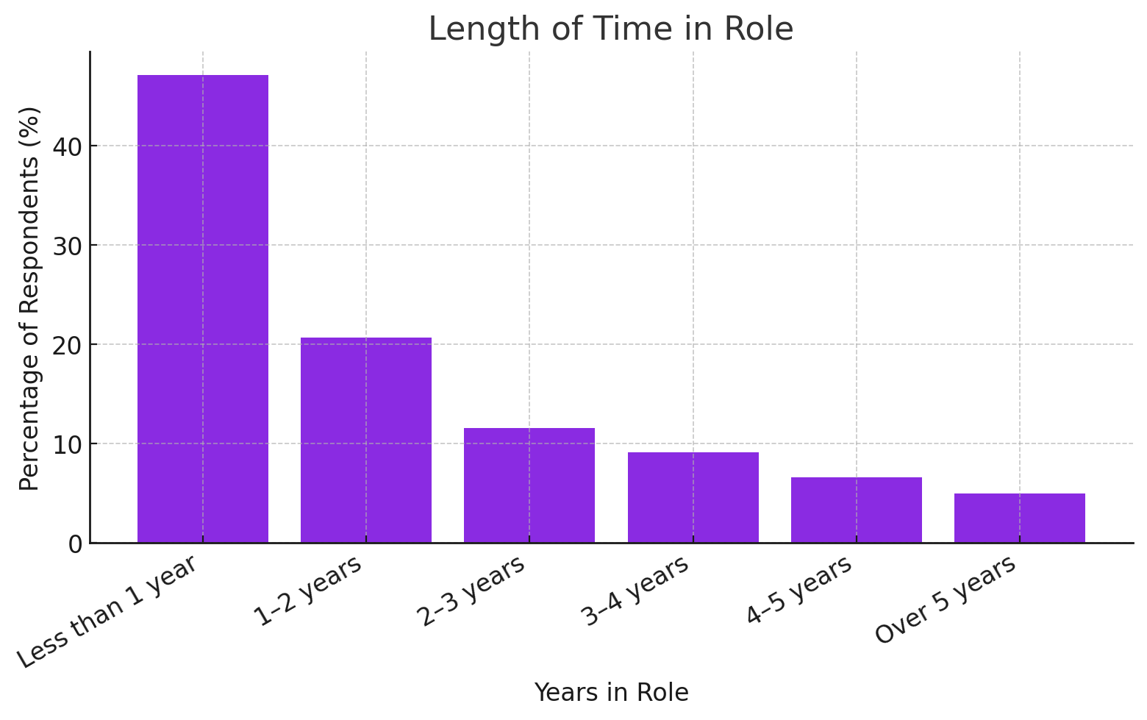
Project 1: LI Practitioners' Confidence
Results

Slide 12
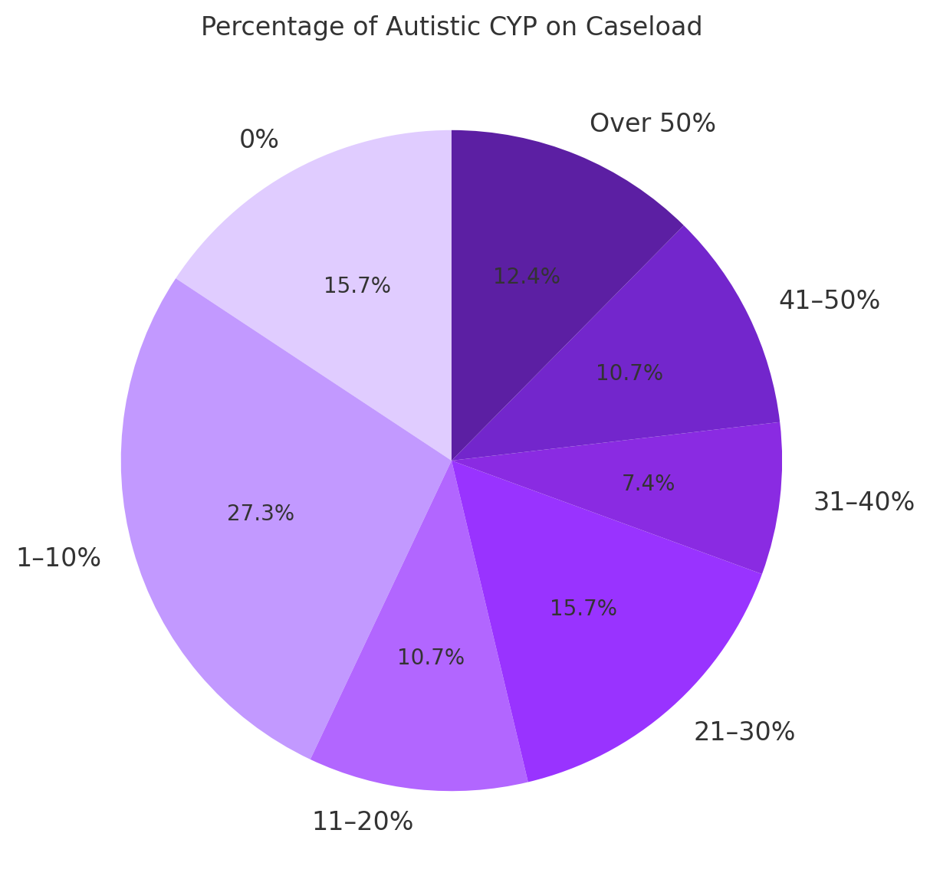
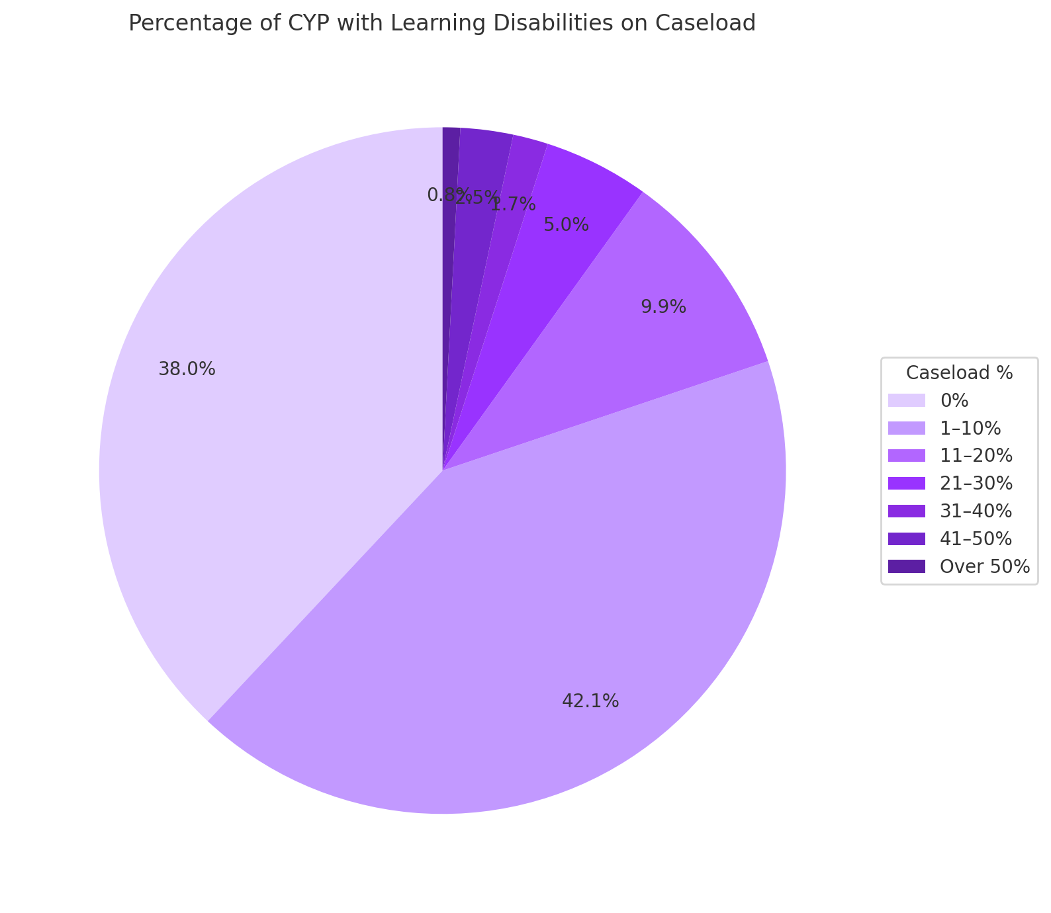
Project 1: LI Practitioners' Confidence
Results

Slide 13
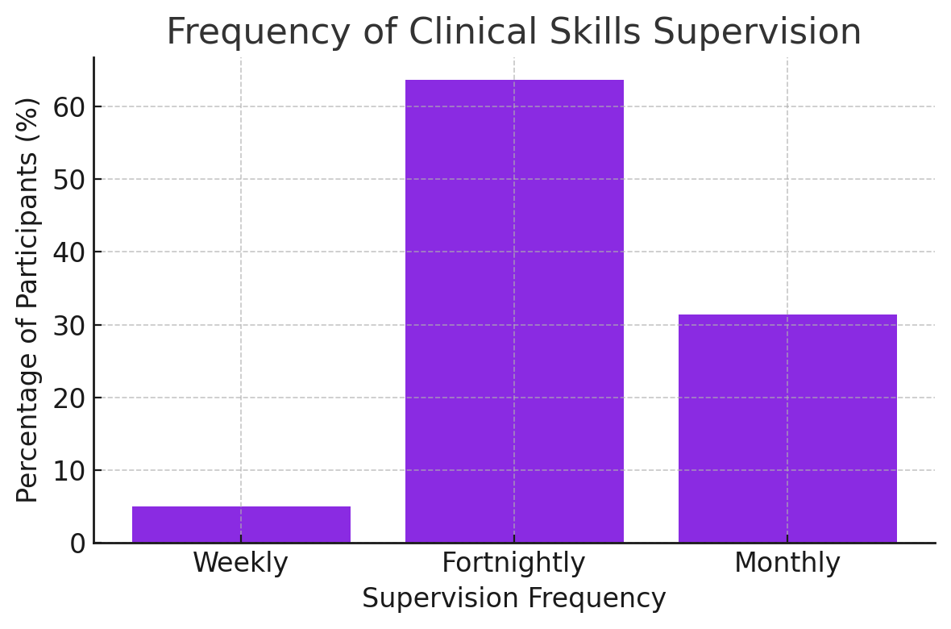
Project 1: LI Practitioners' Confidence
Results

Slide 14
Project 1: LI Practitioners' Confidence
Results
Working with Autistic CYP
Qualified practitioners were significantly more confident in working with autistic CYP than unqualified practitioners.
Practitioners who had completed CPD on autism were significantly more confident working with autistic CYP those who hadn't.
Higher levels of confidence correlated with higher caseload percentage of autistic CYP.
Increased experience in role was associated with higher confidence.
There were no differences significant differences in confidence levels between EMHPs and CWPs, frequency of supervision, or size of caseload.

Slide 15
Project 1: LI Practitioners' Confidence
Results
Working with CYP LD
There were no significant findings for any of the variables (qualification status, CPD, caseload percentage, role, role experience, supervision frequency, or size of case load.

Slide 16
Project 1: LI Practitioners' Confidence
Summary
Our findings suggest that additional training and experience working with autistic CYP improves the confidence of LI practitioners
However, this may not be the case for working with CYP with LD
This could be due to the low numbers of practitioners working with CYP LD, or it could relate to broader issues around the levels of support to carry out this work
Future qualitative research with these practitioners could help us better understand why practitioners aren’t feeling confident working with kids with LD

Slide 17
Project 2: Adaptations LI Practitioners' Make in their Current Practice with Autistic CYP

Slide 18
Project 2: Current Adaptations
Aims
To investigate the adaptations made by low intensity practitioners for CYP with autism and LD
To compare current practitioner adaptations to expert recommendations in literature.
Design
Qualitative, exploratory research design to allow for a rich collection of data.

Slide 19
Project 2: Current Adaptations
Methodology
Semi-structured interviews conducted on adaptations for ASD or LD
Participants are EMHPs or CWPs currently working within the Northeast and Yorkshire region.
Obtained through convenience sampling using established university networks.
Data Analysis
Interviews were analysed via thematic analysis (Braun & Clark, 2006)
7 interviews completed relating to ASD, LD interviews in progress

Slide 20
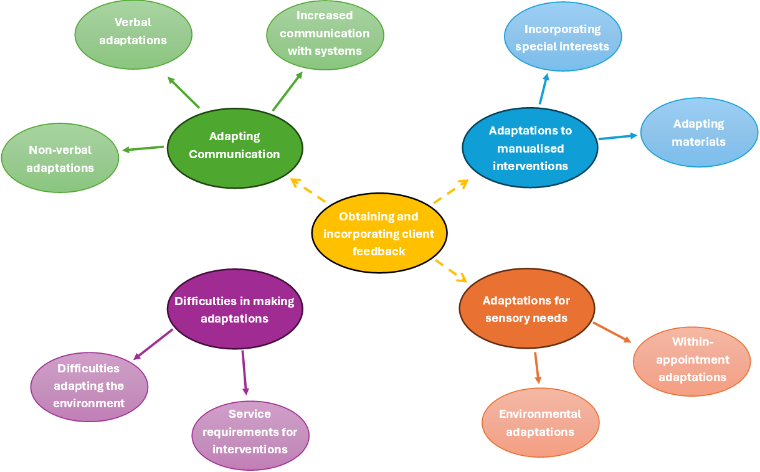
Project 2: Current Adaptations
Results

Slide 21
Project 2: Current Adaptations
Summary
Preliminary findings are showing that current adaptations with autistic CYP align with those outlined in the literature.
Half of participants were trainees and half were qualified – all made similar adaptations.
Positive as clinicians of varying experience were all adapting their practise for young people with ASD.

Slide 22
Next Steps
Current Projects
Complete the data analysis to produce a finalised thematic map.
Complete interviews with LI practitioners relating to their practice with CYP with LD.
Compare the current adaptations identified in the qualitative study with those discussed in the literature.
Develop an adaptation checklist to be used in future research.
Conducting a training needs analysis informed by our results.

Slide 23
Next Steps
Future Projects
Qualitative study with families, carers, and CYP of their experiences of adapted practice.
Develop a framework for adaptations derived from all three sources.
Evaluate the impact of impact of research-grounded training in adapted practice.

Slide 24
Summary
Understanding the current landscape for adapted practice in LI settings is the first step towards building inclusive, community-based care, and our ongoing research agenda in this area aligns with the broader shift towards early intervention and more personalised approaches in psychological care.

Slide 25
Acknowledgements
Tyler Lewis
Jo Weallans
Joanne Comerford
Joleen Ross
Helen Dean
Dr Jessica Collins
Dr Markku Wood
Professor Dave Dagnan

Slide 26
Any Questions?

Slide 27

Thank you
@PPNEngland
www.ppn.nhs.uk
#PPWeek25
#PsychologicalProfessionsWeek2025

