Slide 1

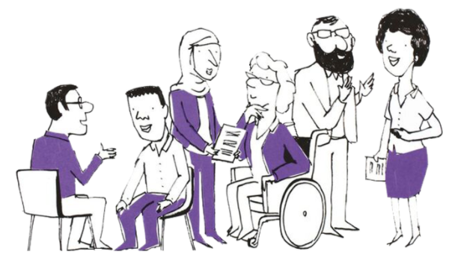

PPN NW and NE&Y NHS Talking Therapies Leadership and Innovation Forum
Spring/Summer 2025
1st May 2025

Slide 2

Welcome:
Agenda
Time | Title | Speaker
09:30 | Welcome | Toby Sweet Forum Chair & Chief Executive, Sunderland Counselling Service
09:45 | Compassionate Leadership in NHS Talking Therapies | Jenny Gravestock Clinical Lead, North Lincolnshire Community Mental Health and Talking Therapy Services
10:15 | Integrating Physical Activity into Talking Therapy Services | Dominic Mossa Senior High Intensity Therapist, NHS Durham and Darlington Talking Therapies Charlotte Regan Health Integration Lead, Tees Valley Sport
Notes:
Liz

Slide 3
Welcome:
Agenda
Time | Title | Speaker
10:45 | Experts By Experience: How We Can Support Talking Therapies | PPN NW Experts by Experience
11:15 | Break
11:30 | Practice Research Network | Jaime Delgadillo Professor of Clinical Psychology, University of Sheffield
12:10 | Southport Post Event Response Service | Dr Samantha Wallace Consultant Clinical Psychologist Dominic Bray Head of Clinical Health Psychology Merseycare NHS Foundation Trust
12:50 | Closing Remarks | Toby Sweet Forum Chair & Chief Executive, Sunderland Counselling Service
Notes:
Liz

Slide 4
Housekeeping
Recording of today’s session
Please keep mics muted
To engage:
Reactions
‘Q&A’ – ‘like’ to uplift a question
Evaluation Survey
Will be sent out after the event
Chat Function
Please use the Q&A function to pose your questions for our presenters, as we go.
This will enable us to capture key themes and ideas to ensure we cover as much as possible in the Q&As at the end of the sessions.
Notes:
Liz

Slide 5
Compassionate Leadership in NHS Talking therapies
A feasibility study
Jenny Gravestock
May 2025

Slide 6
Plan for this presentation
My background
The context
Methods
Findings so far…
Next step

Slide 7
My Background
I have worked in NHSTT for 16 years as a PWP, CBT, Supervisor
In 2019 I became clinical lead for an NHSTT service and in 2020 began a Professional Doctorate with the University of Derby
My primary concern was around staff wellbeing and burnout
For NHSTT but also all NHS staff
I was mindful of a national concern with recruitment and staff retention
I wanted to add value through my research
It needed to be practical and relevant to NHSTT

Slide 8
Context
In the early stages of the doctoral programme, I completed various scoping exercises and an initial scoping literature review (Gravestock, 2022)
I decided to continue to focus on leadership in NHSTT
Specifically on compassionate leadership
I created a new compassionate leadership intervention, designed specifically for NHSTT.
I have just completed a feasibility trial in RDASH Talking Therapies
Here are the definitions I used throughout the study…

Slide 9
Leadership definition
A leader in healthcare is any individual who, by virtue of their role, experience, or expertise, holds a degree of power, responsibility, or the capacity to influence the work environment and well-being of colleagues. Leadership can be recognised through formal titles such as lead, supervisor, or manager, but is also demonstrated through actions that support, guide, and inspire others within the organisation.

Slide 10
Compassionate Leadership definition (West, 2021)
Attending to another person or people
Trying to understand their perspective
Empathising
The drive to try and help relieve their suffering

Slide 11
Compassionate leadership continued…
It isn’t just about a single person or leader
The overall organisational leadership approach and culture are incredibly important
It also relates to authenticity, integrity, inclusivity, and collective leadership
It can be demonstrated in many ways
Behaviours
Language (tone and content)
Decisions
Values
Consistency
Notes:
This is just to emphasise that compassionate leadership is a systemic and complex approach to being and leading within a workplace.

Slide 12
Why compassionate leadership?
Some leadership styles are more helpful than others
Values-based and relational leadership styles are especially helpful
For healthcare and for staff burnout
There is growing support for compassionate leadership in the NHS
Compassionate leadership is compatible with other well-known leadership styles such as servant and transformational (Evans, 2023)
Also, NHSTT has sometimes been criticised for being overly structured, target-focussed, and not individual or person-centred

Slide 13
Summary so far
Burnout and staff wellbeing is a key issue for NHSTT
Research shows leadership is significantly associated with burnout
There are gaps in the leadership and burnout evidence base (Gravestock, 2022):
NHSTT
Intervention / experimental / applied research in mental health services
Organisational based solutions
Notes:
I decided at this point to develop a new intervention designed specifically for NHSTT.

Slide 14
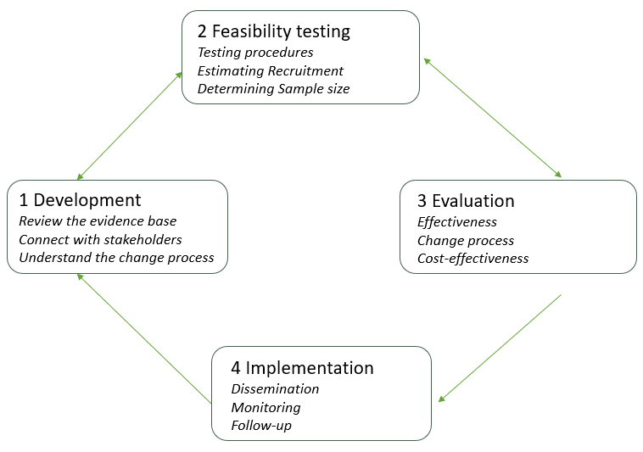
Developing a new intervention
Medical Research Council’s (Craig, 2008)

Slide 15
The Compassionate Leadership Workbook
Strengths of this format:
Familiar (akin to positive practice guides)
Minimally intrusive
Building on strengths
Providing a rationale for compassionate leadership
Including NHSTT based examples and case studies
Addressing specific myths and barriers as based on evidence base

Slide 16
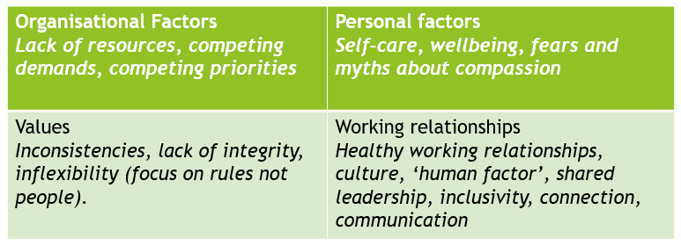
The content: ‘review 2’

Slide 17
How should I test this in a clinical service? Review 3
Area of focus | Recommendation
Study design | A mixed methods approach allows for a more comprehensive perspective and considers a broader range of data. This is useful when applying research to clinical practice as feasibility and practicality can be assessed from participant feedback. Often the qualitative data will complement or add a deeper understanding to the quantitative data collected.
Implementing the interventions | Participants in clinical trials value meeting in-person with like-minded peers, or colleagues that they would not usually interact with. The support of senior leadership is important for the success of any project and leadership training, to allow for attendance and change-engagement. It is important to minimise the impact of the training on the clinicians’ practice i.e. to be mindful of the length and intensity of the training. This is to encourage attendance and reduce the potential for conflicting priorities to lead to dropout or otherwise disrupt engagement. Ensuring the location of training is accessible, such as the participants’ workplace, can aid recruitment and retention.
Data collection | 360-degree data collection, gaining perspectives from the leaders and their colleagues or subordinates can provide a more comprehensive assessment and potentially overcome any social desirability effect. Aligning the theoretical orientation of the intervention and questionnaires would ensure clear and valid measurement of the targeted leadership factors. Using validated questionnaires would be helpful to allow for comparison across research studies.

Slide 18
The Feasibility Study Design
This feasibility trial utilised a mixed-methods explanatory sequential study design with between-subject conditions (Creswell & Plano Clark, 2018).
The data collection was split into two key phases: the initial quantitative phase and the qualitative phase.
Quantitative data was collected from all participants at 6 timepoints across three stages (pre-, mid-, post-intervention).
Qualitative data was collected in the form of leader interviews post-intervention.

Slide 19
Stage of study | Week and Activity
Pre-Intervention | Week 1: Questionnaires sent via email as a Qualtrics link Week 3: Questionnaires sent via email as a Qualtrics link
Post-Intervention | Week 5: Workshop 1 plus all questionnaires Week 9: Workshop 2 plus all questionnaires
Post-Intervention | Week 13: Workshop 3 (final) plus all questionnaires Week 17: Final follow up questionnaires
Qualitative element | Week 17-23: all leader participants are invited to a semi-structured interview

Slide 20
Measures
Compassionate leadership Scale (CLS)
The CLS is to be completed by leader-participants only. This is a 16-item questionnaire indicating levels of compassionate leadership in four key subscales of attending, understanding, empathising, and helping (West, 2021).
Culture Assessment Tool (CAT)
The CAT is to be completed by team member-participants only. This is a ten-item multiple choice questionnaire with 2 subscales: an observer rating of compassionate leadership (6 items) and of compassionate culture (4 items) (West, 2021).
Oldenburg Burnout Inventory (OLBI)
All participants complete the OLBI. This scale is designed to measure burnout through two subscales: Emotional Exhaustion and Disengagement (Demerouti et al., 2003).
Job Discrepancy and Satisfaction Scale (JDSS)
All participants complete the JDSS. This is an eight-item multiple choice questionnaire (Nagy, 2002).
Notes:
First two have not been widely used or validated in research (there is a little evidence for CLS) but they were chosen based on learning from review 3, that it will likely be much easier to evaluate an intervention if the tools map onto the concept being tested. These two, CLS and CAT, were from the West compassionate leadership book and use the same definition of compassionate leadership as the intervention.

Slide 21
Participants
The feasibility trial aimed to recruit a total sample of 56 participants over the two groups of leaders and team members.
The final and total sample included 31 participants.
The final sample included 13 leader-participants; 12 females and 1 male with a mean age of 39.9years (s.d. 8.3). No participant dropped out or withdrew their data from the study. However, one leader was removed from the study due to non-engagement.
The final team member sample included 18 participants; 15 females and 3 males with a mean age of 39.2 (s.d. 13.2). No team-member participant dropped out or were removed from the study.

Slide 22
Questionnaires: summary of findings
Completion rates:
100% for team members
83% for leaders
Timepoints 1 and 6 (with substitutions from timepoints 2 and 5 where needed)
Tests of normal distribution were completed using SPSS
Shapiro-Wilks, Skew, Kurtosis, and Z Scores
Then the appropriate parametric / non-parametric tests were used
Paired-sample t test
Wilcoxon signed-rank test (For the Leader-Participant’s OLBI data)

Slide 23
Questionnaires: summary of findings
Culture Assessment Tool (CAT) – Team Members
Significant improvement in total or overall CAT scores (p=.02,d=603)
Significant improvement in compassionate culture subscale (p = .02, d = .587)
Observed leadership support improved but only approached statistical significance(p = .07, d = .455)
Compassionate Leadership Survey (CLS) – Leaders
Non-significant decline in self-rated compassionate leadership, including total and attending / helping subscales
‘Attending’ subscale decreased, approaching significance (p = .067, d = .587)
Very slight, non-significant gains in ‘empathy’ and ‘understanding’
Notes:
This is an interesting and unexpected pattern. The CAT improved significantly, as we would have hoped, however the CLS seemed to worsen. This wasn’t significant although some subscales were close and with a medium effect size. It is worth noting the leaders were a smaller group, however its not clear that this is the reason for the non-significant effect here.

Slide 24
Questionnaires: summary of findings
Oldenburg Burnout Inventory (OLBI) – Both Groups
Leaders: Data distribution normalised post-intervention
Overall change in burnout scores was not statistically significant but this suggests fewer extreme cases
Team members: Slight improvement in emotional exhaustion; slight increase in disengagement, but no significant changes overall
Job Discrepancy and Satisfaction Survey (JDSS) – Both Groups
No statistically significant changes in job satisfaction for either group
Notes:
There were no statistically significant changes here although the leaders OLBI scores suggest fewer extreme outliers after the intervention.

Slide 25
Leader interviews
11 of the 13 leaders completed interviews, each lasting 30-60 minutes
The questions focussed on key elements of acceptability including beliefs, burden, opportunity cost, attitudes etc.
Leaders were also shown their own questionnaire data and asked for their understanding.
The semi-structured interviews produced qualitative data transcribed from MS Teams recordings. This data was analysed using framework analysis, supported using the NVivo software.
Notes:
Framework analysis: encompasses five stages (Ritchie & Spencer, 1994);
i) familiarisation,
ii) identifying a thematic framework
iii) indexing
iv) charting
v) mapping and interpretation

Slide 26
Leader interviews: summary of findings
Framework analysis identified 9 themes
Acceptability of the intervention
Beliefs and attitudes and compassion in the workplace
The perceived burden or opportunity cost
Perceived change: what and how
Awareness (of leaders)
Interplay of compassionate leadership with NHSTT specific approach to targets and structures
Leader-identified confounding variables
Recommendations for future
Specific changes for the workbook and workshop

Slide 27
Leader interviews: summary of findings
Everyone agreed that CL is acceptable and appropriate (self selecting sample?)
Workshops should lead the training with workbooks in supporting role
Hidden cost of completing work in personal time
Strong theme of self-criticism linked to increased awareness which possibly explains the reduced self-rated scores and increased observer scores
Leaders acknowledged busy-ness of work (this wasn’t specifically asked about) but often blamed themselves for ‘failure’ to work towards their own standards or inline with their own compassionate values
There was a *small* group who demonstrated acceptance that the organisation ‘is what it is’ and tried their best within this, not taking personal responsibility if they were unable
This group did not self-criticism as often and showed some improvements on the CLS

Slide 28
Leader Interviews: summary of findings
Workshops with different roles and levels of leadership is extremely important
Increase understanding and empathy “I didn’t realise it was like that for them”
Improve relationships “they’re just a person aren’t they”
Recognising each others’ motives when making decisions e.g. in meetings “I knew what she was trying to do there”
It is worth noting that leaders identified some potential confounding variables:
Personal caring commitments (for family or children).
There were some Trust-wide restructuring during this time period. A longer-term follow-up and baseline period might have helped manage this.

Slide 29
Future research?
Future practice?
Long follow up period would be helpful
Qualitative information from team members (observers) would be helpful
Perhaps some questions around personal and professional factors
A focus on self-compassion / self-criticism in leaders
In person / online opportunities for learning and reflection are important
Actual protected time is important
Mixed groups and mixed levels of seniority meeting together
Workbooks can support learning, not lead the learning
Perhaps include compassionate leadership as a standing item on existing meetings
Notes:
These are just my preliminary ideas…

Slide 30

Any questions…

Slide 31














Embedding Physical Activity into NHS Talking Therapies

Slide 32

Charlotte Regan
Health Integration Lead

Slide 33
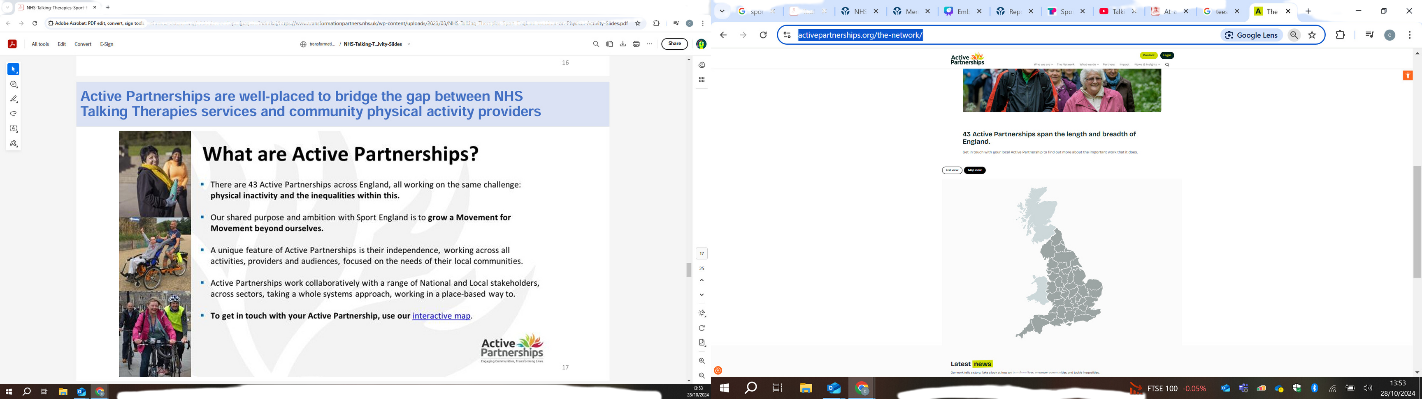
Active Partnerships
There are 43 Active Partnerships across England, all working on the same challenge: physical inactivity and the inequalities within this.
Our shared purpose and ambition with Sport England is grow a movement beyond ourselves.
A unique feature and Active Partnerships is their independence, working across all activities, providers and audiences, focused on the needs of their communities.
Active Partnerships work collaboratively with a range of National and Local stakeholders, across sectors, taking a whole systems approach, working in a place-based way to.
Interactive Map

Slide 34


NICE Guidelines
1.4.40
Advise people that doing any form of physical activity on a regular basis (for example, walking, jogging, swimming, dance, gardening) could help enhance their sense of wellbeing. The benefits can be greater if this activity is outdoors. [2022]
Almost 45% of UK adults feel that their mental health and wellbeing can be improved through physical Activity.
Guidelines
Physical activity improves mental health
The study, which appeared in the peer-reviewed medical journal The Lancet Psychiatry. Researchers found that, on average, a person has 3.4 poor mental health days per month.
But among those who exercise, the number of poor mental health days dropped by more than 40 percent.
One in seven people (15%) said that a long-term condition or disability prevented them from doing more physical activity. This rises to around one quarter of respondents aged 50 or over (24%).
UCLA Article

Slide 35

01.
Physical activity and long-term conditions
workshop
A step-2, three-session online workshop offered to anyone accessing the service (step 2 and 3) with a long-term health condition. Offered alongside other interventions.
Group-based CBT and physical activity
for depression online group
Increasing Physical Activity in Psychological (IPAcT)
02.
A step-3, 10-session online therapy group for depression offered as a stand-alone intervention.
03.
Walk and talk therapy
A step-3, one-to-one CBT intervention with some sessions delivered while out walking. A stand-alone intervention offered in person.
04.
Animal Antiks
In conjunction with a local charity, service users were given the opportunity to join nature walks with alpacas. Offered alongside other interventions
(Step 2 and 3).
05.
Move More; Feel Better
A module on the Foundations App, a wellbeing app with self-help resources focussed on helping people become more active. Offered as an adjunct to anyone starting a treatment intervention (step 2 and 3) with the two participating NHS TTad services.

Slide 36
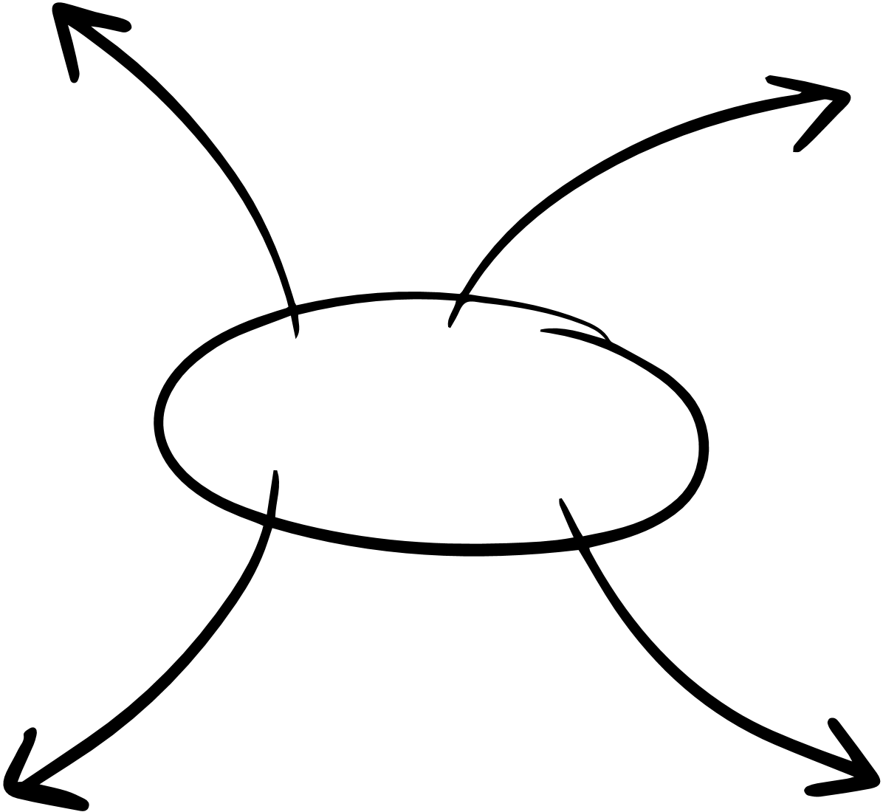
Service surveys showed there is almost unilateral support for the inclusion of physical activity into conversation – with
Not knowing what resources are available
98%
Lack of time
of staff respondents classing it as either extremely or somewhat important to talk to patients about how increasing their level of physical can improve mental health.
Main Barriers
5%
Yet only
did this routinely with every patient (Icope physical activity staff survey - June 2021).
Not wanting to appear judgemental
Not knowing what local groups are available

Slide 37
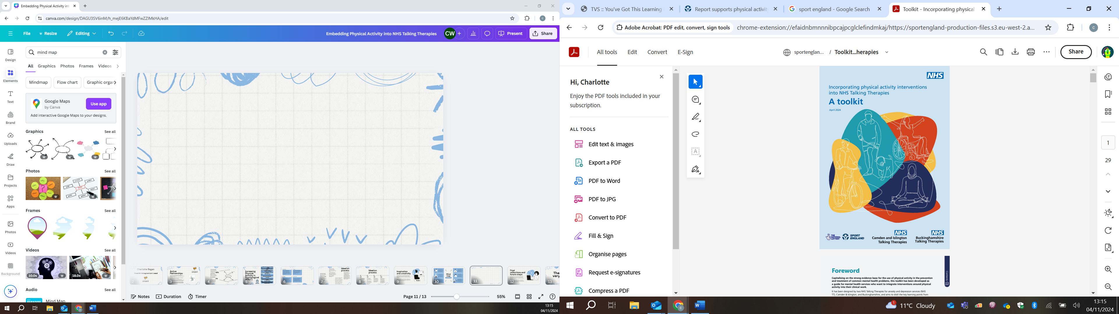
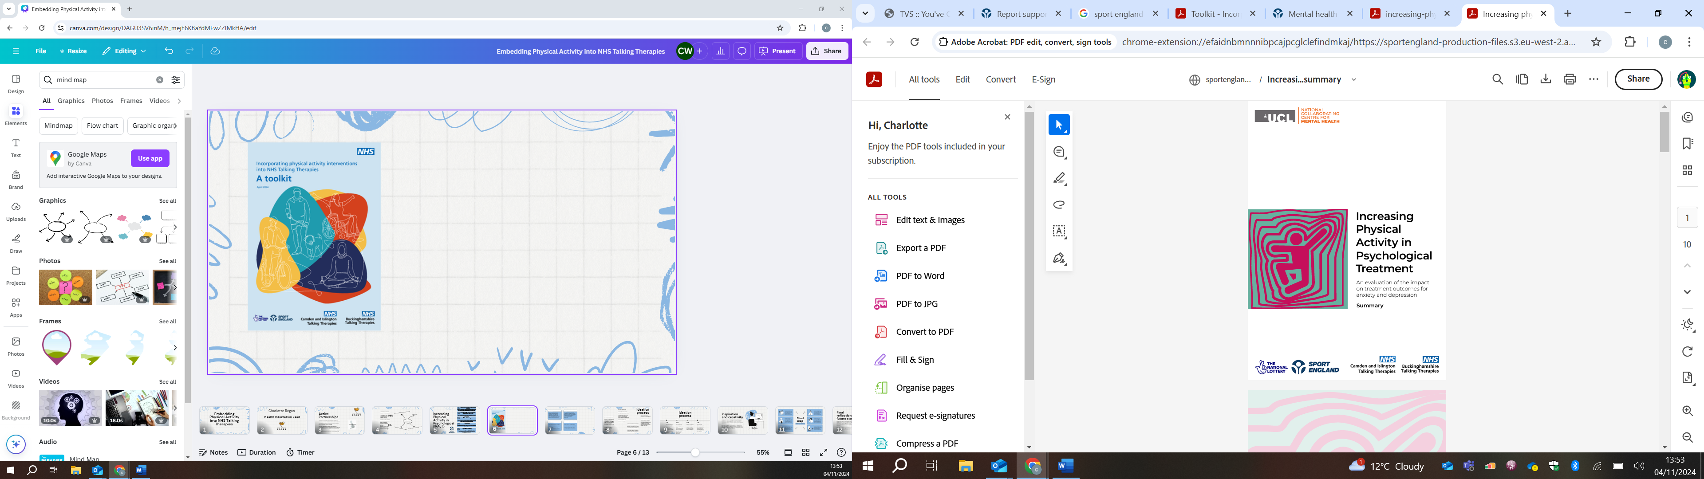

Slide 38
NHS Durham & Darlington Talking Therapies -
Physical Activity Scheme
(PAS)

Slide 39

Dominic Mossa
Senior Psychological Therapist
& Physical Activity Scheme Lead

Slide 40
PAS Aims
NHS Durham & Darlington Talking Therapies launched their Physical Activity Scheme (PAS) in July 2023
This scheme compliments our core menu of psychological therapies by promoting the compelling evidence-based benefits of PA in alleviating emotional distress, across our clinical workforce
PAS aims to increase the awareness and accessibility of physical activity (PA) opportunities for ‘inactive’ patients in the area, thus reducing the known health and wealth inequalities
PAS promotes the notion that PA is for everyone; attempting to debunk misconceptions that those living with a disability or LTC are ineligible from it’s benefits

Slide 41
Referral
PAS Process
Automatic patient ‘opt-in’: When registering a new referral on Iaptus, Admin will tag all patients with the ‘PHYSICAL ACTIVITY SCHEME’ referral label
Screening question introduced regarding a patient’s attainment of the NHS’ PA guidelines, within the ‘lifestyle’ section of the referral form
Referral form provides brief psychoeducation on the NHS’ guidelines for physical activity & provides patient with the opportunity to opt-out of the PAS

Slide 42
Post-Assessment
Upon completion of their initial assessment, Booking Team send the below, one-time bulk SMS to all patients with the Physical Activity Scheme referral label containing a link to the NHS’ exercise portal. This includes ‘NHS Online Fitness Studio’ with videos for: Aerobic, Strength & Resistance, and Pilates & Yoga; with adaptations for those contending with LTCs and injury
“Hi. At your recent assessment, it was identified that your mental health may benefit from increased levels of physical activity. Please click on this website to start planning your journey to improved physical and mental wellbeing: https://www.nhs.uk/live-well/exercise/. *If you have any concerns regarding your physical health, please consult with your GP prior to doing any new/more intensive exercise. NHS Durham & Darlington Talking Therapies”

Slide 43
Treatment sessions considerations
All clinical recording templates have been amended to prompt consideration of the PAS
Initial assessment template encourages exploration and setting of physical activity preferences/goals.
In subsequent sessions, follow-up (treatment) session and discharge/’Keeping Well Plan’ templates advocate explicit monitoring and scheduling of graded physical activity into standard treatment planning

Slide 44
Direct Referral/Signposting
Working partnership established between NHS D&D TT and Local AP’s (CDS and TVS), in particular in the production of a PA opportunities directory (that is reviewed and refreshed quarterly)
The directory is broken down into physical activity services and resources for our special interest demographics, including LTC, Older Persons, Perinatal and Veterans
Clinicians to directly refer/signpost to these local sports organisations for more supported, structured PA opportunities where physical inactivity is identified
Wellbeing4Life primary partner for patients that require more ‘hand-holding’ in accessing PA opportunities

Slide 45
Special Considerations
ME/CFS
Graded exercise should not be recommended. The guideline makes it clear that any programme based on fixed incremental increases in physical activity or exercise, for example graded exercise therapy (GET), should not be offered for the treatment of ME/CFS.
Physical activity goal setting should therefore be overseen by the individuals ME/CFS lead healthcare professional

Slide 46
Year 1-2 Achievements
Opting hundreds of patients into our PAS, providing them with automated access to the NHS' Online Fitness Studio following their initial assessment with the service, so that they can start their journey to improved physical and mental wellbeing, whilst waiting for their formal psychological therapy to start
Establishing strong working partnerships with County Durham Sport and Tees Valley Sport to ensure that we are reducing health and wealth inequalities in accessing physical activity, County-wide
Developing a live 'Physical Activity Scheme - Directory of Resources' that enable us to provide bespoke signposting to online and local/in-person physical activity opportunities, that are no-to-nominal cost

Slide 47
Year 1-2 Achievements
Providing workforce-wide CPD opportunities for clinicians via 'Physical Activity Clinical Champion' training, in partnership with Sheffield Hallam University's Advanced Wellbeing Reseach Centre
Building a team of almost 40 PAS Champions across the service, from various localities and modalities of therapy
Forging a partnership with the TEWV NHS FT's ARCH Recovery College, to provide an 'in-house' PA offer
Receiving acclaim from several other NHS Talking Therapies services, who have expressed an interest in replicating our PAS
TEWV's Communications Team running a feature on our PAS across their social media and online platforms, as an area of outstanding practice, to coincide with Mental Health Awareness Week

Slide 48
Thank you very much!

Slide 49

Experts by Experience:
How we can support Talking Therapies?
PPN NW Experts by Experience:
Hilary Tetlow, Ali Bryant, Keith Holt, Joe Keaney
Reb Aziz-Brook, Assistant Psychologist
Notes:
Hilary – Introduce everyone

Slide 50
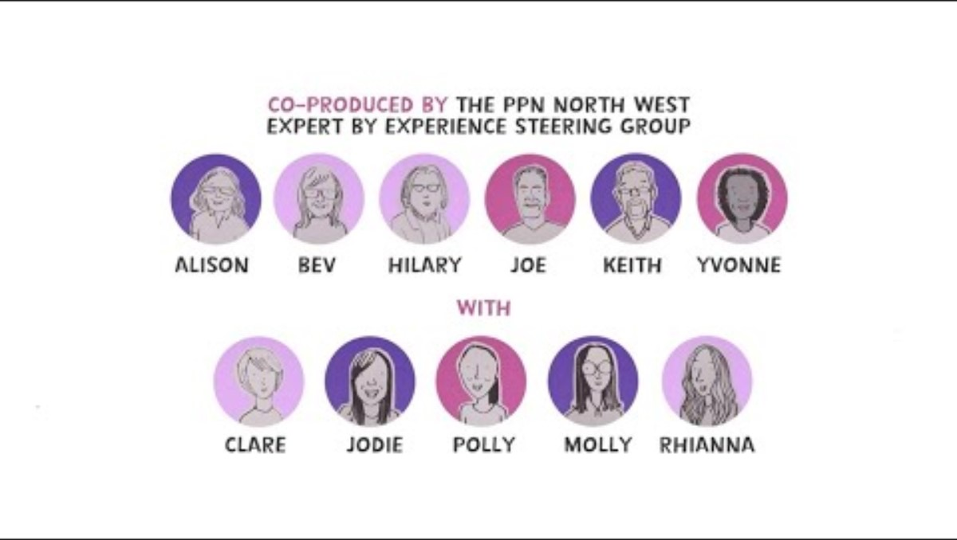
Who is an Expert by Experience?
Please load www.menti.com on your device
Do You Know what Experts by Experience offer and who they are?
Code: 4982 2653
Notes:
Hilary and Reb – to introduce

Slide 51
Who is an Expert by Experience?
Full link to EBE animation here: Why is Involvement of Experts by Experience Good for Everyone? - YouTube (3.51 mins)
Notes:
Hilary to introduce the animation

Slide 52


EBEs – History
“Nothing About Us Without Us”
The "Nothing about us without us" motto emerged in the 1980s and 1990s, as a rallying cry for self-determination and inclusion.
The phrase reflects the broader historical context of disability activism, including the Civil Rights Movement, which fought for equality and inclusion for marginalized groups.
Notes:
Ali to speak

Slide 53
EBEs – History
“Nothing About Us Without Us”
The 1960s saw significant legal and legislative victories against discrimination, laying groundwork for later disability rights advancements.
The Civil Rights Movement's focus on equality and the broader social justice movements of the era helped to create a more inclusive environment where disabled people could begin to organize and fight for their own rights, contributing to the eventual rise of the disability rights movement and the motto.
Notes:
Ali to speak

Slide 54
EBE – History
“Nothing About Us Without Us” – so, what does this mean?
Self-Advocacy:
Emphasises importance of involving people (with physical or mental health difficulties) in all decisions that affect them, ensuring voices are heard and needs met
Challenging "For" Organizations:
Distinguishes between organisations “of” people with physical or mental health difficulties (and run by people with these difficulties) and organisations “for” people with these difficulties (but run by non-disabled people). Motto highlights the need for service user-led organisations and decision-making.
Empowerment and Dignity:
Phrase underscores the importance of user involvement – a way to empower service users and promote their dignity
Notes:
Ali to speak

Slide 55
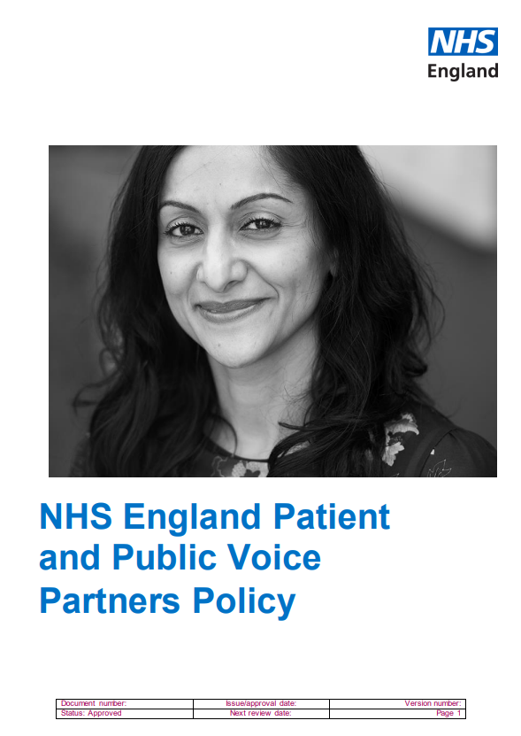

EBEs
Today’s Context and the NHS
Ongoing Relevance:
The phrase continues to be a powerful rallying cry for disability rights activists, emphasizing the need for disabled people to be involved in all aspects of decision-making that impact their lives.
It serves as a reminder that true inclusion and equity require the active participation of disabled people in shaping their own futures
Notes:
Ali to speak

Slide 56
EBEs
NHS
EBEs can be broadly defined as individuals, family/friends and carers who have lived experience of mental and physical health difficulties (and of caring for somebody who does) and who have accessed NHS mental health services as a result of these difficulties.
There is a national requirement for the public to be involved in both the design and delivery of healthcare services. In addition, accrediting and registration bodies set out expectations around expert by experience involvement in all stages of practitioner psychologist training (DOH, NHS, NHSE, HCPC, BPS)
There are benefits associated with EBE and healthcare staff working in partnership to enhance the learning and practice of health professionals in the delivery of better outcomes for those who use services (Ahuja & Williams, 2005; Horgan et al, 2018; McMullin & Needham, 2018)
Despite general consensus that EBE involvement is both necessary and beneficial to the development of services and associated outcomes for those who use health services, the application of EbE involvement differs across services and training programmes and regions.
Notes:
Ali to speak

Slide 57
Experts by Experience?
Please load www.menti.com on your device
Have you ever worked in Talking Therapies with an Expert by Experience?
Code: 4982 2653
Notes:
Reb to speak

Slide 58
Talking Therapies
Benefits
Personal and Professional Growth
New Directions
Service user led produces outcomes responsive to people who use services – ‘Fit for Purpose’
Creativity
New Life
Inclusion, Equity and Diversity of experiences and thought
Notes:
Keith to speak to this

Slide 59
Talking Therapies – Learning from Experience
Barriers to Involvement – PPN NW Survey 2022
Lack of diversity in EBE groups – not representative
Barriers to coproduction in practice
Identifying EBEs
Time Restrictions
Remote Working
Lack of awareness
No Leadership
Rigid service requirements – barriers to payment/change
Funding to support co-ordination and development
Not given sufficient priority
Notes:
Keith to speak to this

Slide 60
Experts by Experience?
Please load www.menti.com on your device
Did you have EbE involvement as part of your Talking Therapy training?
Code: 4982 2653
Notes:
Reb

Slide 61
Talking Therapies
User Experience
Expectations when self-referring
Expectations of how will experience the service
Drop-out rates
Barriers to engagement
Social & Economic determinants of health
Digital Literacy, internet poverty
Notes:
Ali to speak to this one

Slide 62
Talking Therapies
Therapeutic Alignment
Relationship is key
Reason people continue the journey and see through to the end
Feeling comfortable speaking out if not working
Asking for new therapist, choosing therapist
Understanding of criteria, can feel “closed”; “excluded”
Certain vulnerabilities e.g. men not being comfortable accessing TT
Notes:
Hilary

Slide 63
Talking Therapies
Optimal Conditions
Timely access
Clear Communication about options, progress, timescales
Flexibility
Somewhere you feel safe and comfortable to speak about difficult things, free from hearing through walls, maintaining privacy.
Really important that a room has a window
Being asked the question – are you comfortable, access to water, tissues on the table.
Notes:
Hilary

Slide 64
Experts by Experience?
Please load www.menti.com on your device
Do you have ideas as to how EbEs could work in your service?
Code: 4982 2653
Notes:
Add in – questions around EBE involvement with Talking Therapies.

Slide 65
Questions/Discussion

Slide 66

Thank you
www.ppn.nhs.uk
For Further Information, access the YouTube video below:
PPN NW Webinar: Transforming Care and Learning from Experts by Experience in the PPN (57.43)

Slide 67


Break

Slide 68

The Northern Talking Therapies Practice Research Network: Lessons from 10 years of collaboration
Jaime Delgadillo, PhD
Professor of Clinical Psychology
University of Sheffield

Slide 69
Membership
NHS Talking
Therapies Services
Barnsley
Bassetlaw
Bury
​Bradford
Calderdale and Kirklees
Cumbria
Doncaster
Durham
Greater Manchester
Heywood, Middleton and Rochdale
Hull and East Riding
Lancashire​
Leeds
​Lincolnshire
Manchester
North Lincs
​North Yorkshire
Nottinghamshire
Kirklees
​Rotherham
Sheffield
Wakefield
​Wirral in Merseyside
​York and Selby
ACADEMIC COLLABORATORS
Universities of:
Sheffield
Huddersfield
Manchester
UCLAN
York
P
R
N

Slide 70
Mission: to generate practice-based evidence (PBE)
observe
implement
PBE
understand
improve

Slide 71
Practice-based evidence: dose-response in GSH
1 service
N= 1,850 individual GSH
5 services
N= 4,451 stress control group participants
16 services
N= 76,962 GSH cases
Delgadillo et al, 2014
Delgadillo et al, 2016
Robinson et al, 2020

Slide 72
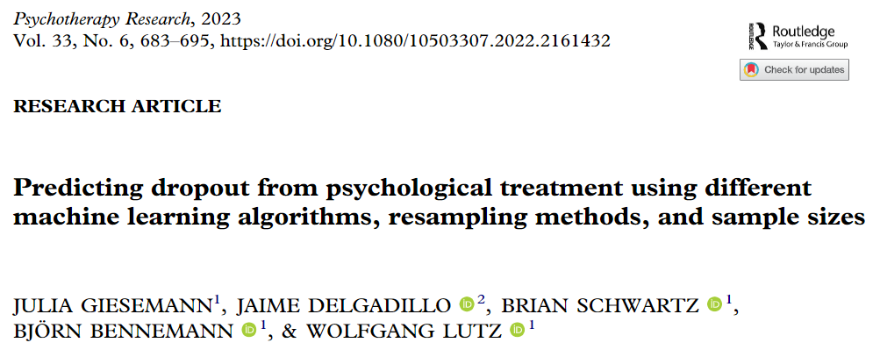
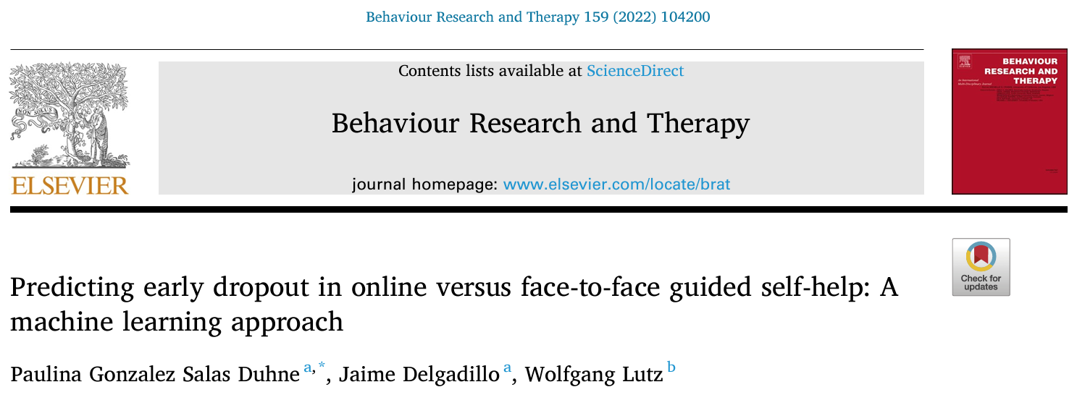
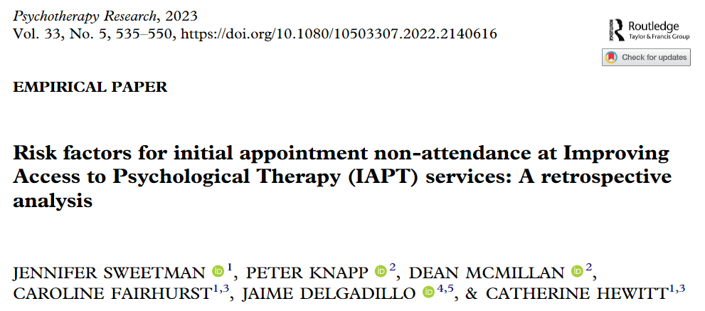
Practice-based evidence: understanding dropout
Predictors of dropout:
younger age
unemployed
higher socioeconomic deprivation
referred by a health professional (rather than self-referral)
severe depression and anxiety
severe functional impairment
Lengthier waiting time
Bowker et al, 2024, Psychotherapy Research
N= 6,051 patients assessed by 148 therapists

Slide 73
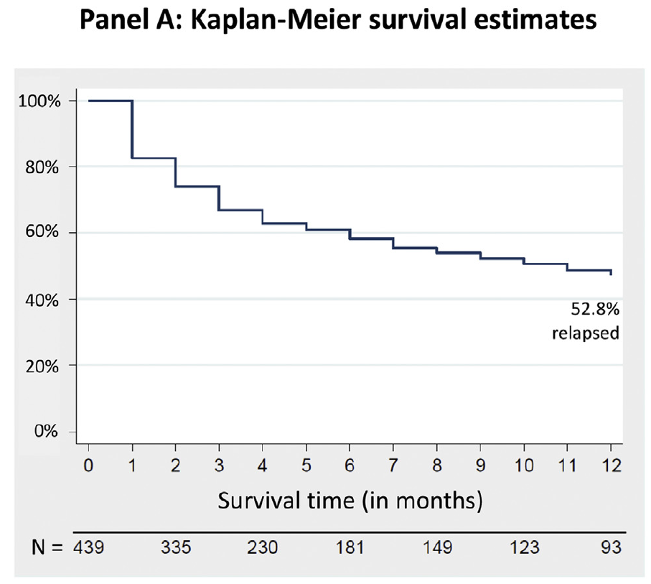
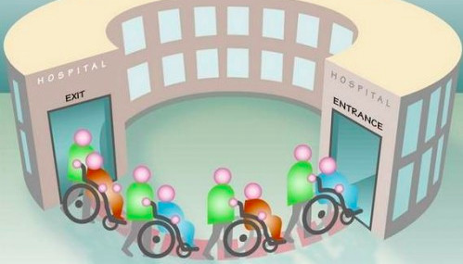
Practice-based evidence: relapse after therapy
N= 21,029 patients treated over a 5-year period
13.7% returned for 1 or more treatments
Recovery rates decreased with higher number of returns
Ali et al, 2017
Lorimer et al, 2023

Slide 74
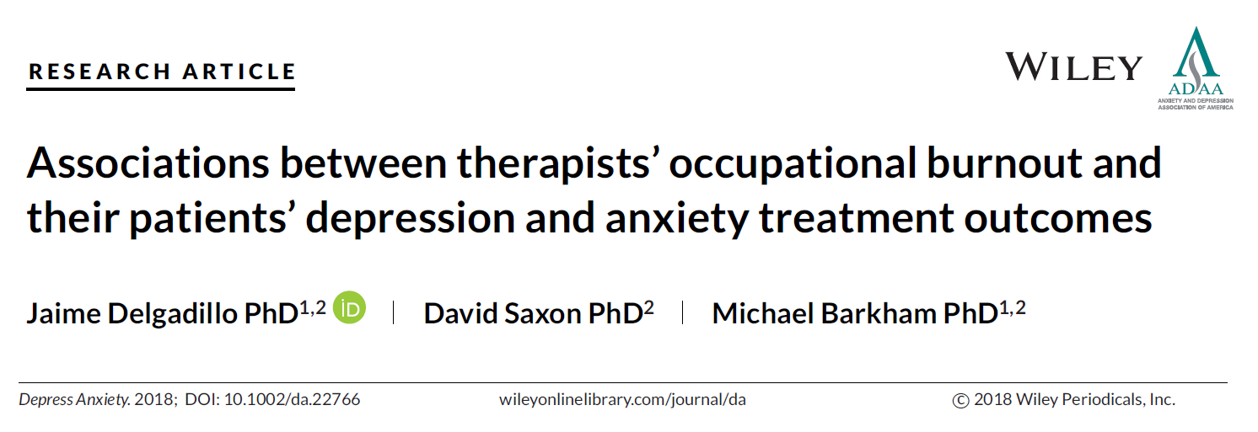
Practice-based evidence: therapist effects
49 therapists completed measures of job satisfaction & burnout
Outcomes data (N=2,223) collected 1 year post-survey
Higher burnout (OLBI-D) and lower job satisfaction (JDSS) significantly associated with poorer treatment outcomes
Less effective More effective
Less effective More effective

Slide 75
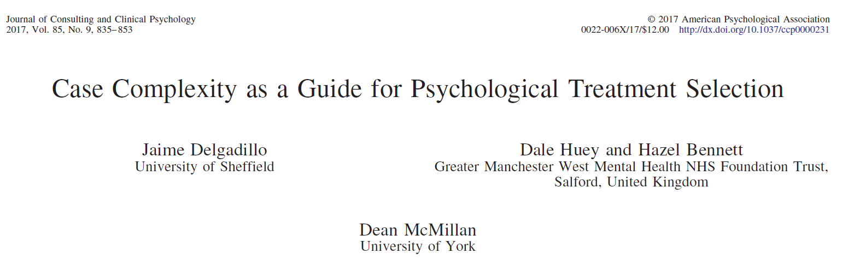
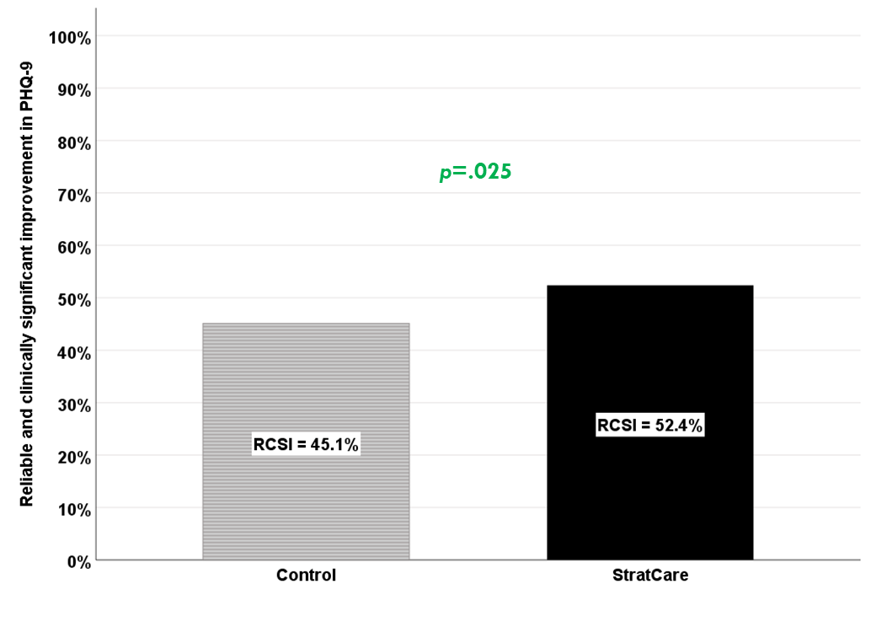
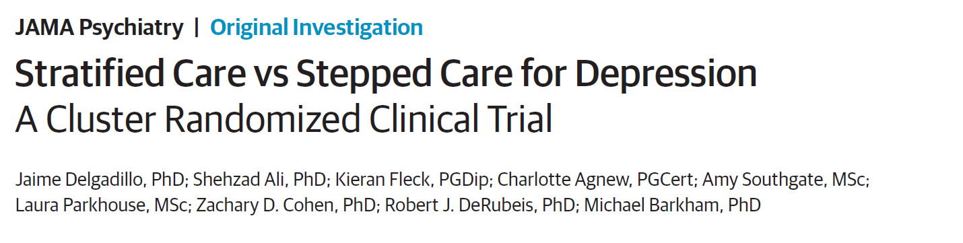
Practice-based evidence: treatment matching
N = 755 (training), N = 757 (validation)
Treatments: low vs. high intensity interventions
Analysis: Machine learning algorithm development
Predictors: severity, impairment, comorbidity, personality, age, employment status
Design: Cluster RCT
N = 951
Treatments: stratified vs. stepped care for depression
Analysis: Logistic regression comparing depression recovery between groups

Slide 76
Practice-based evidence: learning points
1. Always aim to offer an optimal dose of GSH (4-7), and step-up if there is no evidence of reliable improvement.
2. If there is reliable improvement, offer relapse prevention booster sessions to consolidate gains.
3. Dropout occurs in the earliest phases of therapy, usually because it’s not working and because the patient has low expectations about the treatment.
4. Look after staff wellbeing. Therapists with high burnout are less effective at helping their patients.
5. GSH doesn’t isn’t appropriate for everyone. Complex cases need high intensity treatments.

Slide 77

SPERS Reflection Session What is a normal response, what’s already helping…. and what might be next?
Dr Hannah Ainslie/Dr Dominic Bray/ SPERS Team September 2024
Dominic.Bray@nhs.net
Feel free to use these slides and please acknowledge your source if you do
Notes:
Slides put together for teams supporting others and wanting to understand a trauma response, how best to support others as well as selves.
A session designed to facilitate empowering teams & individuals by normalising responses/actions, reinforcing and building confidence in what people are already doing.
Hannah Ainslie & Dominic Bray 20th September 2024

Slide 78
Agenda for today
Introductions
Expectations for today’s session
Ground rules
Brief summary of the experience of the team by local lead
Discussion on impact of incident
Understanding our reactions and affirming what’s already helping us to deal well with what’s happened
Further ideas on how to manage these reactions as needed
How to access further support
Feel free to use these slides and please acknowledge your source if you do

Slide 79
Ground rules
It is not mandatory that you are here. It is your choice.
You are free to leave at any point
You can contribute as little or as much as you want
We will listen and respect each other's views
These conversations are confidential and not to be shared outside of today’s session unless they absolutely have to be.
Feel free to use these slides and please acknowledge your source if you do

Slide 80
Summary of the team's experience
Feel free to use these slides and please acknowledge your source if you do
Notes:
Local lead gives summary to ground the session

Slide 81
What has been the impact for you and for others?
Feel free to use these slides and please acknowledge your source if you do
Notes:
What have you observed in yourself as well as in others
May want to flick to ‘normal responses’ (blue boxes) slides to reinforce this is ok

Slide 82
What’s already helping you as individuals and as a team deal well with what has happened?
Feel free to use these slides and please acknowledge your source if you do

Slide 83
Uncovering your present and future strengths…
Suppose this session were useful today, who would know (you, colleagues, your families, your patients)?
How would they know…… what would they notice?
What might they already be noticing about how you are handling this?
What tough situations have you managed to deal with before as individuals and as a team…..and how did you even do that?
What went well – as individuals and as a team when you were dealing with this?
What’s still going well – as individuals and as a team?
Who amongst your circle of colleagues, families, friends and communities would have been least surprised when you dealt with this well?
Suppose you look back in one year’s times and concluded ‘this was our finest hour’, what would you be most proud of?

Slide 84
Immediate responses in the aftermath…
Can be varied
Affected by own experiences
Even extreme responses are natural responses – not a sign of psychopathology
It is incorrect to assume that all survivors need to express emotions and talk about the trauma
These are normal reactions to abnormal circumstances
They serve a purpose
Feel free to use these slides and please acknowledge your source if you do

Slide 85
Immediate emotional reactions
Exhaustion
Confusion
Sadness
Anxiety
Agitation
Numbness
Dissociation
Confusion
Physical arousal
Blunted affect.
Feel free to use these slides and please acknowledge your source if you do

Slide 86
Immediate cognitive reactions
Difficulty concentrating
Rumination or racing thoughts (e.g. replaying traumatic events over and over again)
Distortion of time and space (e.g. traumatic events may be perceived as if it were happening in slow motion)
Memory problems
Feel free to use these slides and please acknowledge your source if you do

Slide 87
Immediate physical reactions
Nausea/gastrointestinal distress
Sweating/shivering
Faintness
Muscle tremors or uncontrollable shaking
Increased heart rate, blood pressure & breathing rate
Extreme fatigue/exhaustion
Greater startle response
Depersonalisation
Feel free to use these slides and please acknowledge your source if you do

Slide 88
Immediate behavioural reactions
Startled reaction
Restlessness
Sleep & appetite disturbances
Difficulty expressing oneself
Argumentative behaviour
Increased use of alcohol drugs and tobacco
Withdrawal and apathy
Avoidant behaviours
Feel free to use these slides and please acknowledge your source if you do

Slide 89
Immediate existential reactions
Use of prayer
Restoration of faith in the goodness of others
Loss of self-efficacy
Despair about humanity, particularly if the event was intentional
Immediate disruption of life assumptions
Feel free to use these slides and please acknowledge your source if you do

Slide 90
What can help after an event like this…
Social support
Basic needs – sleep, eat, exercise, rest
Maintain routine with activities
Pursue hobbies / interests but don’t over do it
Spending time with others
Feel free to use these slides and please acknowledge your source if you do

Slide 91
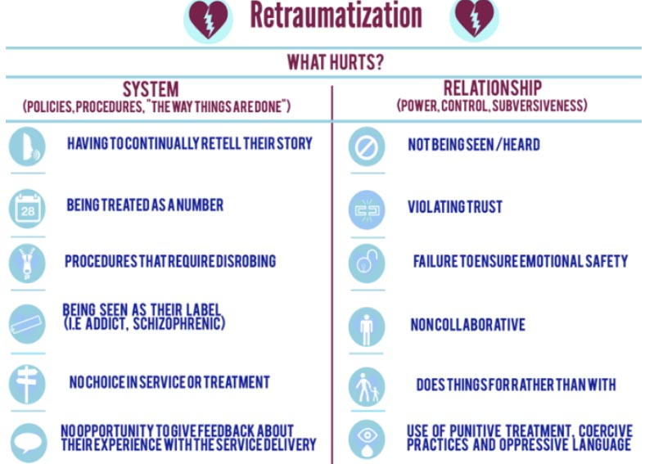
What not to do…
Feel free to use these slides and please acknowledge your source if you do

Slide 92
Coping styles
Action-oriented
Reflective
Emotionally expressive
Reticent
Feel free to use these slides and please acknowledge your source if you do
Notes:
Everyone is different and that’s ok!

Slide 93
More severe responses
Continuous distress without periods of relative calm or rest
Severe dissociation symptoms
Intense intrusive recollections that continue despite a return to safety
Feel free to use these slides and please acknowledge your source if you do
Notes:
When to start taking note / offering extra support…

Slide 94
Further support
Supervision
Manager
Colleagues
Family
Friends
Feel free to use these slides and please acknowledge your source if you do
Notes:
In the first instance, focus on your normal support network

Slide 95
Beyond 6 weeks, if your difficult symptoms have not improved
Occupational Health
Talking Therapies
(Sefton) Mental Health Matters:
Phone: 0300 303 2708
https://www.mhm.org.uk/talking-therapies-sefton
(West Lancs) Mindsmatter:
Phone: 01695 684177
www.lancashirecare.nhs.uk/mindsmatter
Feel free to use these slides and please acknowledge your source if you do

Slide 96
Any closing remarks Thank you everyone
Feel free to use these slides and please acknowledge your source if you do
Notes:
Any recaps
Actions
Remind we will note down who attended and make your manager aware

Slide 97

Closing Remarks
Reminder - Survey to be sent round, please complete to influence future Forums
Thank you ☺

