Slide 1






Diversifying and engaging the next generation of Psychological Professions

Slide 2
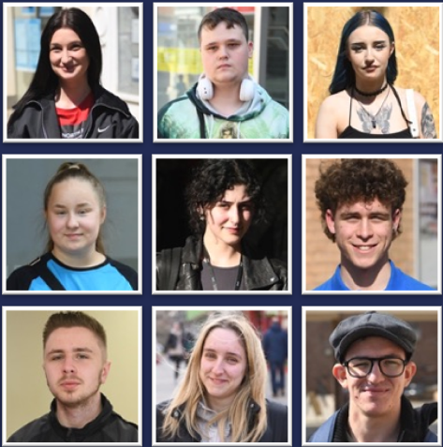
We give new opportunities to young people who deserve better
We fill the gaps in young people’s lives, ensuring that they have the basics in place that the rest of us take for granted, supporting them from being ‘prisoners of circumstance to pilots of their own lives’.

Slide 3




Our Programmes:-
A supportive, nurturing programme for 11-15 year olds who are struggling with traditional education. Building confidence, resilience and a sense of belonging for students wherever they are - in school or at home.
Our 3month virtual programme for 16-25yr olds, that gives young people the opportunity to explore their interests, improve their confidence, a chance to gain new skills and experience with the support of a mentor – a trusted person to turn to, a safe place to belong.
Our 12 month life-changing programme for 18-25 yr olds, including six months’ paid employment, 4 work placements, life coaching and mentoring, activity days, qualifications and experiences.
All our Gappies stay part of the WeMindTheGap alumni family. We offer lifelong support and a safe and trusted person to talk to and work alongside, whether that’s help with careers, housing, money, wellbeing or relationships.

Slide 4
The gap is growing between education and employment
There were an estimated 540,000 economically inactive young people aged 16 to 24 years who were NEET (Not in Education, Employment or Training) as of January 2024, specifically 1886 in Wrexham
More young people than ever did not attain basic Maths and English qualifications in 2023, specifically for Wrexham, 37% English, 42% maths
Over 158,000 young people are not regularly attending school, approximately 1136 students Yr7 - 13 are persistently absent from school across Wrexham
The world of work and entry into that world in 5 years time is likely to need a different approach
“Your background shouldn’t determine your future. And yet, for too many people in our society, it does” Social Mobility Commissioner - Steven Cooper
Employers told us that they are making a conscious business decision not to employ young people under 25 due to their lack of employability skills, resilience and low level mental health challenges

Slide 5



The Big Conversation – Young People research

Slide 6

c3500 young people aged 18-21 yrs live in Wrexham
Where are you?
Who are you?
What do you want and need?

Slide 7
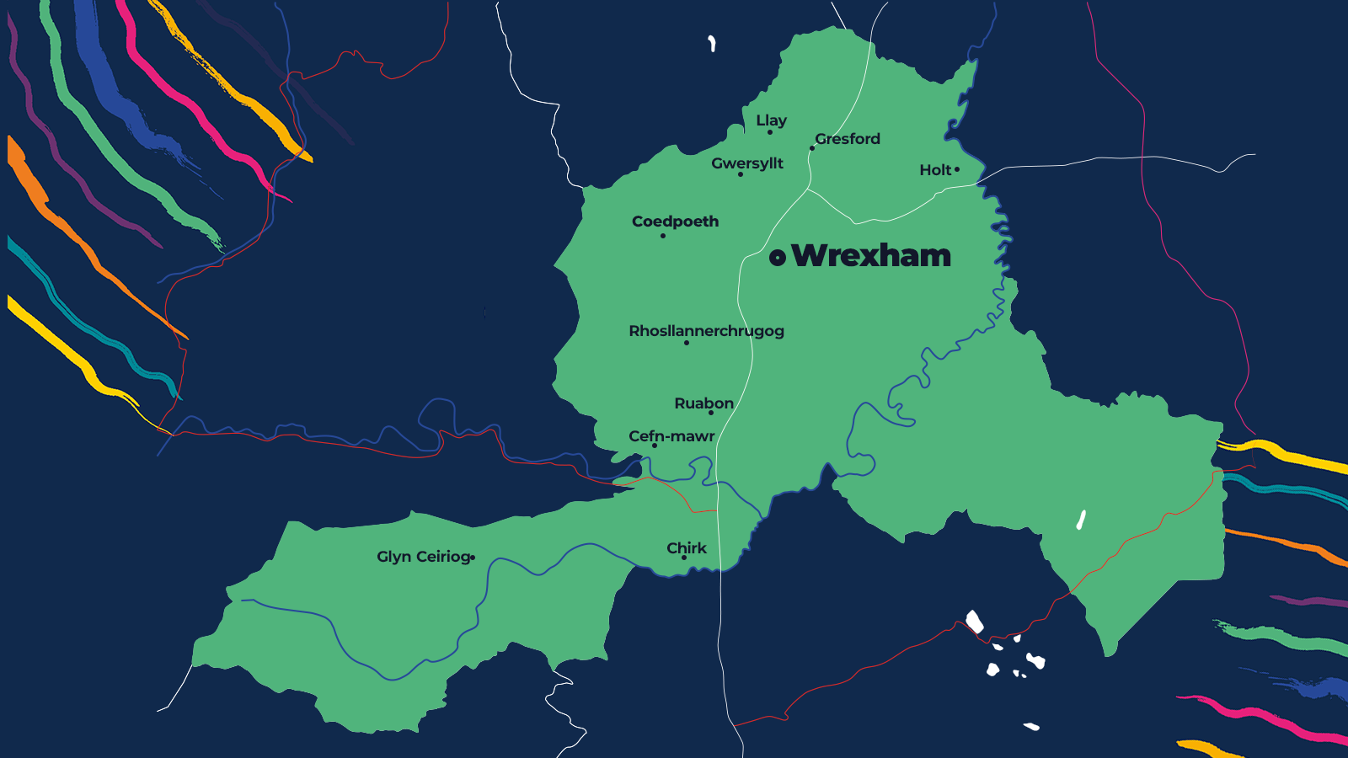
























Results & analysis
We managed to speak to
11.97%
young people across Wrexham
and 425 people in total.

Slide 8

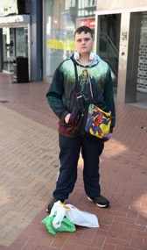

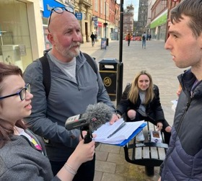
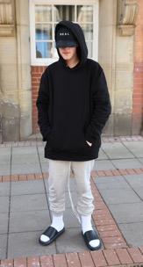
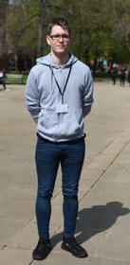
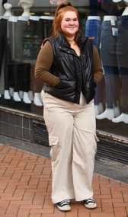
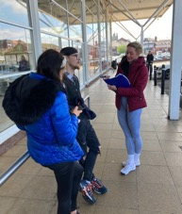
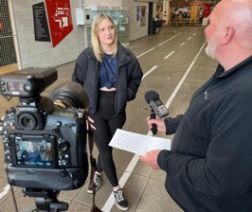

Slide 9



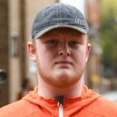






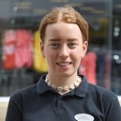








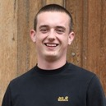





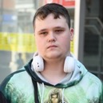
















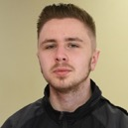



Slide 10
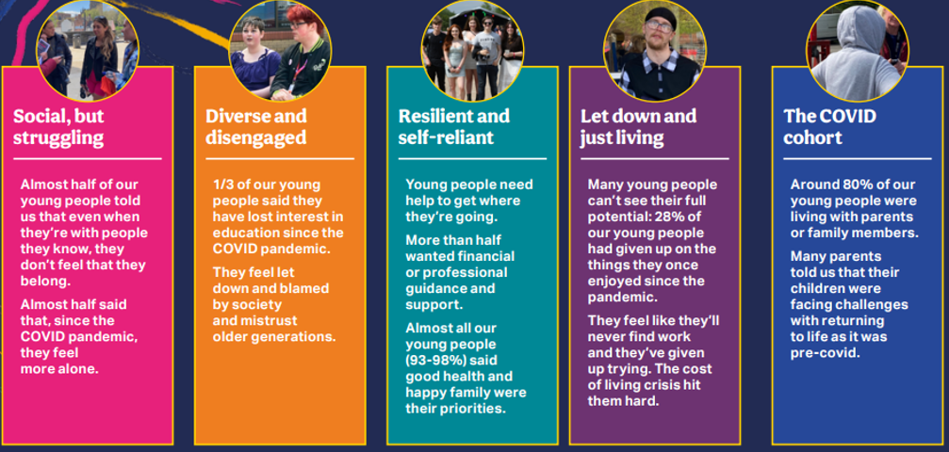
Who are the young people?

Slide 11
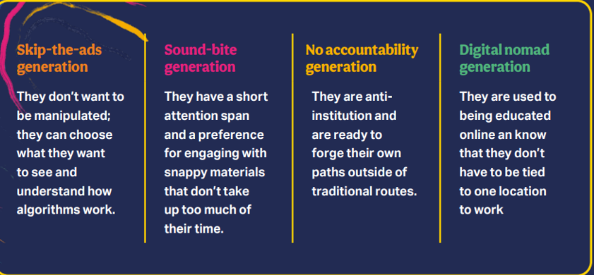
Who are the young people?

Slide 12

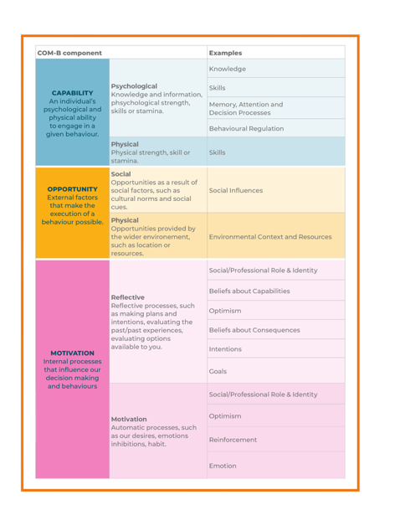
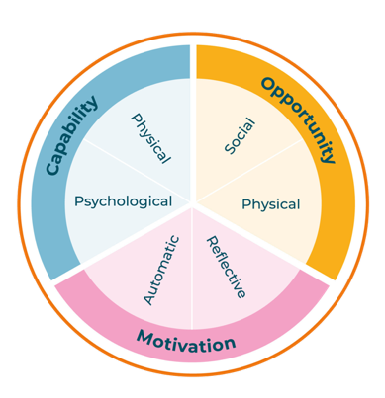
The COM-B model of behaviour change

Slide 13

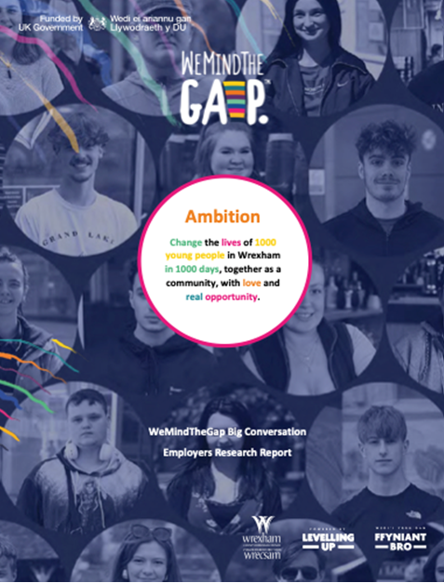
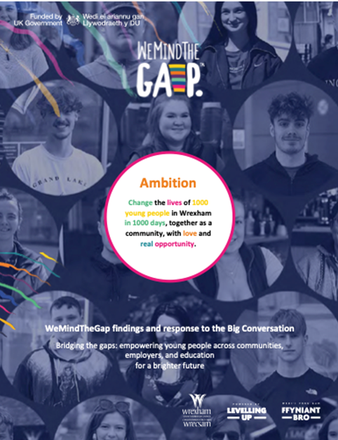
Our Reports:-

Slide 14
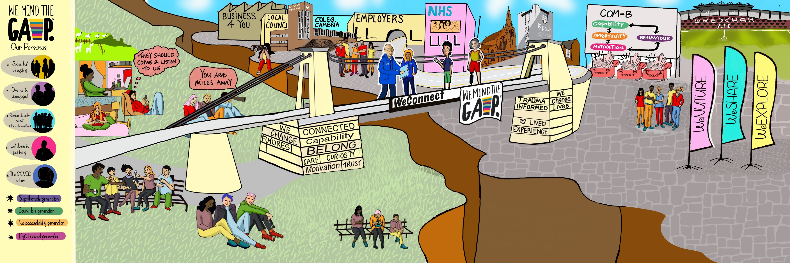
Our response

Slide 15
Thankyou
Ali Wheeler
CEO WeMindTheGap
ali@wemindthegap.org.uk
@wemindthegap
@wemindthegapp
@wemindthegap
@AliWheeler
@WeMindTheGapUK

