Slide 1
The Psychological Professions as a United Gathering
John Herring – Director of Organisational Development and Culture, NHS Greater Manchester

Slide 2
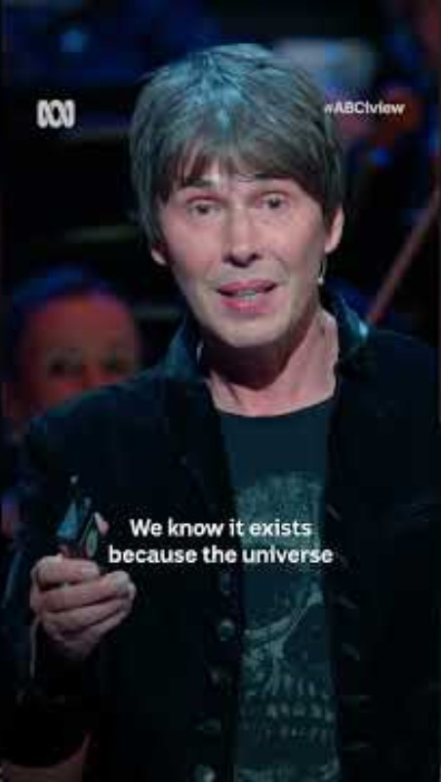

Slide 3
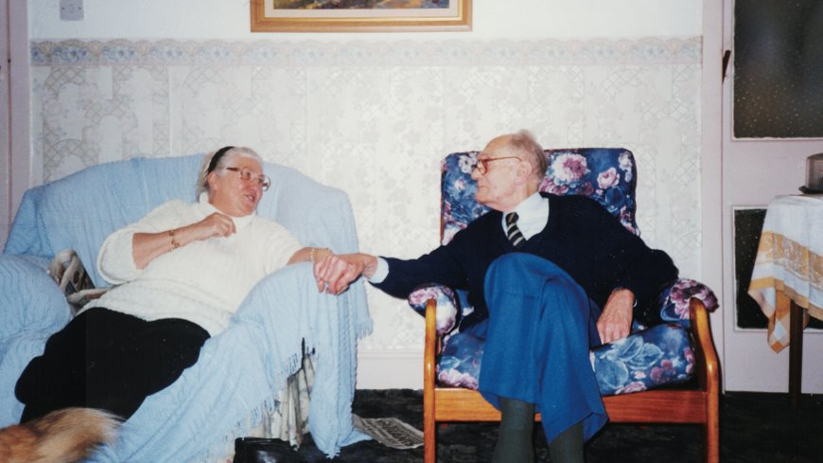
Notes:
PAXMAN:​ A few streets away from the Shepherds, the Herrings are also locking themselves in for the night. They have every reason to worry. The house next door was torched. ​
JOHN HERRING:​ This house and the one next door, when they were empty, the lads got in there and they torched the house and the flames came through the roof. This is why we've got all this damp and damage to the house. ​
PAXMAN:​ We first met John at his doctor's surgery last month, where he had gone for a regular check-up. He was deeply upset by a recent mugging. ​
HERRING:​ (footage dated October 2000)​ Two school lads, only 14, mugged and knocked her down. Took her bag, with £80 in it. They broke her hip. ​
DOCTOR:​ Oh, dear. I'm sorry. ​
PAXMAN:​ Crime makes the everyday life of the Herrings a misery. Next door still has no roof following the arson attack. The dampness seeps through the walls into their house. Every night, John has to shift the coal needed for the next day to the other side of the cellar. He’s 89 years of age

Slide 4
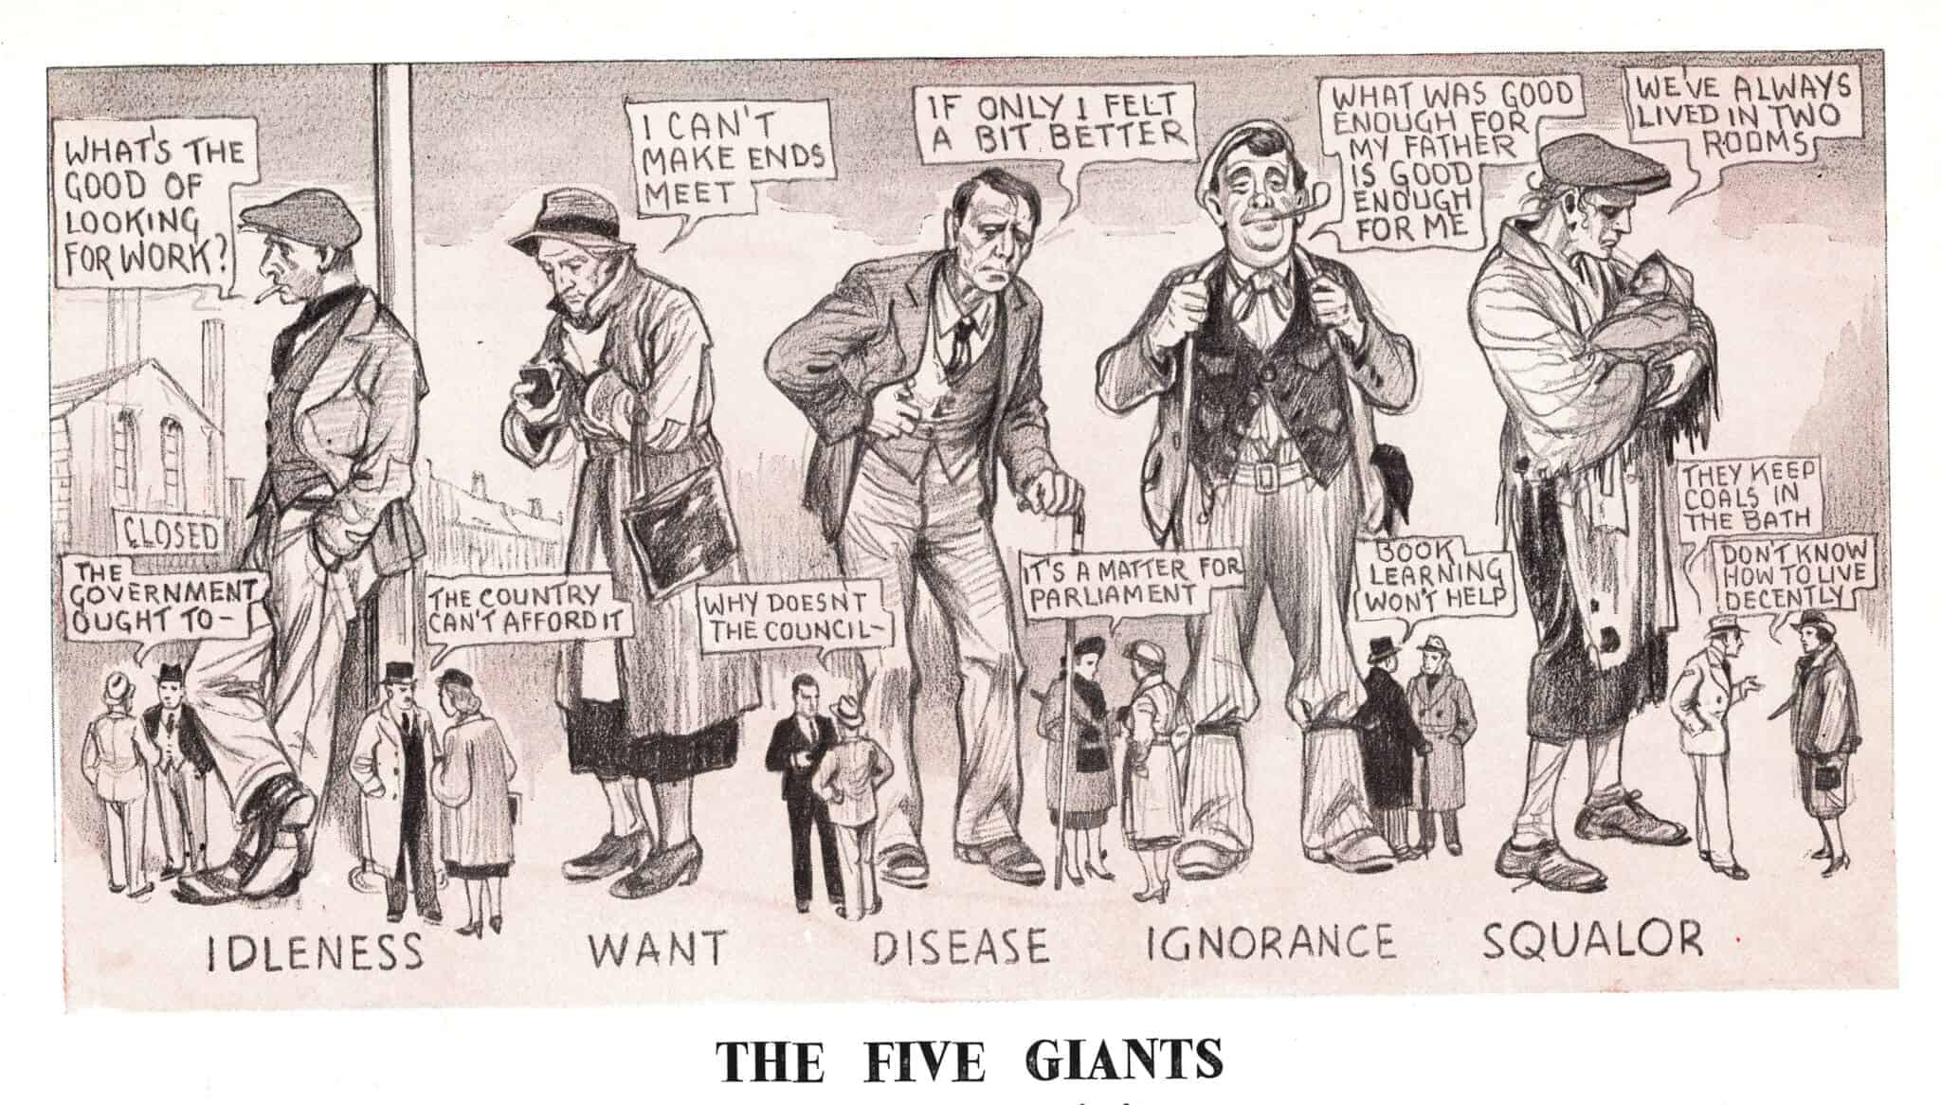

Slide 5

The NHS Social Contract
Will look after me from cradle to grave
Is free at the point of use
I can access services when I need them from our NHS
They will be clinically led and informed by best evidence (Doctor knows best!)
I will only use them when in real need

Slide 6
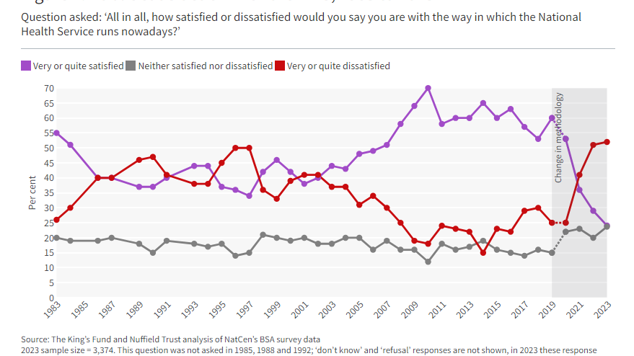

Slide 7
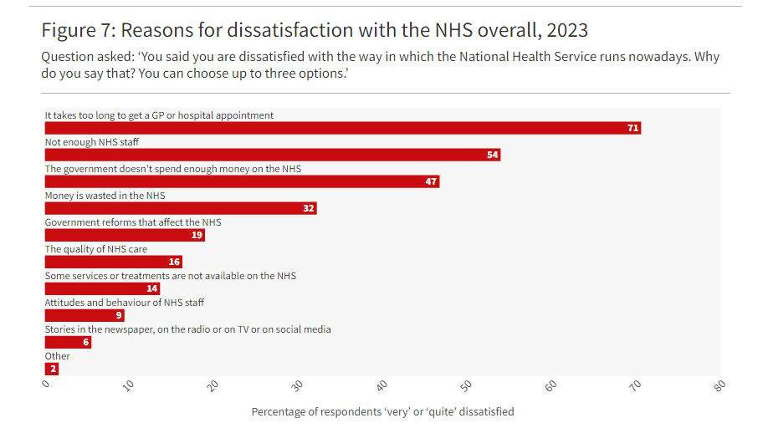

Slide 8
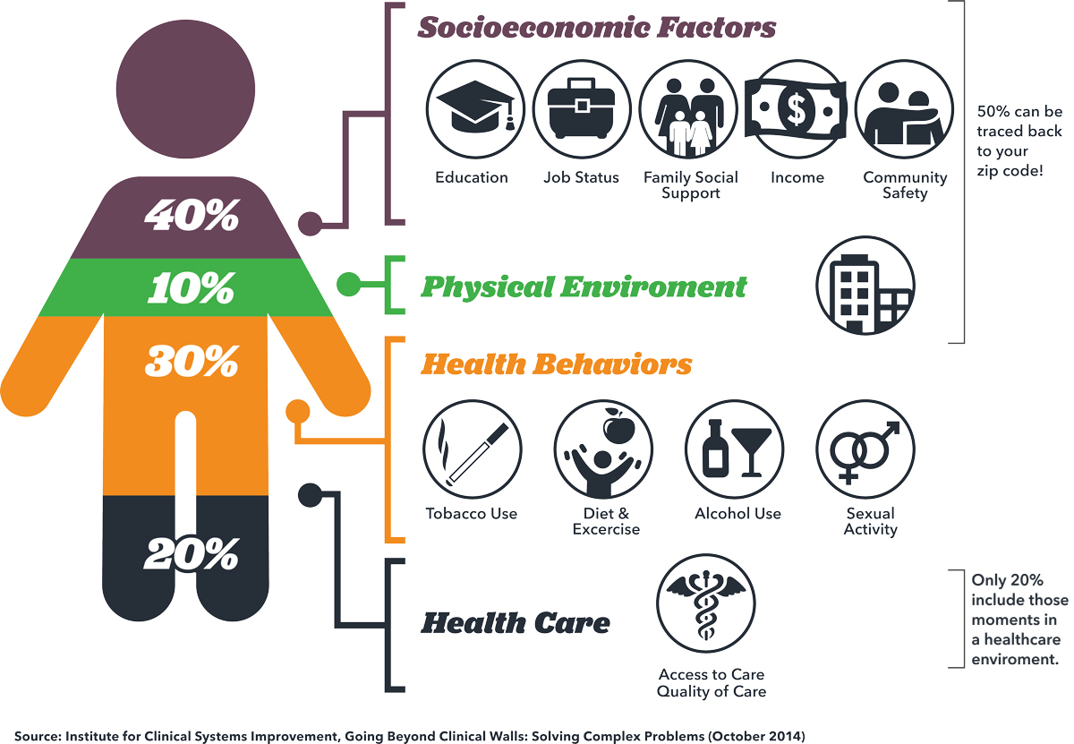
The Breaking of the Social Contract

Slide 9
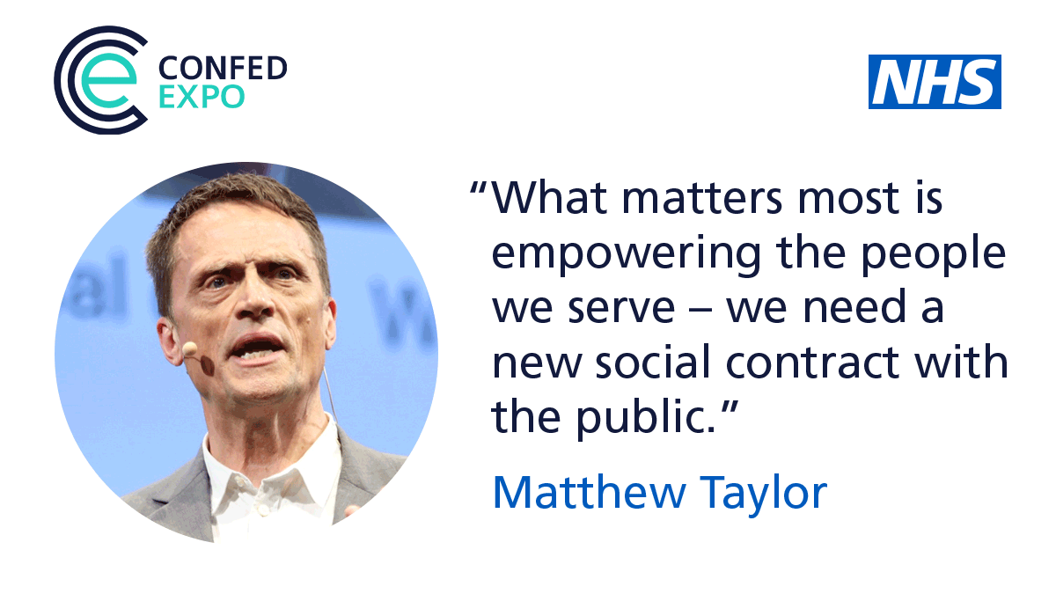

Slide 10


Slide 11
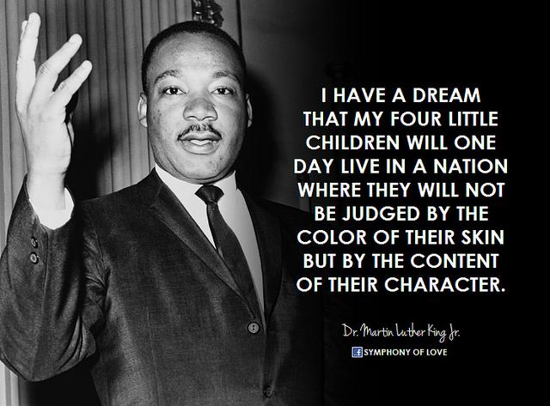
Belief and Meaning

Slide 12
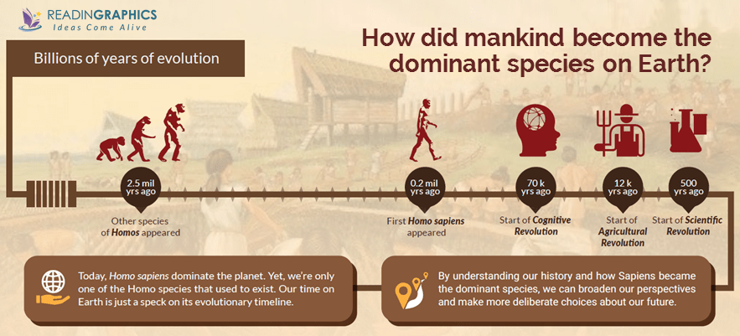

Slide 13


Slide 14


Slide 15
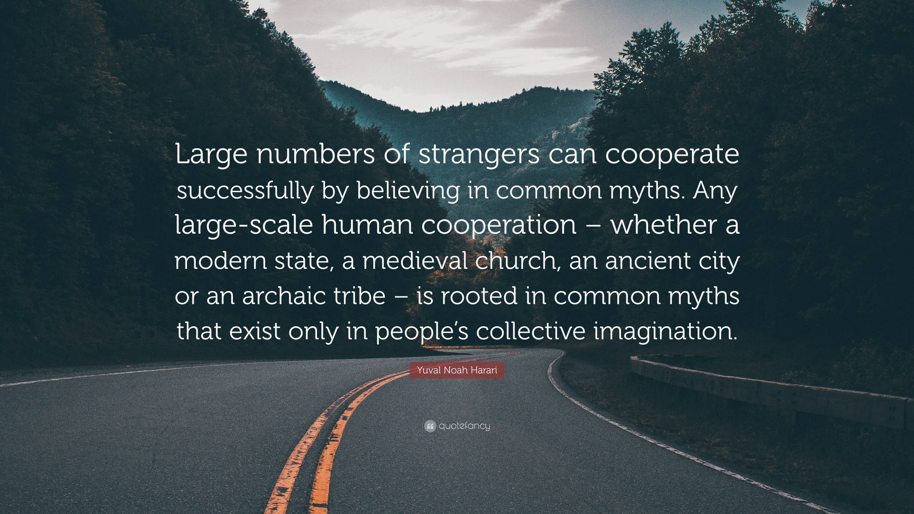

Slide 16
Competition and Collaboration
If you think competition is hard, you should try collaboration.

Slide 17
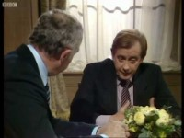

Slide 18
So………
Why did Greater Manchester become the first devolved city region in the country?

Slide 19
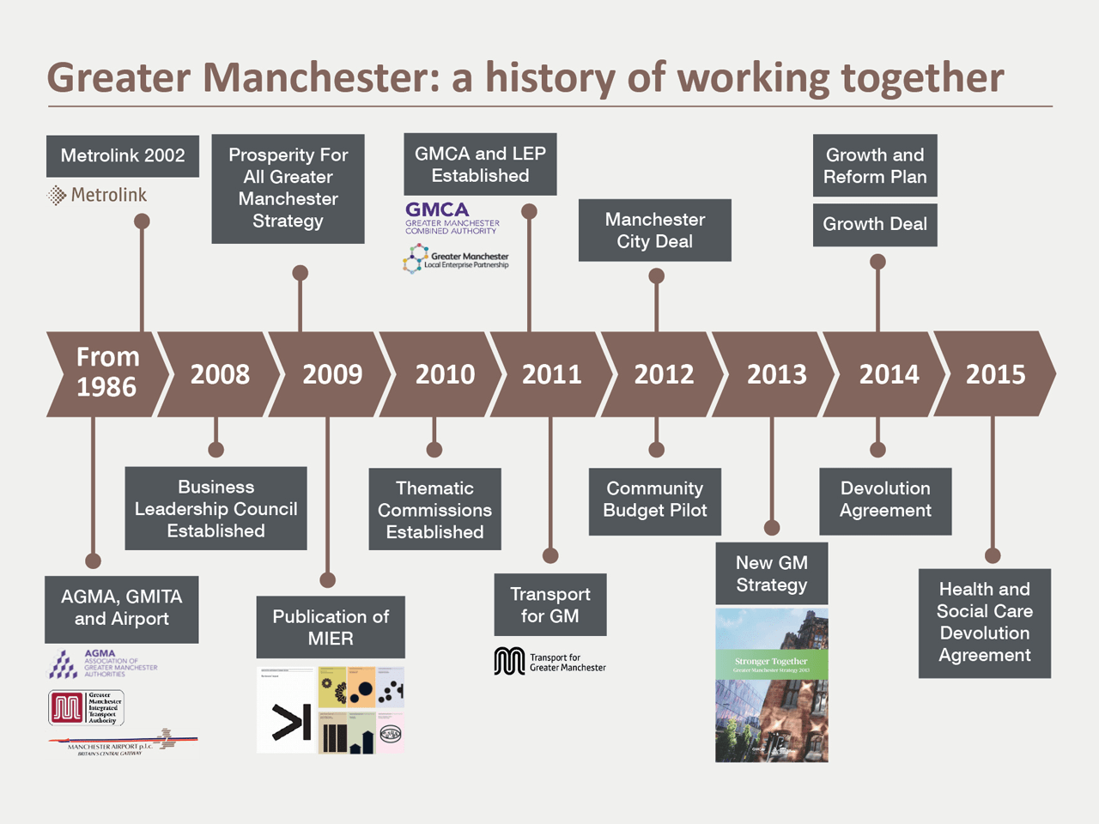
Greater Manchester – A History of Collaboration

Slide 20
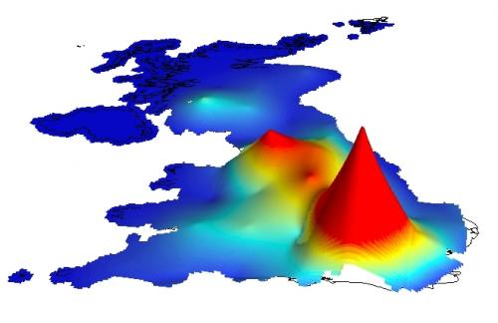
Greater Manchester - Economically

Slide 21
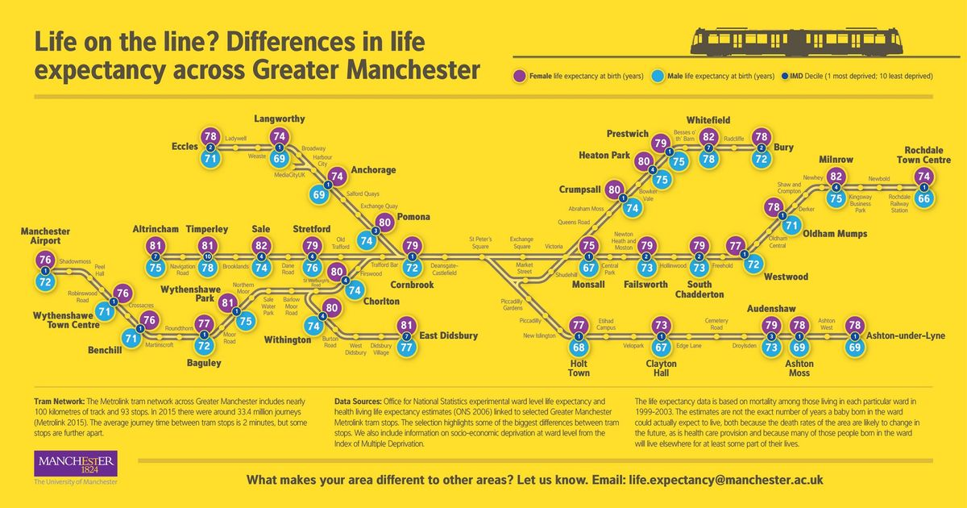
About Greater Manchester’s integrated care system

Slide 22
Greater Manchester – Population Health Journey
King’s Fund Report – October 2024
Greater Manchester (GM) has been the ‘poster child’ for devolution in England, and alongside it, in the health world, the leading light in efforts to improve population health at scale.
The evidence suggests that the focus on population health in GM is starting to pay off, with greater improvement against what would be expected on key measures of health and health inequalities. GM shows that devolution can be successful, but also that it is hard work and will not happen as a matter of course. It relies on clear intent, consistency and coherence over time, underpinned by a strong vision and model for population health, and implemented and connected with economic goals at local authority level.
This is a story of how change happens in a national policy context, when it is driven by a coherent vision and commitment at system and local authority level. It is a story that has lessons for a government seeking to deliver a health mission that is centred on closing regional gaps in health inequalities and for other systems seeking to improve population health.

Slide 23
Greater Manchester – Population Health Journey
Impact
Since devolution Greater Manchester’s life expectancy increased above the national average, particularly in areas of income deprivation and lowest life expectancy.
There were improvements in health life expectancy and self-reported life satisfaction.
Reduction in alcohol related admissions
Improved Cancer Screening rates
A significant narrowing of the smoking rates in the region (12.5%) compared to the national average (11.6%), plus a 50% reduction in Smoking at the Time of Delivery since 2017 (resulting in 6,000 babies born smoke free since 2017).

Slide 24
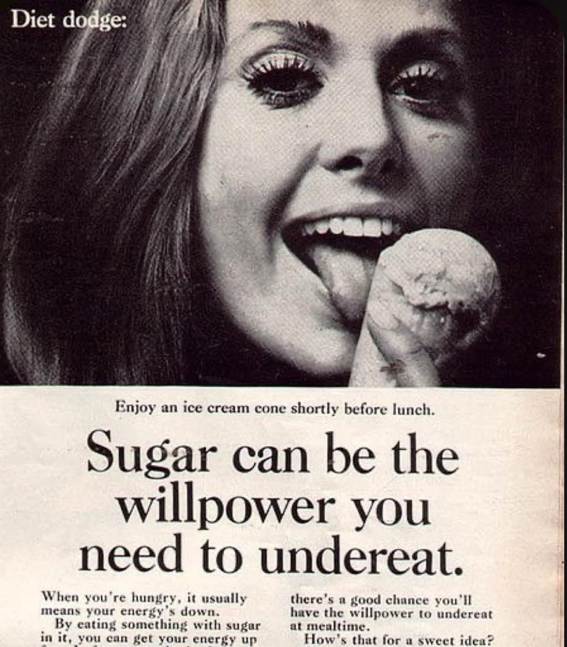
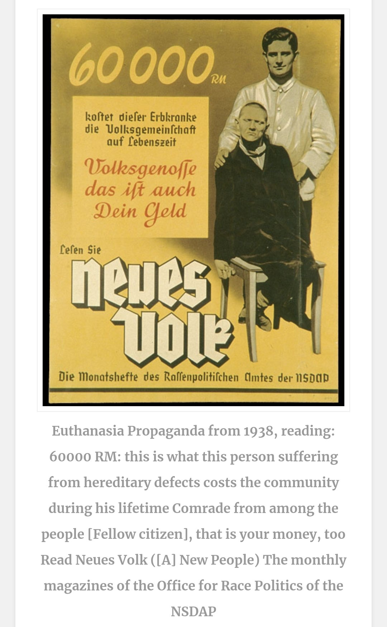

Meaning and Purpose – The Divisive Side

Slide 25
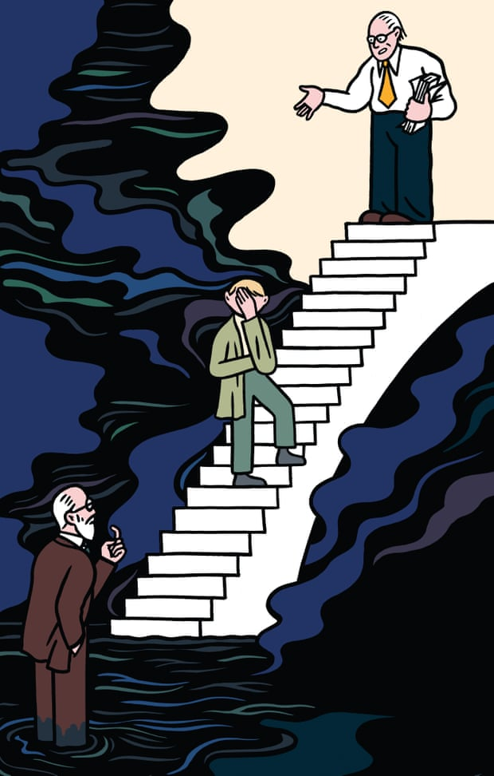
Psychological Therapies – the Internecine War

Slide 26
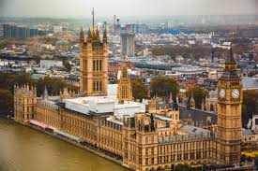
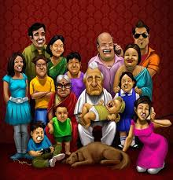



Psychology is 'the scientific study of the mind and how it dictates and influences our behaviour, from communication and memory to thought and emotion.

Slide 27
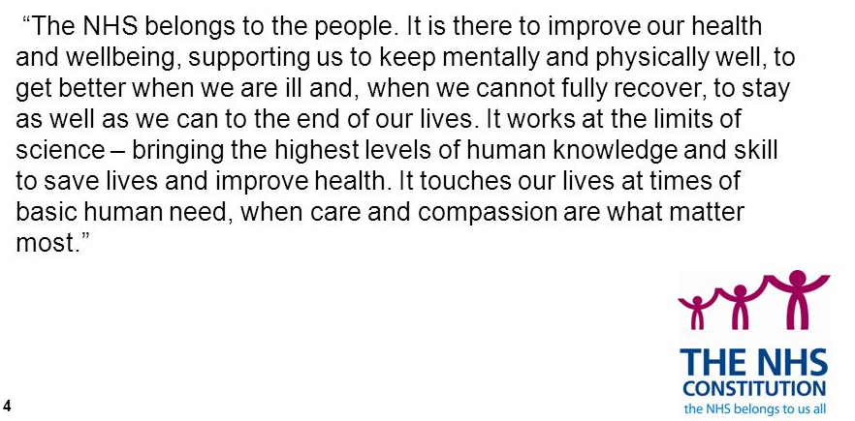


Slide 28
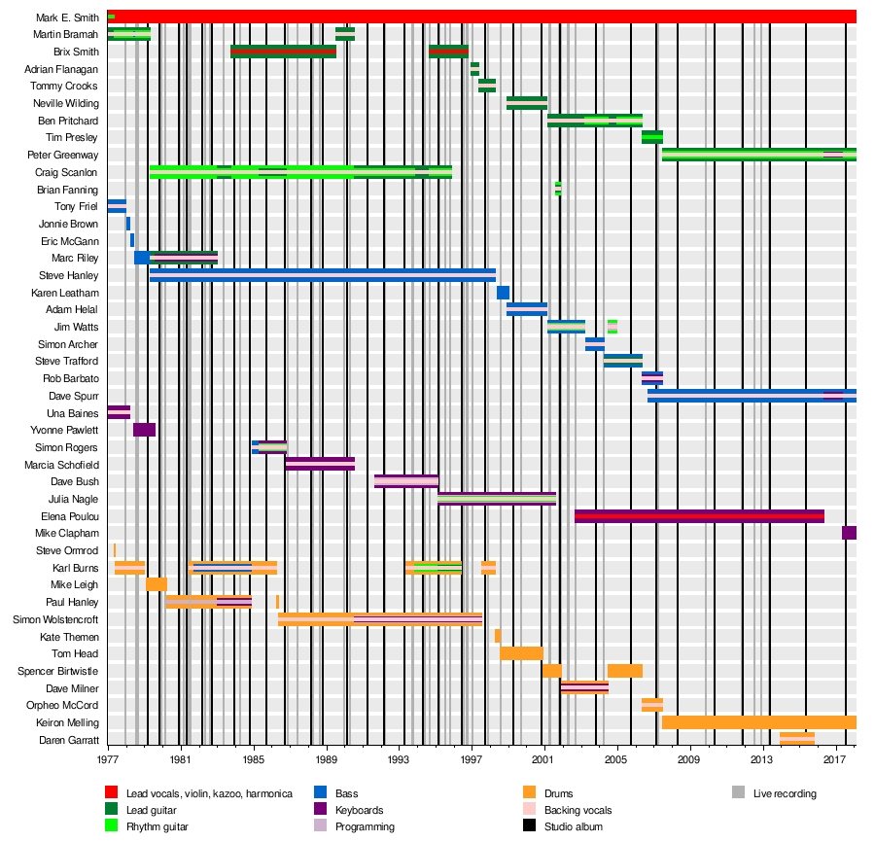
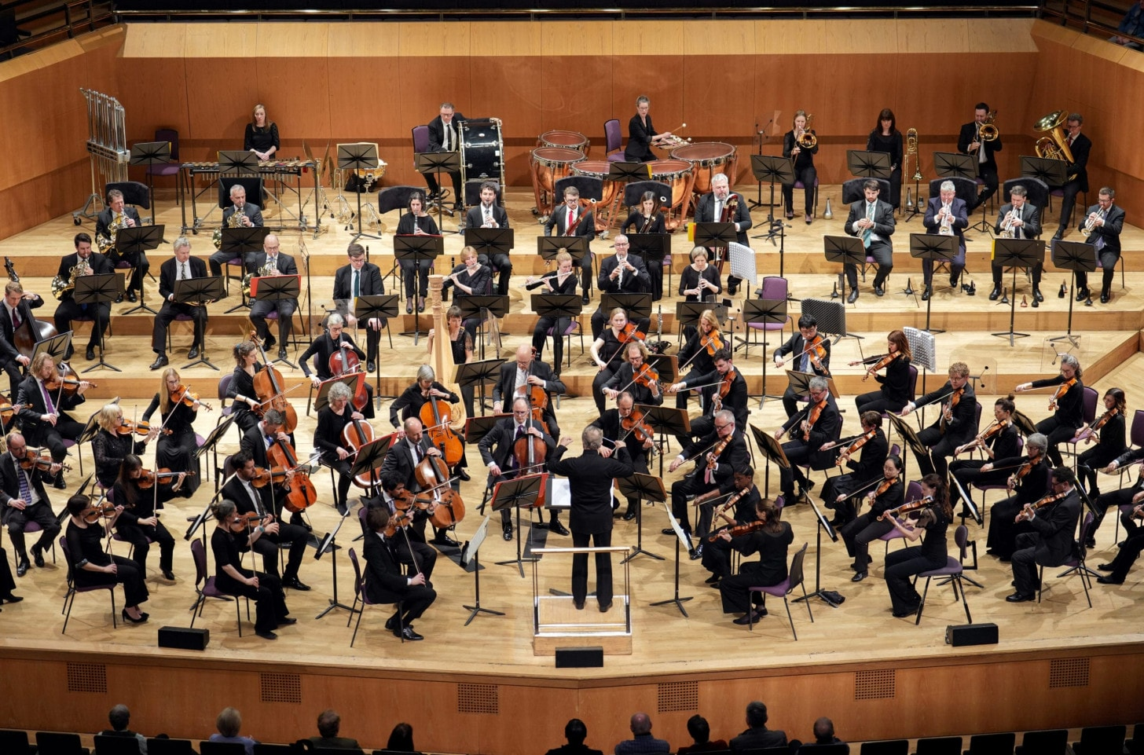
Psychological Therapies in the NHS are…..
or

Slide 29
Psychological Therapies in the NHS
In a complex world where belief and meaning are not only drivers for human behaviour but also drivers for our beliefs about the ‘theory of a person’, necessary and sufficient (or not), eclectic vs purist, evidence-based practice vs practice-based evidence etc… what might we better do, as a profession, to
Create a new social contract in service of and with the people who come to us?
Create a new narrative of unity and collectivism?
Attract new people into the profession and welcome them into a safe and stable environment of inclusive psychological therapies?

Slide 30
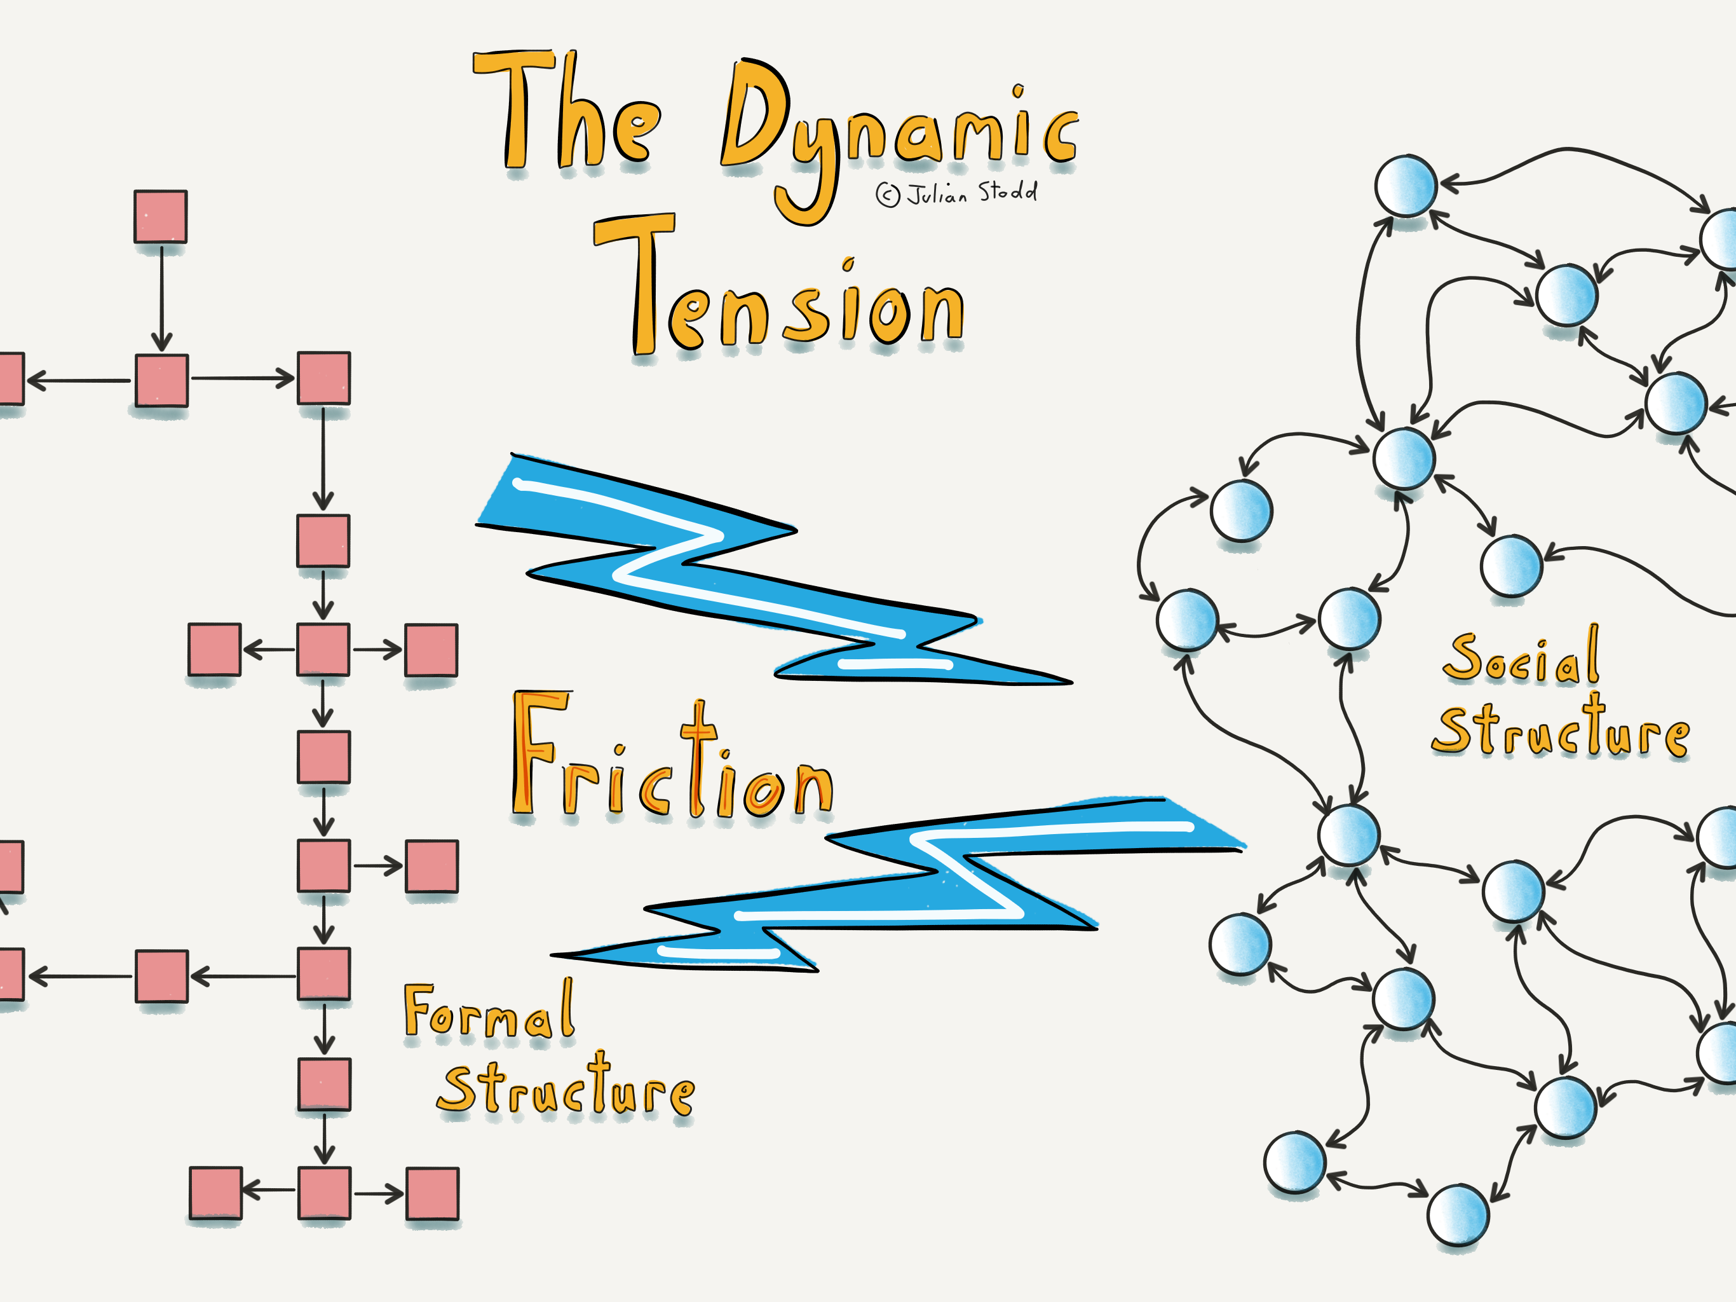

Slide 31
Notes:
PAXMAN:​ A few streets away from the Shepherds, the Herrings are also locking themselves in for the night. They have every reason to worry. The house next door was torched. ​
JOHN HERRING:​ This house and the one next door, when they were empty, the lads got in there and they torched the house and the flames came through the roof. This is why we've got all this damp and damage to the house. ​
PAXMAN:​ We first met John at his doctor's surgery last month, where he had gone for a regular check-up. He was deeply upset by a recent mugging. ​
HERRING:​ (footage dated October 2000)​ Two school lads, only 14, mugged and knocked her down. Took her bag, with £80 in it. They broke her hip. ​
DOCTOR:​ Oh, dear. I'm sorry. ​
PAXMAN:​ Crime makes the everyday life of the Herrings a misery. Next door still has no roof following the arson attack. The dampness seeps through the walls into their house. Every night, John has to shift the coal needed for the next day to the other side of the cellar. He’s 89 years of age

