Slide 1



Welcome
Please note we will be recording the session
Upon arrival, please MUTE on connection
Please use the chat function throughout the session and we will bring you in during the Q&A section at the end if you have a question
Any unanswered questions will be collated and we will get answers back to you as soon as we can
To turn on live captions, select Captions/Subtitles On (CC)
We will share the presentation slides on our website
after the event
Grab yourself a cuppa. The session will begin at 2:00pm
@PPNMidlands bsmhft.ppnmidlands@nhs.net www.ppn.nhs.uk/midlands

Slide 2
Housekeeping
Please;
Turn off your camera during presentations and we invite you to turn your camera on during the Q&A
MUTE your mic and remain muted throughout the presentation
Use the chat function throughout presentations and we will bring you in during the Q&A at the end of the session
We will use Mentimeter to capture your takeaways from the session at the end
@PPNMidlands bsmhft.ppnmidlands@nhs.net www.ppn.nhs.uk/midlands

Slide 3
Who are the Psychological Professions?
In England, the psychological professions are a group of professionals whose work is informed by psychological disciplines and therapies. They work with people to alleviate psychological and emotional distress, to improve mental and physical health management and empower individuals and communities to improve their health and wellbeing.
The psychological professions include psychologists, psychological therapists and psychological practitioners.
Read more about the range of occupations on the Health Careers website
Our Vision
To transform lives and communities by embedding and developing
psychological knowledge across the whole of the health and care network.
@PPNMidlands bsmhft.ppnmidlands@nhs.net www.ppn.nhs.uk/midlands

Slide 4
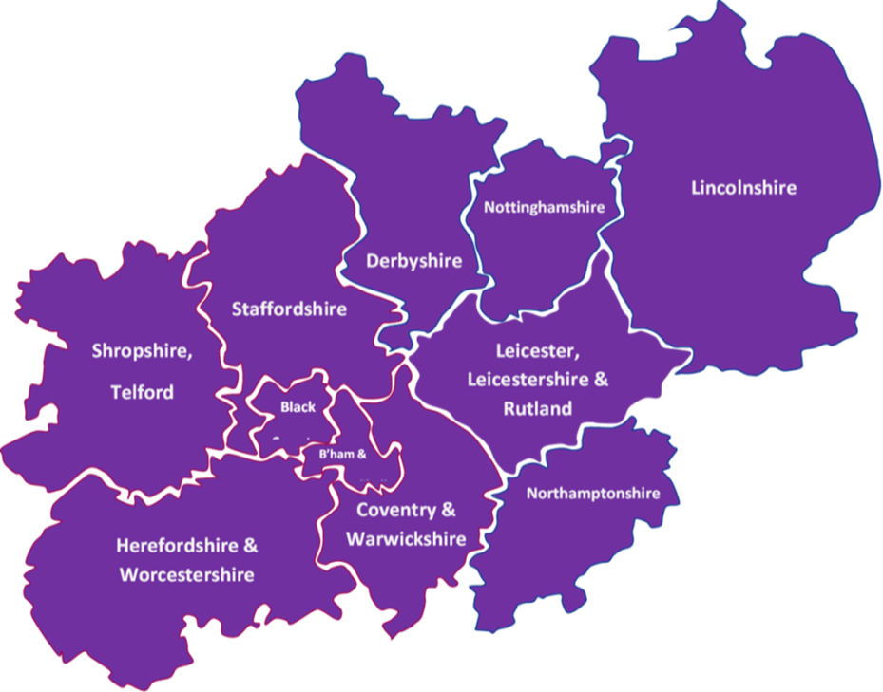
PPN Midlands – a snapshot!
Established Sept 2020
Covers one of the largest geographical areas in England
11 Integrated Care Systems
39 NHS trusts that employ Psychological Professionals
100+ Higher Education Institutions with
over one third providing
training with NHS
accreditation
for psychological
professions roles
@PPNMidlands bsmhft.ppnmidlands@nhs.net www.ppn.nhs.uk/midlands

Slide 5

Psychological Professions Vision for England 2019-24
@PPNMidlands bsmhft.ppnmidlands@nhs.net www.ppn.nhs.uk/midlands

Slide 6

#PsychologicalProfessionsWeek2024
#PPWeek24

Slide 7




Psychological Practice in Physical Health: Fundamental Awareness Programme
PPN Leadership Fellows

Slide 8

Overview
Context & Evolution
Learning Hub & Resource Demo
Next steps: Dissemination

Slide 9



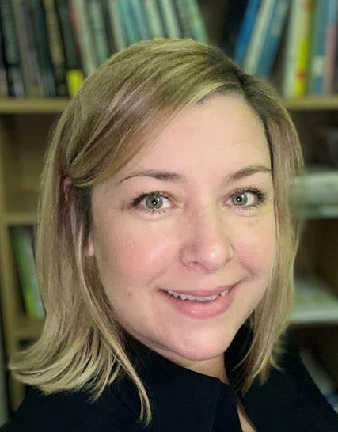

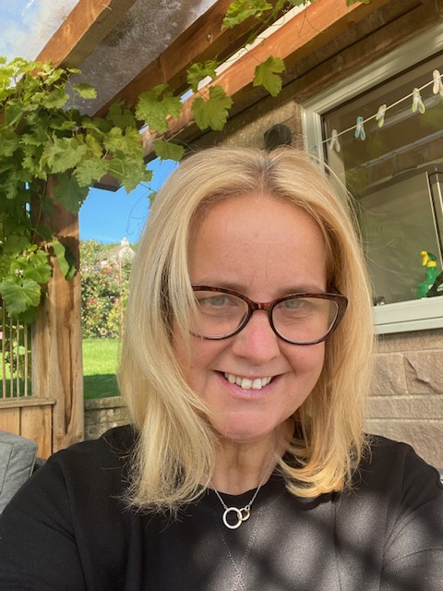
PPN Leadership Fellows – Who are we?
Dr James Parker
Consultant Clinical Psychologist
PPN Midlands Leadership Fellow
Oncology & Palliative Care Psychology Lead, South Warks Uni NHS FT
Psychosocial Clinical Lead West Midlands Cancer Alliance
Dr Claire Pearson
Consultant Clinical Psychologist
PPN Midlands Leadership Fellow
Associate Director of Psychological Professions
Nottinghamshire Healthcare NHS Foundation Trust
Dr Anita D’Urso
Consultant Clinical Psychologist
PPN Midlands Leadership Fellow
Lead Psychologist East Midlands Neonatal Operational Delivery Network
Dr Louise Price
Consultant Clinical Psychologist
Head of Psychological Services
University Hospitals Coventry and Warwickshire NHS Trust

Slide 10
Context – NHS Long Term Workforce Plan: June 2023
In response to a growing need the NHS Long Term Plan proposed a rapid growth of the Psychological Professions workforce, roughly doubling by 2037 (fastest growing group in the NHS):
Increase training places by 26% for both clinical psychology and child and adolescent psychotherapy by 2031
Over the next three years NHS England has committed funding of over £600 million to grow the wider psychological professions workforce through training approximately 15,000 more individuals to undertake psychological therapist and psychological practitioner roles.
1,065 Clinical Psychology training places were commissioned in 2022/23 with a similar level projected in 2023/24
2,556 training places for Psychological therapists were commissioned in 2022/23 with more than 3,000 projected in 2023/24

Slide 11
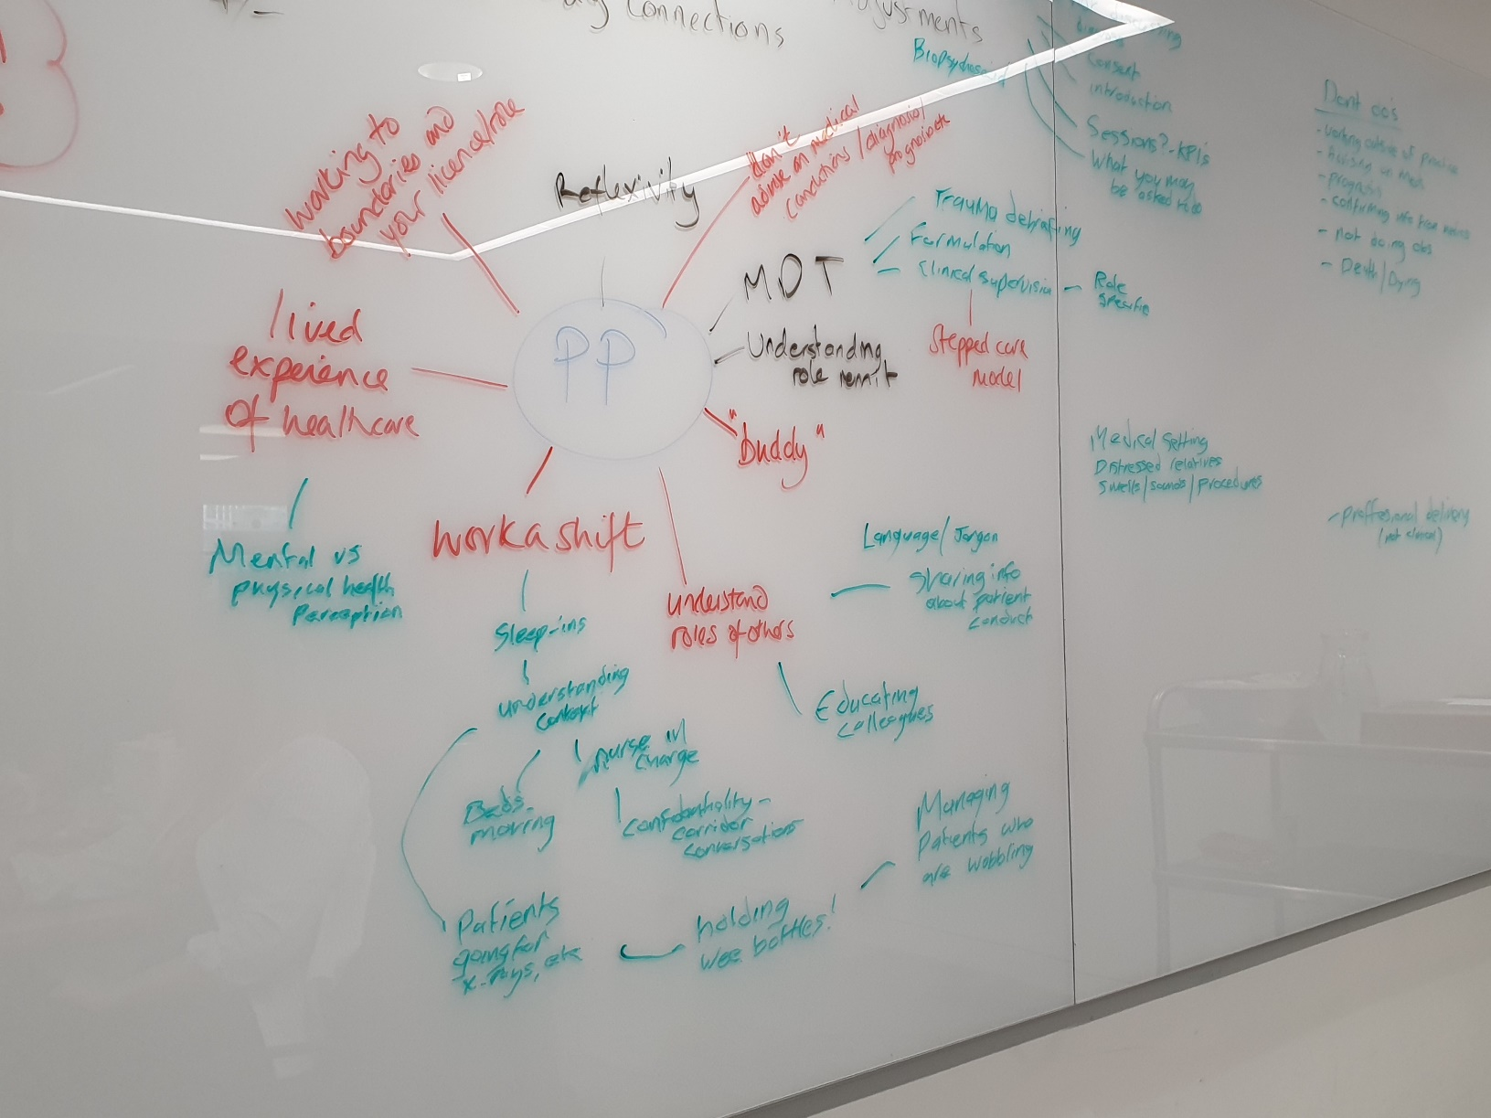
Evolution
November 2023 – PPN day in London launched the Psychological Practice in Physical Healthcare position paper
January 2024 – PPN Midlands and Leadership Fellows meeting where agreed to develop e-learning materials to upskill the Psychological Professionals workforce to work in physical health settings
April 2024 – PPN Midlands and Leadership Fellows meeting where began to think about content that was not competency based, but focused on awareness raising and providing fundamental information to Psychological Professionals new to working in a physical health setting

Slide 12

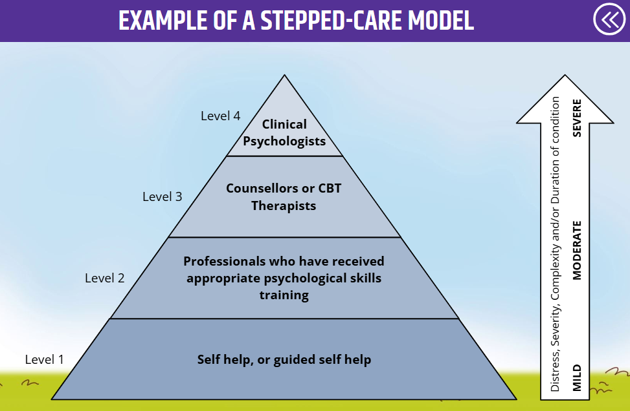
Evolution
May – June 2024 – working independently on different allocated topics or themes on shared document on the Google drive
June 2024 – met to review coherence of content and further refine
July – Aug 2024 – further refinement of content with Expert By Experience and Physical Health Community Of Practice member feedback. Formatting to make suitable for animated slides
Sep 2024 – feedback incorporated and content reviewed and finalised. Narration by PPN Midlands Chair.
Oct 2024 – Expert By Experience video recorded and beta version on NHS Learning hub tested, final amendments to content agreed by PPN Leadership Fellows and PPN Core Team before sign off
Nov 2024 – official launch!!

Slide 13
Design and development
Context: budget limitations
Previous course development (launched in PPWeek23 – Developing psychological therapy skills: Transferring training into practice)
Competitive tendering
Design commenced in early September, using Articulate Storyline
Limitations with graphics: about 70% of graphics were recycled from previous designs
Programme link: Psychological Practice in Physical Health: Fundamentals Elearning Programme
Demo!

Slide 14

Next Steps & Dissemination
Nov 2024 – official launch!!
Postgraduate training courses
New members of teams
PPN Physical Health Community Of Practice.
What/where are our blind spots?

Slide 15

Mentimeter
www.menti.com
Code is 3430 6084
or scan the QR code
@PPNMidlands bsmhft.ppnmidlands@nhs.net www.ppn.nhs.uk/midlands

Slide 16

Next Steps & Dissemination
What ideas have you got for sharing and disseminating the E-Learning Programme?
What comments, learning points, or take-aways do you have from today's session?

Slide 17
Thanks for joining us today
www.ppn.nhs.uk/register
Midlands | bsmhft.ppnmidlands@nhs.net
Southwest | ppn-sw@exeter.ac.uk
Southeast | spnt.ppnse@nhs.net
NE&Y | ppn-ney.lypft@nhs.net
Northwest | ppn.north@hee.nhs.uk
London | wlm-tr.ppnlondon@nhs.net
East | Hpft.eoeppn@nhs.net
National | spnt.ppnengland@nhs.net
@PPNMidlands bsmhft.ppnmidlands@nhs.net www.ppn.nhs.uk/midlands

