Slide 1


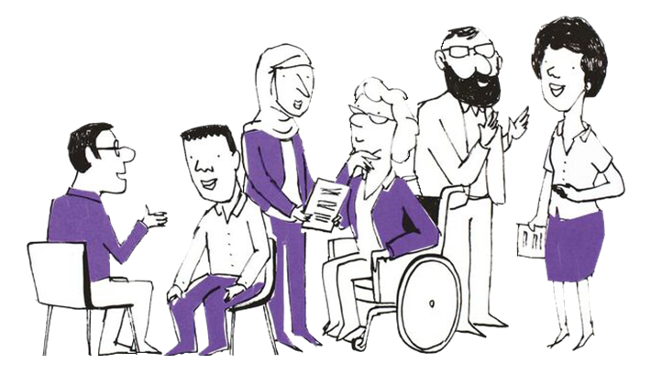
Welcome
Please note we will be recording the session
Upon arrival, please MUTE on connection
Please use the chat function throughout the session and we will bring you in during the Q&A section at the end if you have a question
Any unanswered questions will be collated and we will get answers back to you as soon as we can
To turn on live captions, select Captions/Subtitles On (CC)
We will share the presentation slides on our website
after the event
Grab yourself a cuppa. The session will begin at 2:00pm
@PPNMidlands bsmhft.ppnmidlands@nhs.net www.ppn.nhs.uk/midlands

Slide 2
Housekeeping
Please;
Turn off your camera during presentations and we invite you to turn your camera on during the Q&A
MUTE your mic and remain muted throughout presentations
Use the chat function throughout presentations and we will bring you in during the Q&A at the end of the session
We will use Mentimeter to capture your takeaways from the session at the end
@PPNMidlands bsmhft.ppnmidlands@nhs.net www.ppn.nhs.uk/midlands

Slide 3
Who are the Psychological Professions?
In England, the psychological professions are a group of professionals whose work is informed by psychological disciplines and therapies. They work with people to alleviate psychological and emotional distress, to improve mental and physical health management and empower individuals and communities to improve their health and wellbeing.
The psychological professions include psychologists, psychological therapists and psychological practitioners.
Read more about the range of occupations on the Health Careers website
Our Vision
To transform lives and communities by embedding and developing
psychological knowledge across the whole of the health and care network.
@PPNMidlands bsmhft.ppnmidlands@nhs.net www.ppn.nhs.uk/midlands

Slide 4
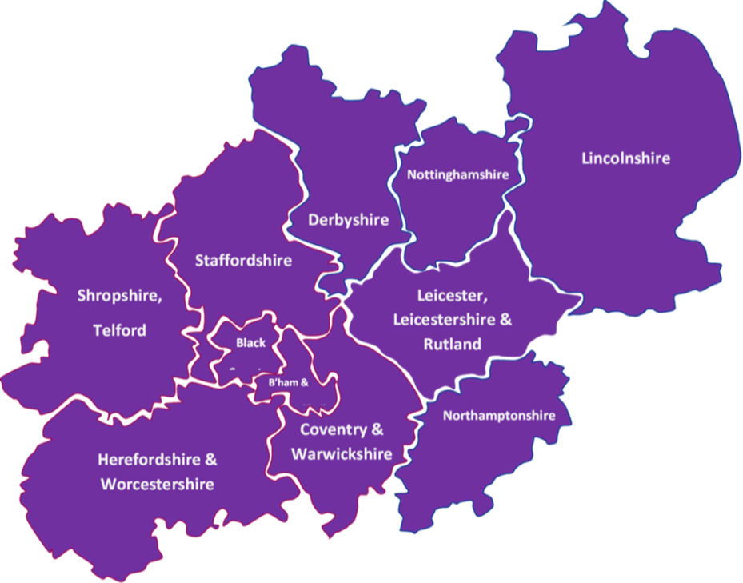
PPN Midlands – a snapshot!
Established Sept 2020
Covers one of the largest geographical areas in England
11 Integrated Care Systems
39 NHS trusts that employ Psychological Professionals
100+ Higher Education Institutions with
over one third providing
training with NHS
accreditation
for psychological
professions roles
@PPNMidlands bsmhft.ppnmidlands@nhs.net www.ppn.nhs.uk/midlands

Slide 5
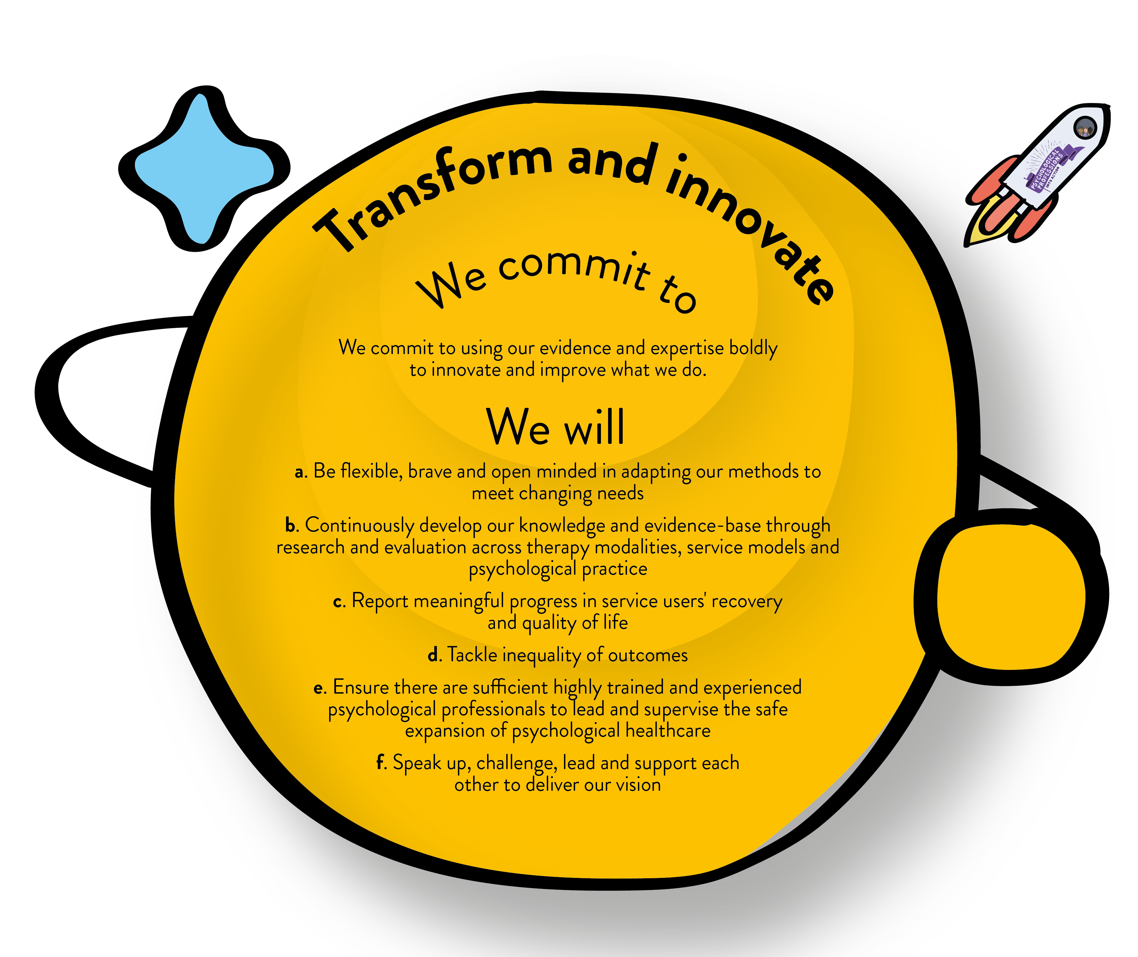
Psychological Professions Vision for England 2019-24
@PPNMidlands bsmhft.ppnmidlands@nhs.net www.ppn.nhs.uk/midlands

Slide 6
Mental Health and Wellbeing Practitioner
New role: First cohort commenced in September 2021
Roll-out safe and effective expansion to help address the growing demand for mental health services whilst still transforming and innovating
Specified System of Practice (not yet published)
“Services may include adult community mental health, perinatal mental
health and drug and alcohol services, and potentially others that serve
people with severe mental health problems, where MHWPs
deliver according to the core taught MHWP competences.
MHWPs should only work in services where the work is
aligned to the competences taught in the role, and any
additional necessary training undertaken”.
@PPNMidlands bsmhft.ppnmidlands@nhs.net www.ppn.nhs.uk/midlands

Slide 7
MHWPs in Addictions
Luke Mitcheson, Clinical Psychologist and OHID Clinical Advisor
Notes:
Plain slide with subhead and bullets

Slide 8
Context: Mental health in addictions
High rates of mental health co-morbidity in people who use substances
Often excluded by mental health services because of their substance use
Loss of professions in sector including core professions with mental health expertise
Dame Carol Review
New Drug Strategy
3-year funding up-lift
Notes:
Plain slide with subhead and bullets

Slide 9
What MHWPs can bring to drug and alcohol treatment and recovery services
The potential benefits of bringing MHWPs into your staff mix include:​
Developing your team's capacity and capability to treat common co-occurring mental health difficulties and thereby help people to:​
accrue recovery capital​
reduce their substance misuse​
Enabling segmentation of caseloads and capacity to work with people with more complex needs​
Increasing expertise that can be shared in the team around working with mental ill health ​
Supporting the development of integrated pathways with local mental health services by:​
providing a first-step into mental health treatment ​
supporting stabilisation in mental health and substance use to open up access to more high-intensity treatment with specialist providers (e.g. DBT service)​
Supporting recruitment and retention by developing alternative training routes for staff who may not have the qualifications required to access other psychological professional training.​
Notes:
Plain slide with subhead and bullets

Slide 10
Findings from the 2022/23 pilot cohort
Online evaluation survey of drug and alcohol service trainees and service managers
Although the response rate for the survey was low, the below findings were observed:
High Satisfaction Levels: Both trainees and service managers' report high levels of satisfaction with the training, with most responses being "Strongly Agree" or "Agree"
Confidence in Applying Skills: Most trainees reported high confidence in applying psychological interventions, with 'Completely Confident' being a common response
Impact on Delivery: Service managers observed that the training has led to noticeable benefits in service delivery, including better mental health support for clients indicating a successful integration of the MHWP role

Slide 11
Looking ahead: challenges
Role and existing pathways
Commissioning priorities
Numbers and continuity from prison - treatment progress (quality)?
Supervision
Management and role drift
Funding
Notes:
Plain slide with subhead and bullets

Slide 12
Inclusion - Midlands Partnership Foundation Trust
Mental Health and Wellbeing Practitioners in community drug & alcohol services
Deborah Hart & Karina Farrell

Slide 13
Mental Health and Wellbeing Practitioners (MHWPs) in community drug and alcohol services: Why are they needed?

Slide 14
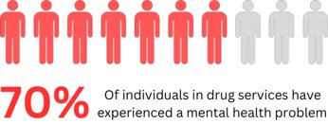
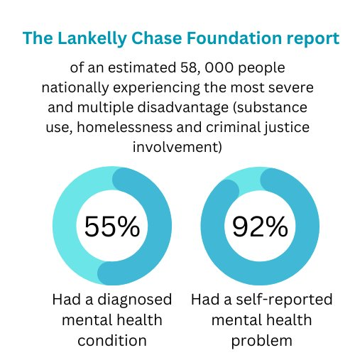
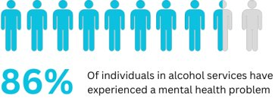
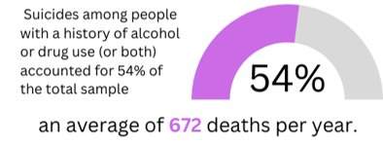
The prevalence of mental health problems within substance use services
(Weaver et al., 2003)
(Bramley et al., 2015)
(Appleby et al., 2016)

Slide 15
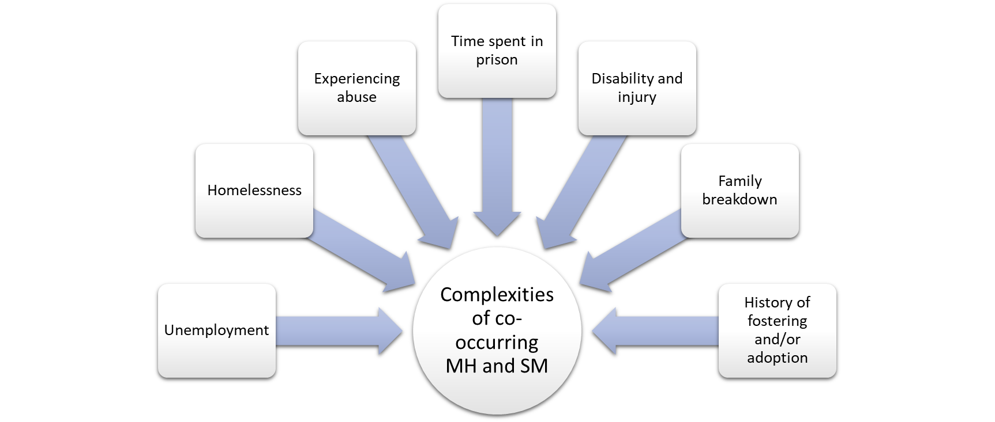
Demographic complexities
​
National Institute for Health and Care Excellence. (2016)

Slide 16
Demographic complexities
People with co-occurring alcohol and/or drug problems alongside poor mental health also find themselves turned away from support because of this complexity
93% of respondents reported that accessing mental health services was 'a real challenge' or 'quite a challenge'
​
Making Every Adult Matter Coalition. (2022)

Slide 17

Barriers to accessing different levels of MH support
The Stepped Care Model
Step 1 – Primary care and GP surgeries​
Such services often do not have the capacity to support those who present with co-occurring conditions.
Christie, E. (2017), The Recovery Partnership (2015)

Slide 18
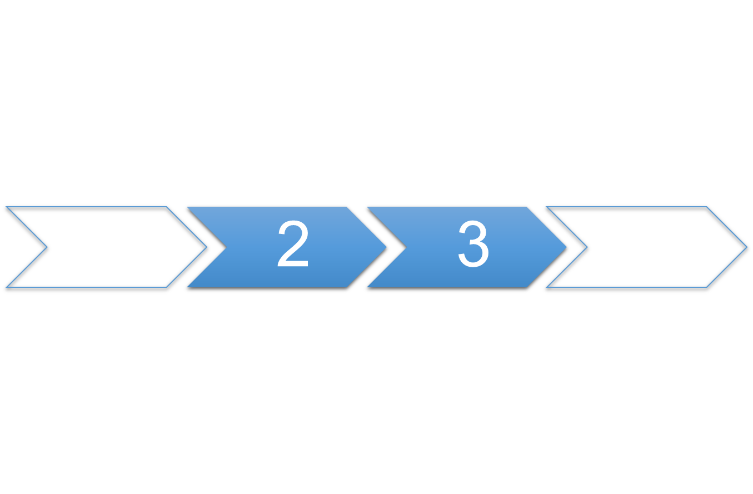
Barriers to accessing different levels of MH support
The Stepped Care Model
Step 2 & 3 – Talking therapies and high-intensity therapies
Only 1.4% of those in substance use treatment with a mental health need have received Talking therapies intervention
National Treatment Agency for Substance Misuse (2011), National Statistics. (2023)

Slide 19

Barriers to accessing different levels of MH support
The Stepped Care Model
Step 4 – Specialist services
Current substance use can be considered a barrier to effective engagement in specialist therapies such as EMDR
Christie (2017), National Institute for Health and Care Excellence (2018)

Slide 20
Service access challenges – views of professionals and stakeholders
Appropriateness of care
Support often based on a clinical diagnosis-led model
Limited mental health training in drug & alcohol services resulting in 'quick' referrals to mental health services (and vice versa)
Accessibility of care
Expectation to engage in the same way as general population (impact of demographic complexities overlooked)
Difficulty in attending appointments regularly
Attending under the influence of substances
‘Anti-social’ behaviour
​
Making Every Adult Matter Coalition. (2022)

Slide 21
The benefits of integrating MHWPs into drug and alcohol services
Acknowledges the current pressures faced nationwide by PCNs & CMHTs
Creates an accessible service for individuals already engaged with drug & alcohol teams
Promotes a holistic treatment service
Low-intensity treatment assists with preparation for psychological intervention
Improves communication between professionals

Slide 22
MHWPs in drug and alcohol services: Our experience so far

Slide 23

Emotion regulation is the main intervention used amongst MHWPs in drug & alcohol services
Why might this be the case?
Stellern et.al (2022)
Individuals with substance use problems have greater difficulty regulating emotions
Garke et al. (2020)
Emotion dysregulation is associated with the frequency and severity of substance use

Slide 24

Goals of emotion regulation interventions
Understanding and naming your own emotions
Identify (observe and describe) your emotions
Know what emotions do for you
Decrease the frequency of unwanted emotions
Stop unwanted emotions from starting in the first place
Change unwanted emotions once they start
Decrease emotional vulnerability
Decrease vulnerability to emotion mind
Increase resilience, your ability to cope with difficult things and positive emotions
Decrease emotional suffering
Reduce suffering when painful emotions overcome you
Manage extreme emotions so that you don’t make things worse
(Linehan, 2015, pp. 318–410)

Slide 25
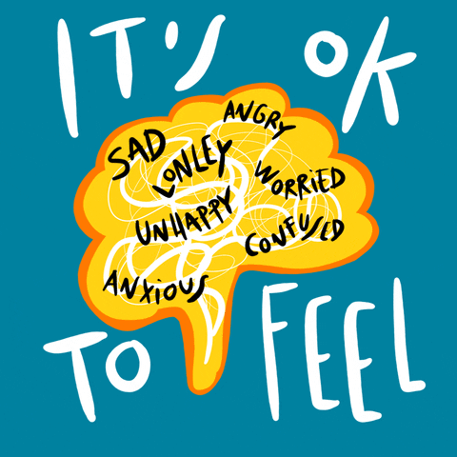
Emotion regulation group
Currently, Inclusion is piloting emotion regulation groups in two services: Hampshire and Telford. This is planned to be extended to all Inclusion services with MHWPs in post.
This was developed by adapting individual intervention to group settings. It consists of 6 weekly sessions.
Aim: The ‘Emotional Regulation’ group has been adapted by the MHWP from a psychologically-informed, evidence-based intervention that has previously been conducted by MHWPs in a 1-1 format. The ‘Emotional Regulation’ group aims to assist service users who have identified problems with understanding emotions, and/or with emotions that don’t seem to fit the situations where they arise, such as extreme outbursts of emotion. This group encourages service users to re-establish positive relationships with their emotions and learn appropriate emotional coping skills.

Slide 26

Case study: Client A
30-year-old woman
Problematic alcohol use since a very young age.
Self-referral
Identified need for support with managing emotions & building confidence.
12 sessions of emotion management and confidence building alongside recovery work
Outcome:
Improvement in ReQol scores from 4 to 39
Improvement in DIALOG score from 40 to 67
Client successfully completed Detox & remains abstinence.
Client reports that she now has a new positive, healthier, not critical point of view..
Client managed to gain a new position after having to leave her previous position due to her alcohol dependency.
Goals:
Learning skills to manage extreme emotions
Rebuild sense of self
To return to work

Slide 27
Case study: Client B
56-year-old female
Previous diagnosis of PTSD and psychosis
Problematic alcohol use
Identified need for support with establishing routine and emotion regulation in preparation to return to work
Client completed total of 16 sessions due to complexity of presenting problems
Goals:
To feel more in control of my life by establishing daily routine
To be able to manage extreme fear and anxiety
To return to work and remain in work without the need to be signed off sick again
Outcomes:
Improvement in Reqol scores from 16 to 30
Client’s SUDs on average dropping by half with the use of tools learnt during the intervention
Client reports that this is the most help she has ever received from a mental health professional
Client returned to work from long term sick

Slide 28
Challenges encountered whilst establishing MHWPs in drug and alcohol services
High complexity of co-occurring difficulties (incl. homelessness, unemployment, family breakdowns, poor physical health etc.)
More than one presenting problem (clients often struggling in many areas of psychological wellbeing)
Drug and alcohol training not a part of MHWP university training syllabus -knowledge has been built up in-post
Building up from lower banded roles without senior clinicians in post​
Identifying ‘the right time’ for psychological intervention during client’s drug & alcohol recovery journey
Lower attendance levels making meaningful therapeutic progress difficult to achieve
Limited understanding of the role within the service and amongst external agencies
Stigma around CMHS not being able to work with people who are actively engaging with MH services, & trying to bridge that gap.

Slide 29
Care opinion feedback
I felt really heard and listened to. There was never any judgement or awkwardness, everything felt safe and secure. I felt in a safe environment. We went through things at my own pace and I never felt like I was rushed or forced to do anything I didn’t want to do… It has made me realise how vital this is and what an amazing service this is, I would recommend it to anyone struggling.

Slide 30
Care opinion feedback
“Deborah did numerous sessions with me regarding emotional regulation. When I first approached stars my emotional state was unhealthy and dysfunctional. After numerous sessions Deb gave me some tools to work with and along with hard work and her dedication as a professional I’ve grown so much since. She was always available to me if needed. I don’t recognise myself from the start of the process to leaving them. I’ll be sad to longer be working with Deb as she’s just brilliant!, without the work my life would be destroyed.
I was a professional myself but had lost my role through alcohol dependency. I now, I have a new positive, healthier, not critical point of view.
If you have the encounter of meeting Deborah rest assured they will do their upmost for you.”

Slide 31

Thanks for listening

Slide 32
References
Bramley, Fitzpatrick, Edwards, Ford, Johnsen, Sosenko, & Watkins. (2015). Hard Edges: Mapping severe and multiple disadvantage. In lankellychase.org.uk (https://lankellychase.org.uk/wp-content/uploads/2015/07/Hard-Edges-Mapping-SMD-2015.pdf). Lankelly Chase Foundation.
Christie, E. (2017). Better care for people with co-occurring mental health and alcohol/drug use conditions: A guide for commissioners and service providers. Public Health England.​
Garke, M. Å., Isacsson, N. H., Sörman, K., Bjureberg, J., Hellner, C., Gratz, K. L., Berghoff, C. R., Sinha, R., Tull, M. T., & Jayaram-Lindström, N. (2021). Emotion dysregulation across levels of substance use. Psychiatry Research, 296, 113662. https://doi.org/10.1016/j.psychres.2020.113662​
Linehan, M. (2015). DBT skills training manual (pp. 318–410). Guilford Publications.
Making Every Adult Matter Coalition. (2022) Multiple disadvantage and co-occurring substance use and mental health conditions. London: Making Every Adult Matter.​
National Health Service. (2021). Mental health and wellbeing practitioner. Health Careers. https://www.healthcareers.nhs.uk/explore-roles/psychological-therapies/roles-psychological- therapies/mental-health-and-wellbeing-practitioner
National Institute for Health and Care Excellence. (2018). Post-traumatic stress disorder [NICE Guideline No. 1.7.3]. https://www.nice.org.uk/guidance/ng143​
National Institute for Health and Care Excellence. (2016). NICE guideline: Severe mental illness and substance misuse (dual diagnosis): community health and social care services Scope. The Department of Health in England.​
National Statistics. (2023). Adult substance misuse treatment statistics 2021 to 2022: report. Office for Health Improvement & Disparities.​
National Treatment Agency for Substance Misuse (2011) IAPT positive practice guide for working with people who use alcohol or drugs. London. NTA; 2011​
Stellern, J., Xiao, K. B., Grennell, E., Sanches, M., Gowin, J. L., & Sloan, M. E. (2022). Emotion regulation in substance use disorders: a systematic review and meta‐analysis. Addiction, 118(1). https://doi.org/10.1111/add.16001
Appleby, Kapur, Shaw, Hunt, Flynn, Ibrahim, Turnbull, Gianatsi, & Tham. (2016). The National Confidential Inquiry into Suicide and Homicide by People with Mental Illness. Making Mental Health Care Safer: Annual Report and 20-year Review. University of Manchester. https://documents.manchester.ac.uk/display.aspx?DocID=37580
The Recovery Partnership. (2015). State of the Sector: 2014-15. Adfam. https://www.drugwise.org.uk/wp-content/uploads/sosfinal2015.pdf
Weaver, T., Madden, P., Charles, V., Stimson, G., Renton, A., Tyrer, P., Barnes, T., Bench, C., Middleton, H., Wright, N., Paterson, S., Shanahan, W., Seivewright, N., & Ford, C. (2003). Comorbidity of substance misuse and mental illness in community mental health and substance misuse services. British Journal of Psychiatry, 183(04), 304–313. https://doi.org/10.1192/bjp.183.4.304​
Whittington, A., Brabban, A., Hardy, A., Longden, E., Burbach, F., Smith, R., Cowan, M., Kell, L., Harding, H., Myles-Hooton, P., Dunkley, C., Waller, G., Turner, H., Freeman, D., Waite, F., Pratt, P., & Elswood, M. (2023). Mental Health and Wellbeing Practitioner: A Guide to Practice (1st ed.) [PDF]. NHS Health Education England.​

Slide 33
Inclusion
@Inclusion_NHS www.inclusion.org
The value for organisations &
Lessons learned so far…
Dr Sarah Stacey
Consultant Clinical Psychologist & Inclusion Professional Lead for Psychology
November 2024

Slide 34
Value for organisations
Increased number of psychological professions = support for growth in psychological knowledge and thinking
Structured interventions are easier to monitor and evaluate helps to build evidence base in under-served areas
Use of standardised measures:
ReQoL and Dialog supports team and service focus on measuring progress
Meeting of previously unmet needs enables colleagues to focus on other aspects of their roles, and MHWP interventions supports better engagement

Slide 35

Lessons learned
Challenge of effectively engaging people with complex difficulties in a short-term intervention
Absence of onward referral pathways can be frustrating – identify at outset what ‘stepping up’ could/will look like
Building up from lower banded roles without senior clinicians in post – pay attention to support structures
Variable understanding of role, purpose, work with teams to support understanding - don’t under estimate the time this takes
Importance of peer support
Importance of relationships with universities

Slide 36



What next?
Additional trainees
Evaluation

Slide 37
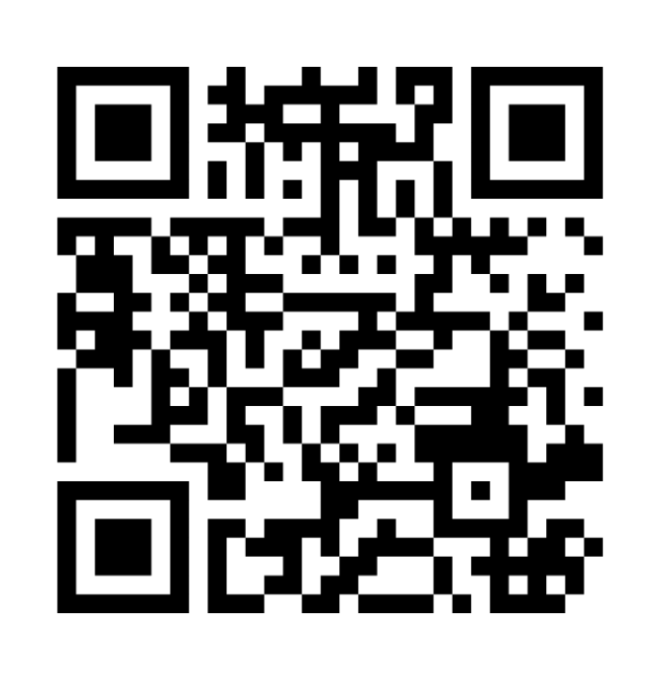
Questions?..
Menti
www.menti.com
Code is 6330 780
or scan the QR code
@PPNMidlands bsmhft.ppnmidlands@nhs.net www.ppn.nhs.uk/midlands

Slide 38
Thanks for joining us today
www.ppn.nhs.uk/register
Midlands | bsmhft.ppnmidlands@nhs.net
Southwest | ppn-sw@exeter.ac.uk
Southeast | spnt.ppnse@nhs.net
NE&Y | ppn-ney.lypft@nhs.net
Northwest | ppn.north@hee.nhs.uk
London | wlm-tr.ppnlondon@nhs.net
East | Hpft.eoeppn@nhs.net
National | spnt.ppnengland@nhs.net
@PPNMidlands bsmhft.ppnmidlands@nhs.net www.ppn.nhs.uk/midlands

