Slide 1


Welcome
Upon arrival to the event, please MUTE on connection
We will be recording the session. Please keep your camera off during presentations.
Please use the chat function throughout the event and we will bring you in during the Q&A section at the end of the session
Any unanswered questions will be collated, and we will get answers back to you as soon as we can
We will share the presentation slides after the event
Grab yourself a cuppa and the session will begin at 3:00pm
@PPNMidlands bsmhft.ppnmidlands@nhs.net www.ppn.nhs.uk/midlands

Slide 2





4th Anniversary Webinar
Share PPN Midlands achievements for the past year and current workstreams
Transform and innovate: the role of Health psychology in an Integrated Care System
@PPNMidlands bsmhft.ppnmidlands@nhs.net www.ppn.nhs.uk/midlands

Slide 3
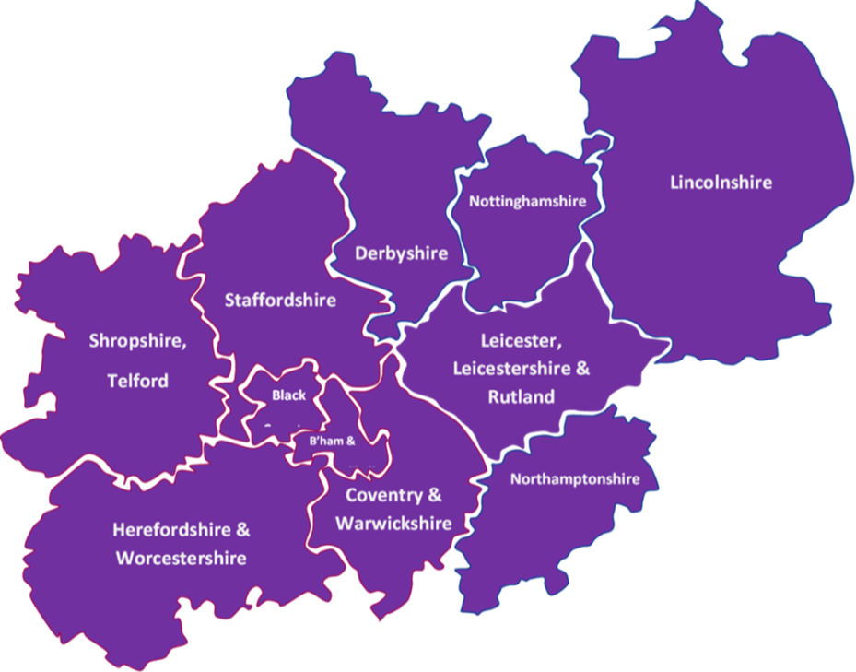
PPN Midlands – a snapshot
Formally established in September 2020
Covers one of the largest geographical patches in England
Has 11 Integrated Care Systems
Has 39 NHS trusts that employ Psychological Professionals
Has 100+ Higher Education Institutes, with over one third providing training with appropriate accreditation for NHS Psychological Professions roles

Slide 4
Some of our achievements to date
Over 2500 members
Over 160 bulletins
First Midlands Psychological Professions Workforce report in 2023
Communities of Practice
CPPO’s; Practitioners; Clinical Associates in Psychology (CAPS); Physical Healthcare; Assistant Psychologists and students
Professional advice to NHS England Workforce, Training & Education team
Developing e-learning resources
- Skills into Practice
- Psychological Practice in Physical Health ‘Fundamentals’
Careers event attendance to promote the profession
Supporting Equality, Diversity and Inclusivity
- Ethnic representation in the workforce
Connecting 11 Integrated Care Systems with Psychological Professions leads
Over 1500 critical friend responses
Project to Connect Midlands Lived Experience Leads
Other workstreams, such as Promoting Mental Health and Wellbeing Practitioners (MHWP) in specialist settings… and more
Communication, Engagement and Connections
Sharing data driven knowledge and supporting learning exchange
Professional advice informing professional practice and process

Slide 5


Slide 6

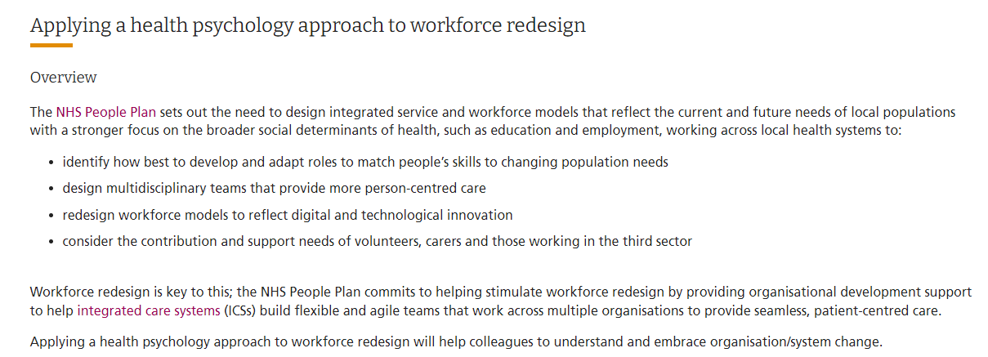
Health Psychology Workforce Transformation Programme
https://www.hee.nhs.uk/our-work/workforce-transformation/health-psychology-workforce-transformation-programme
“New roles for qualified health psychologists have been established in key areas in Scotland…. This approach is slowly evolving in England. For example, a national pilot programme embedding seven trainee health psychologists in workforce transformation and redesign across seven regions has achieved proof of concept (NHS HEE, 2023). Swifter growth of opportunities for health psychologists, and a focused funded training programme in physical health care presents one solution for strategically upscaling to maximise the impact of psychological practice on population health and wellbeing.”
Clinical Psychology Forum 375 – April 2024 p.57

Slide 7

Shaping the Future: Health Psychology in NHS Workforce Redesign
Helena Lee
Trainee Health Psychologist
Helena.lee16@nhs.net
With thanks to Elizabeth Jenkinson, Lucy Renwick, Eleanor Bull and Jo Hall.

Slide 8
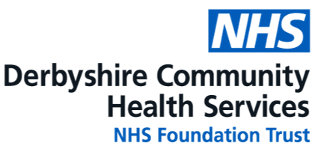

Session outline:
Health Psychology and the Training Routes
The new NHS funded route
My work
Reflections

Slide 9
What is Health Psychology?
The study of psychological and behavioural processes in health, illness and healthcare (Johnson, 1994).
What we think, feel and do about health.

Slide 10
Where do Health Psychologists work?
Work across primary, secondary or tertiary care
Involved in large-scale public health programmes and individual/group consultations.
Also work in academia – teaching and researching.
Approx. 610 Health Psychologists in the UK.
Around 1 in 6 are employed directly by the NHS.
Source: BPS (2021) Psychology Careers_HEALTH 2021_2.pdf (bps.org.uk)
Notes:
Across a range of healthcare settings including primary, secondary or tertiary care within statutory, third sector, or private healthcare.
Large-scale public health programmes and organisations to individual or small group consultations
Health Psychologists also work in academia – teaching and researching in their area of expertise.
Approx. 610 Health Psychologists in the UK, estimated that around 1 in 6 are employed directly in NHS services
Source

Slide 11
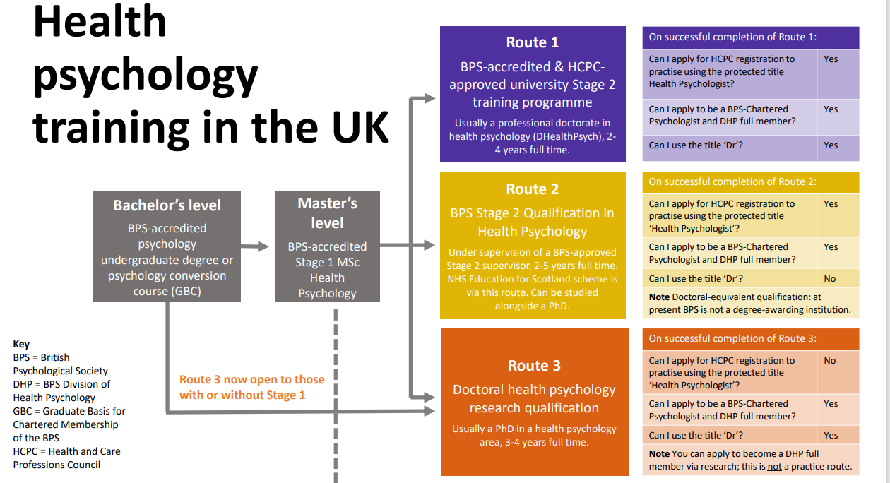
Division of Health Psychology | BPS
Notes:
Training in England has been either self-funded or funded by an employer – BPS QHP route OR Prof Doc route.
Funding for 4 trainees per year through NHS National Education for Scotland (NES). This training route has made considerable impact on health and care
transformation and opportunities for health psychologists in the NHS in Scotland.
Until now, there had been no such route in England. We now have the first Health Education England (now NHS England) funded positions.
NHS route:
Undergraduate degree in Psychology
Stage 1 training is an MSc in Health Psychology
Stage 2 training starts at Band 6
Newly Qualified at Band 7
Training in England has been either self-funded or funded by an employer- BPS QHP route OR Prof Doc route.
Health psychology has been underutilised.
Similar to other applied psychology training programmes, health psychologists have at least 7 years specialist training - 3 year BPS accredited BSc, 1 year MSc health psychology which provides knowledge foundation and doctoral level training, usually 2-5 years through BPS or professional doctorate. Often locally funded e.g. through funded bursaries or self-funded in England, no national training scheme. Scotland route is not always 4 per yr, so suggest say a small number each year since 2008? Could definitely signpost to the DHP pages here

Slide 12
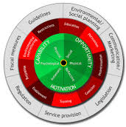
Background
Established by HEE: to build on workforce redesign using psychology and behaviour change.
Integrating Health Psychology trainees: to test impact and effectiveness.
Evidence-based Tools: Applying proven tools for sustainable behaviour change.
Using the COM-B model and Behaviour Change Wheel for redesign.
Building Capacity: Expanding regional behavioural science expertise.
Notes:
Established by HEE: Building workforce redesign capability and capacity using psychology of the system and behaviour change to benefit staff, patients, and organisations. E.g. by embedding effective new ways of working.
Embedding Health Psychology: Integrating health psychology roles across organisations to test their impact and effectiveness.
Leveraging Health Psychologists’ Expertise: Utilising their knowledge and skills to embed new ways of working that improve health and care.
Evidence-based Tools: Applying proven tools to understand behaviour change and develop sustainable interventions.
Build Capacity in Behavioural Science: Expanding regional capabilities in behavioural science methods and practices.
Apply Behavioural Science: Trainees will use the COM-B model and Behaviour Change Wheel to support workforce redesign programmes (Michie et al 2011).
This includes working with health care teams to understand which practices are a priority for change, which behaviours they are finding difficult to change, and why.

Slide 13



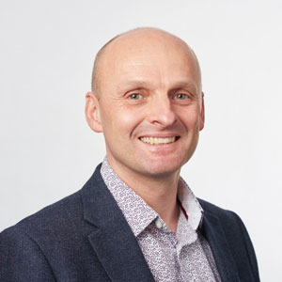


The steering board
Prof Lucie Byrne-Davis, Professor of Health Psychology, University of Manchester & Chair of the Division of Health Psychology of the British Psychological Society
Prof Jo Hart, Professor of Health Professional Education, University of Manchester
Prof Angel Chater, Professor of Health Psychology and Behaviour Change, University of Bedfordshire
Dr Adrian Whittington, National Lead for Psychological Professions, NHSE and I
Lucy Renwick, Workforce Transformation Lead, Innovation and Transformation Directorate, HEE
Dr Elizabeth Jenkinson, National Training Director for Health Psychology in Workforce Redesign, University of the West of England
Notes:
Thinking of just mentioning that I have a slide with the steering board members on if anyone wants a copy then they can email me, rather than talking about this or showing it as I don’t have time

Slide 14
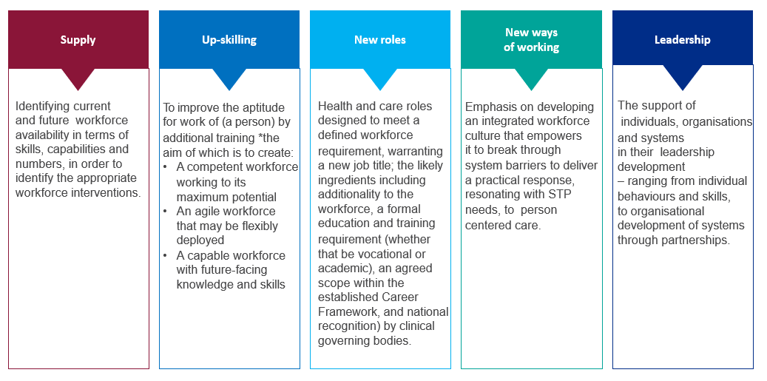
What do we mean by workforce redesign?
“Transformation is a process of profound and radical change, that takes an organisation in a new direction and to an entirely different level of effectiveness”.

Slide 15


My QHP Qualification
Meet 5 competencies:
Professional skills
Research
Psychological interventions
Consultancy
Teaching and Training
Two years full-time working for Derbyshire Community Health Services NHS Foundation Trust.
Focus on Workforce Transformation and Redesign.
My supervisors:
Co-ordinating supervisor –
Dr Eleanor Bull (Principal Health Psychologist)
Workplace supervisor – Dr Jo Hall (Principal Clinical Psychologist)

Slide 16
The value DCHS saw in a Trainee Health Psychologist
To support the development of the Health Psychology profession.
To gain from the expertise and experience of a trainee health psychologist.
To learn about the experience of hosting a trainee health psychologist.
To learn more about the value of a Health Psychology trainee.
To play our part in expanding the psychological workforce.
To benefit the NHS workforce through additional psychological capacity.

Slide 17
My Competency Work Summary
Research
Psychological interventions
Consultancy
Teaching and Training
Quality Conversations Training Programme
QC masterclasses
Reflective Practice sessions
Behaviour change training
Systematic review:
Menopause.
Effectiveness of workplace interventions.
Individual client:
Resolve counselling service.
Empirical research project:
Financial concerns health and social care staff.
Group:
Menopause.
Looking after your health and wellbeing.
Talking to important people in your life.
Notes:
Systematic review
Effectiveness of workplace interventions for people experiencing the menopause, their colleagues and managers.
42% currently affected by the menopause.
60% said it had impacted on their work.
Empirical research project:
Financial concerns in health and social care staff.
Quantitative - health needs assessment survey.
Qualitative - semi-structured interviews.
4 in 5 told us they are very or somewhat worried about the rising cost of living
1 in 3 told us they have current financial concerns

Slide 18




Beyond the training course:
Supporting Integrated Care System staff to implement Quality Conversation skills into their practice.
How to ask q
Notes:
My consultancy and part of my Teaching and training

Slide 19

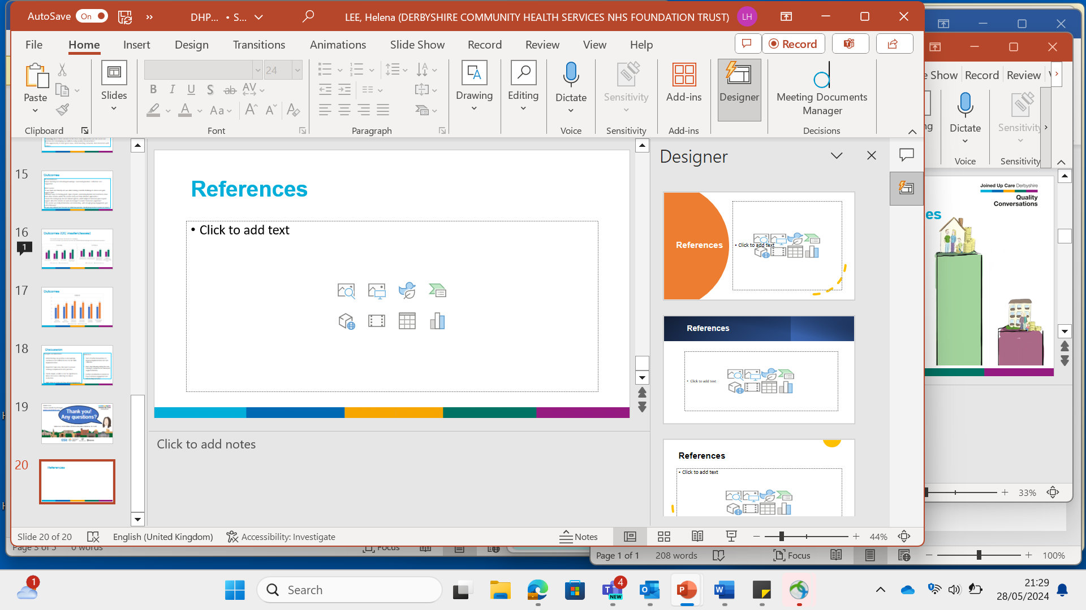
Quality Conversations:
QC is training to support effective conversations.
Derbyshire’s version of Making Every Contact Count.
Focused on reducing health inequalities and health literacy barriers.
Improve access and effectiveness of healthcare.
2082 attendees (over 4 years)
8 organisations/sectors within ICS
NHS trusts, Councils, Primary care, voluntary, community and social enterprise sector.
One three-hour online training session.
Spotlight session – behaviour change, mental health, self-management, leaders and health literacy.

Slide 20

Background and rationale:
Implementation gap: learners struggle to implement Continuing Professional Development course material into practice (Cook et al, 2019).
Healthcare professionals (HCPs) did not deliver behaviour change interventions on 50% of occasions they perceived a need (Keyworth et al, 2018).
Barriers to implementing Making Every Contact Count (MECC):
Lack of - time, training, confidence, evidence of effectiveness and perception of it being someone else’s responsibility (Haighton et al, 2021).
Environmental context & resources, beliefs about capabilities & consequences, knowledge, intentions, skills, social professional role and identity, emotions (Haighton et al, 2021).
Behavioural science improves the effectiveness of interventions (Michie et al, 2011)..
Notes:
Implementation gap: learners struggle to implement Continuing Professional Development course material into practice (Cook et al, 2019).
Healthcare professionals (HCPs) did not deliver behaviour change interventions on 50% of occasions they perceived a need (Keyworth et al, 2018).

Slide 21
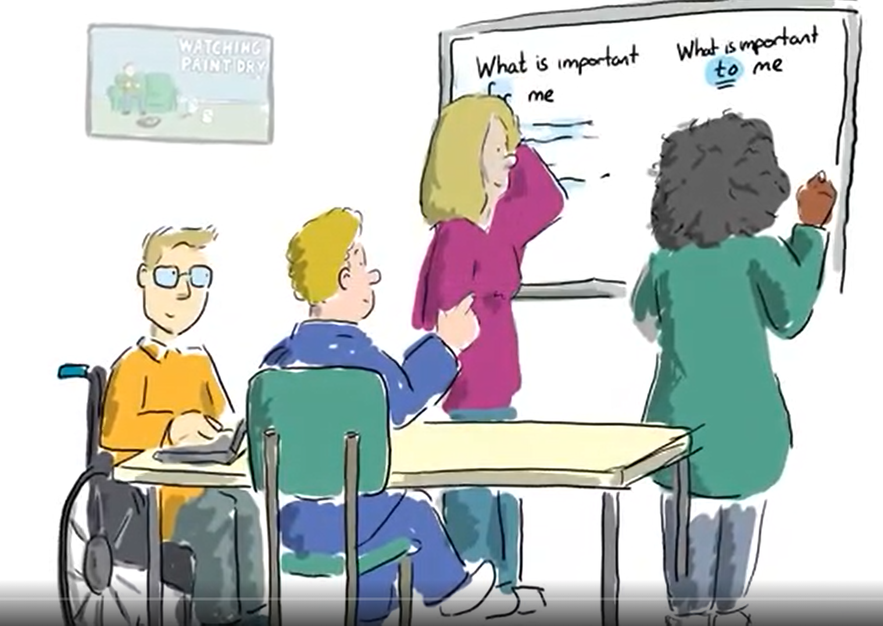
Methods:
Purpose:
To support learners to implement their learning into practice.
Two post-course interventions:
Quality Conversations Masterclasses
Training for the peer coach network

Slide 22
Quality Conversation masterclasses:
Shared group learning/ reflective practice.
Focused on a key skill or area.
Sessions open to all JUCD staff who have attended the core training at least 4 weeks before.
Bespoke sessions for specific services on request.
Skill recap
Strengths
Real challenging scenario
Group problem-solving
19 attended open session
97 attended QC masterclass
8 organisations/sectors within JUCD
78 attended a service specific session

Slide 23

Peer coaches:
75 Peer coaches
Supportive network of QC champions.
Ideally 1-2 people per team.
Resources with bitesize learning on.
Introduction to behaviour change training.
Lunch and learn session resources to facilitate QC masterclass style sessions with their own teams.
Notes:
This was to create a sustainable intervention.
Participants wanted the MECC approach integrated within staff culture and not viewed as an add-on, so that infrastructure would be created to support it (Chisholm et al, 2018).

Slide 24
COM-B | Peer coaches | QC masterclasses
Social opportunity | Making using QC the social norm Social Professional Role and Identity, Beliefs about capabilities and consequences
Physical opportunity | Learning how to implement QC in different situations Beliefs about capabilities and consequences, Knowledge, skills
Psychological capability | Increasing knowledge and upskilling Knowledge, Skills
Automatic motivation | Reminders to help make using QC skills a habit Environmental context and resources
Reflective motivation | Understanding how to apply, and the impact of, QC techniques Beliefs about capabilities and consequences, Knowledge, Intentions
(Michie et al, 2011)

Slide 25

Feedback collection methods:
Peer coaches:
Qualitative feedback gathered by questionnaires and emails and analysed through content analysis.
QC masterclasses:
Quantitative feedback on knowledge, confidence and COM-B measures (rated 1-5) (Keyworth et al, 2020).
Qualitative feedback on their experiences of the training. Pre (N=40), post (N=23) and 6-weeks delay post-session (N=5) feedback.

Slide 26
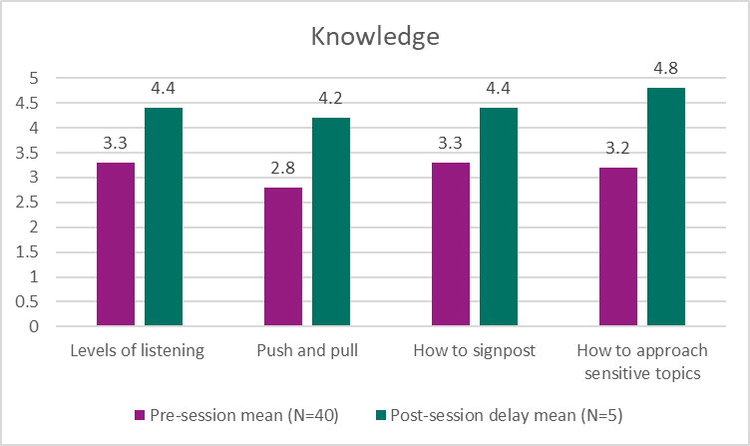
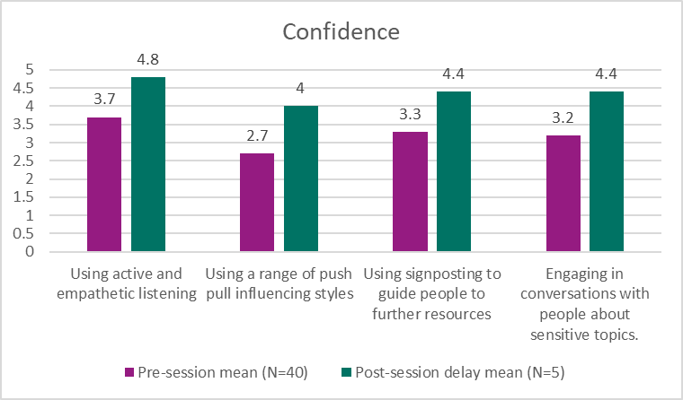
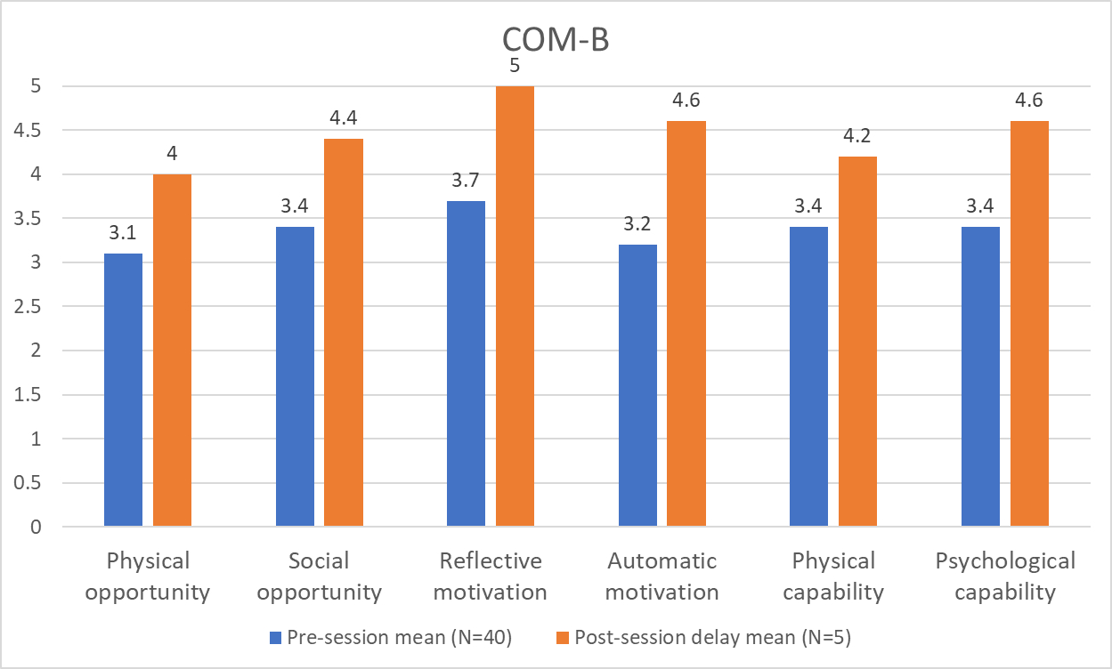
Findings:
QC masterclasses:
‘learning & refreshing knowledge’, ‘overcoming barriers’, ‘reflection’,
‘supportive’.
Peer coaches:
‘networking’, ‘learning about other services’ ‘sharing best practice’ ‘reflecting to improve’.
QC masterclasses:
Notes:
Direct quotes:
“It was open and friendly and was able to bring a real life challenge to discuss and gain support with.”
“Different ways of creating goals, types of goals, overcoming barriers and resistance, ideas from other services within the session today and their different approaches.”
“I loved the small group size and relaxed agenda, which helped it feel more peer-to-peer support. Also that cameras on were encouraged to make it feel more supportive.”
“The session was really informative, and interesting , with enough group engagement, got useful takeaway.”
“It was very relaxed and focused on reflective practice. Small group made it easier on teams.”
Direct quotes:
“Refreshes me on coaching skills learnt and makes me reflect on recent communications and practice being better.”
“Learning about other services in the trust, new approaches we can use in our practise and developing our skills in using quality conversations.”
“The opportunity to hear good news, share learning, network, feel connected with others.”

Slide 27

Discussion:
Strengths:
Initial findings are positive.
Important topic area.
ICS reflective sessions allowed for sharing of knowledge and experiences & improved links for partnership working.
Limitations:
More data needs collecting for robust evaluation.
High drop-out rates and low virtual engagement.
ICS training did pose challenges in some sessions as attendees' area of work differed greatly.
Notes:
Strengths:
Initial findings are positive on knowledge, confidence and COM-B factors for QC skills implementation.
Important topic area. We need to ensure training is implemented into practice.
ICS training allowed for networking, sharing of knowledge and experiences and improved links for partnership working.
Limitations:
Small sample, unable to test for significance. More data needs collecting for robust evaluation.
High drop-out rates and low virtual engagement.
ICS training did pose challenges in some sessions as attendees' area of work differed greatly.
Reflections:
Start of further interventions to improve implementation and data collection.
Further consideration is needed on how to increase engagement and reduce drop-out rates.
Training across an ICS can have challenges from a facilitation perspective but many benefits for learners

Slide 28
Reflections on the training programme
Strengths
Challenges
Flexible remit allows shaping placement around service needs and trainee strengths/ areas of development.
Longer placement helps the trainee integrate into the team fully.
Easy to match the 5 competencies with work opportunities.
Useful to have an academic lead for the trainee separate from the placement lead.
Team valued their additional colleague for the 2-year period, with their range of adaptable skills in teaching, training, and service development.
Unclear how much placement time should be allocated to write-ups, especially for service-benefiting assignments.
Challenge keeping academic tasks active in a fast-paced NHS environment.
Difficult to retain trainees post-course due to lack of workforce redesign roles for psychologists within the NHS.

Slide 29

Helena Lee
Trainee Health Psychologist
Helena.lee16@nhs.net
Thank you!
Any questions?
How to ask q

Slide 30
References
Chisholm, A., Ang-Chen, P., Peters, S., Hart, J., & Beenstock, J. (2019). Public health practitioners’ views of the ‘Making Every Contact Count’initiative and standards for its evaluation. Journal of Public Health, 41(1), e70-e77.
Cook, C. R., Lyon, A. R., Locke, J., Waltz, T., & Powell, B. J. (2019). Adapting a compilation of implementation strategies to advance school-based implementation research and practice. Prevention Science, 20, 914-935.
Haighton, C., Newbury-Birch, D., Durlik, C., Sallis, A., Chadborn, T., Porter, L., Harling, M., & Rodrigues, A. (2021). Optimizing making every contact count (MECC) interventions: A strategic behavioral analysis. Health Psychology, 40(12), 960.
Keyworth, C., Epton, T., Goldthorpe, J., Calam, R., & Armitage, C. J. (2018). Are healthcare professionals delivering opportunistic behaviour change interventions? A multi-professional survey of engagement with public health policy. Implementation Science, 13, 1-9.
Keyworth, C., Epton, T., Goldthorpe, J., Calam, R., & Armitage, C. J. (2020). Acceptability, reliability, and validity of a brief measure of capabilities, opportunities, and motivations (“COM‐B”). British journal of health psychology, 25(3), 474-501.
Michie, S., Van Stralen, M. M., & West, R. (2011). The behaviour change wheel: a new method for characterising and designing behaviour change interventions. Implementation science, 6, 1-12.

Slide 31

Mentimeter
Please share your thoughts and feedback on Mentimeter
Go to www.menti.com and enter 3122 0550 or scan the QR code

Slide 32

Thank you for being part of
our PPN Midlands community
Stay connected with us
Email address – bsmhft.ppnmidlands@nhs.net
PPN Midlands fortnightly bulletin
Communities of Practice
National Psychological Professions Week
Details of Midlands sessions to follow soon!
Email: bsmhft.ppnmidlands@nhs.net Web: www.ppn.nhs.uk/midlands

Slide 33


