Slide 1

Psychological Professions Week 2024
Communication Pack
11 November 2024 – 15 November 2024
#PsychologicalProfessionsWeek2024
#PPWeek24

Slide 2
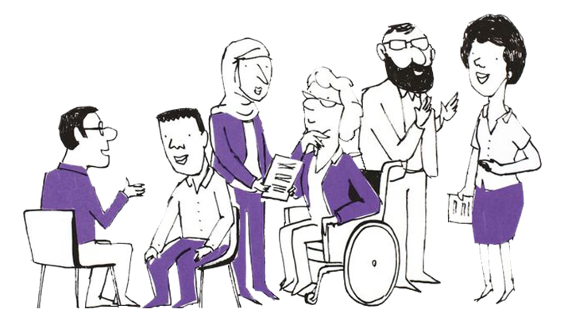
What are the Psychological Professions?
In England, the psychological professions are a group of professionals whose work is informed by psychology and psychological therapies. They work with people to alleviate psychological and emotional distress, to improve mental and physical health management and empower individuals and communities to improve their health and wellbeing.
The psychological professions include psychologists, psychological therapists and psychological practitioners.
Read more about the range of occupations Health Careers website and the PPN
Careers Map.
Our Vision
To transform lives and communities by embedding and developing
psychological knowledge and practice across the whole of health and care.
#PsychologicalProfessionsWeek2024
#PPWeek24

Slide 3
Background
The NHS Long Term Plan set out ambitious proposals to expand access to psychological therapies and interventions in England at a faster pace than ever before. Delivering this transformation required a ‘step-change’ in our workforce - expanding in numbers, but also investing in our staff and supporting them to work differently. The psychological professions workforce grew by 65 per cent between March 2020 and April 2024 in line with the NHS Long Term Plan ambitions
Building on this, the NHS Long-Term Workforce Plan (2023) outlines an ambition to continue to grow the psychological professions by a further 24,000-26,000 posts by 2037. This includes expansion of psychologists, psychological therapists and psychological practitioners across pathways and training, including 15,000 more psychological therapists and psychological practitioners from 2023/24 to 2025/26.
To drive and enable this ambition, NHS England (previously Health Education England) commissioned the Psychological Professions Networks (PPNs) nationally and across each of the 7 regions in England. The PPNs provide a joined-up voice for the psychological professions in workforce planning and development, and to support excellence in practice. Currently the PPNs have over 17,000 members.
On the second week of November since 2020, the PPNs have run events that demonstrate and promote the impact and value of the psychological professions during Psychological Professions Week.
#PsychologicalProfessionsWeek2024
#PPWeek24

Slide 4
Psychological Professions Week 2024 - Objectives
Raise awareness of the psychological professions, including careers in the psychological professions, opportunities and the workforce growth ambitions
Engage and encourage a diverse audience to attend the PPN regional webinars and events during 11-15 November 2024
Encourage physical and mental health services, education providers, professional bodies and other organisations to celebrate Psychological Professions Week by holding their own events and communications.
Increase membership of the PPNs
#PsychologicalProfessionsWeek2024
#PPWeek24

Slide 5
Psychological Professions Week 2024
- PPN Regional Events
PPN regional events are aimed at PPN members, the public and wider stakeholders so they can come together to celebrate the psychological professions. The sessions will be an opportunity to learn, engage, influence and drive strategic ambitions to develop the professional group for the benefit of patients and the public.
Throughout the week, PPN regionally led virtual and in-person events will be held.
Find out more and register for sessions: PPWeek24 Programme
For more information visit: www.ppn.nhs.uk
#PsychologicalProfessionsWeek2024
#PPWeek24

Slide 6
Psychological Professions Week 2024
Join in and be part of the movement for a more psychological NHS
Join us for Psychological Professions Week 2024! This year we are doing something different and are asking organisations, services, teams and individuals to develop and deliver local events and communications to celebrate the great work the psychological professions do in the NHS. There has never been a more important time to join this movement!
Please consider the following guidance for events and communications:
Align events and communications to the Vision for the Psychological Professions
Support the building of bridges between practitioners, policy, and the public
Recognise and support the unique and valuable contribution of all 21 psychological professions
Involve experts by experience in the design and delivery of events, alongside psychological professionals (and for regional and national events, NHSE colleagues)
Demonstrate the impact the Psychological Professions have on delivering high quality healthcare for patients, carers, and families
Promote the delivery of national policy and local innovation in ways that are in synergy
Encourage people to join the PPN to be part of the movement for a more psychological NHS.
#PsychologicalProfessionsWeek2024
#PPWeek24

Slide 7

Psychological Professions Vision for England
#PsychologicalProfessionsWeek2024
#PPWeek24

Slide 8
How to be part of PPWeek24
We need your help to encourage colleagues, organisations and partners to mark Psychological Professions Week 2024.
You can help to do this by:
Adding the PPWeek24 email signature image to yours during September to November inclusive
Using the PPWeek24 Teams backgrounds during October and November
Encourage people to join the PPN to be part of the movement for a more psychological NHS
Developing creative and authentic local content to promote Psychological Professions Week across your platforms
This can include profiling and telling the stories of psychological professionals, service users who have benefited from their services, sharing job and career opportunities that are available, creating blogs, posting on social media, developing local news stories, running virtual or face to face events.
#PsychologicalProfessionsWeek2024
#PPWeek24

Slide 9
How to be part of PPWeek24
You can help us do this by:
Sharing, via your channels, networks and social media, the details of Psychological Professions Week 2024, national webinar, regional events, local events, PPN website, key messages, communication assets and membership links.
Don’t forget to share your activity with us. You can also tag relevant regional PPN accounts on Twitter posts:
@PPNEngland @PPNEast @LondonPPN @PPNMidlands
@NEandY_PPN @NWPPN @se_ppn @swppn
Please use the hashtag #PPWeek24 or #PsychologicalProfessionsWeek2024 in all posts.
#PsychologicalProfessionsWeek2024
#PPWeek24

Slide 10
Key dates
02 September 2024 : Psychological Professions Week 2024 Communications Commence
30 September 2024: Registrations open for PPN Regional Events (PPWeek24 Programme) (please check individual event information)
4 November 2024: 'One week to go' communications
11 – 15 November 2024: Psychological Professions Week 2024!
#PsychologicalProfessionsWeek2024
#PPWeek24

Slide 11
Audience
Everyone is welcome to mark Psychological Professions Week 2024 across England and join the national webinar and PPN regional events!
Our audiences include:
Psychological professionals – qualified, training and aspiring
Experts by Experience and people with lived experience
Policymakers
Education, workforce and career leads and teams
NHS commissioned service providers
Members of the public interested in the psychological professions and NHS services.
#PsychologicalProfessionsWeek2024
#PPWeek24

Slide 12
Key messages
Psychological Professions Week 2024 is taking place 11-15 November 2024.
The week is led by the Psychological Professions Network and aims to celebrate the impact and highlight the potential of the psychological professions.
Join us in celebrating Psychological Professions Week 2024!
Add the Psychological Professions Week logo to your email signature and use the Teams backgrounds.
Encourage your organisations, services, team, and colleagues to develop and deliver local events and communications to celebrate the great work the psychological professions do in the NHS.
Register and attend one or more of the PPN regional sessions, and the national webinar.
View the PPN regional events programme and how to register at PPWeek24 Programme.
All PPN events are free for members!
It is FREE to become a member of Psychological Professions Network, visit www.ppn.nhs.uk. Join the PPN to be part of the movement for a more psychological NHS.
#PsychologicalProfessionsWeek2024
#PPWeek24

Slide 13
Assets
Using the link to the PPN website, you’ll find one central hub for all the Psychological Professions Week 2024 assets:
GIF
Logo
Social Card Template
Email signatures
Poster
Background Images
Communication Pack
#PsychologicalProfessionsWeek2024
#PPWeek24

Slide 14
Further information
For further information or queries, please contact your regional PPN.
PPN - England
PPN - East of England
PPN - London
PPN - Midlands
PPN - North East and Yorkshire
PPN - North West
PPN - South East
PPN - South West
If you require information about Psychological Professions Week 2024 or this communications pack, please contact your regional PPN.
#PsychologicalProfessionsWeek2024
#PPWeek24

