Slide 1


Psychological Professions Week 2023
Communication Pack
13 November 2023 – 17 November 2023
#PsychologicalProfessionsWeek2023
#PPWeek23

Slide 2
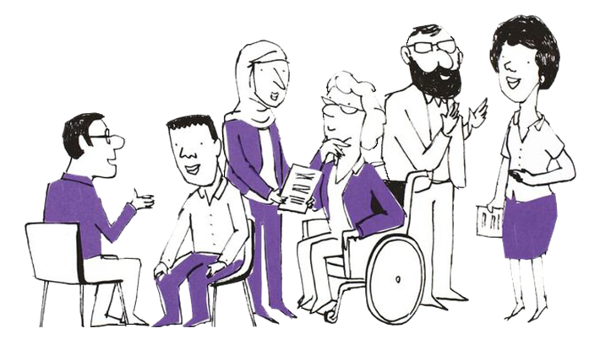
What are the Psychological Professions?
In England, the psychological professions are a group of professionals whose work is informed by psychological disciplines and therapies. They work with people to alleviate psychological and emotional distress, to improve mental and physical health management and empower individuals and communities to improve their health and wellbeing.
The psychological professions include psychologists, psychological therapists and psychological practitioners.
Read more about the range of occupations Health Careers website.
Our Vision
To transform lives and communities by embedding and developing
psychological knowledge across the whole of the health and care network.
#PsychologicalProfessionsWeek2023
#PPWeek23

Slide 3
Background
The NHS Long Term Plan sets out ambitious proposals to expand access to psychological therapies and interventions in England at a faster pace than ever before. Delivering this transformation will require a ‘step-change’ in our workforce - expanding in numbers, but also investing in our staff and supporting them to work differently. The psychological professions workforce alone will need to grow by at least 60 per cent between March 2020 and April 2024.
Building on this, the NHS Long-Term Workforce Plan (2023) outlines a proposal to continue to grow the psychological professions by a further 24,000-26,000 posts by 2037. This includes expansion of psychologists, psychological therapists and psychological practitioners across pathways and training, and finally, 15,000 more psychological therapists and psychological practitioners over the next 3 years.
To drive and enable this ambition, NHS England (previously Health Education England) commissioned Psychological Professions Networks (PPNs) nationally and across each of the 7 regions in England. The PPNs provide a joined-up voice for the psychological professions in workforce planning and development, and to support excellence in practice. Currently the PPNs have over 13,700 members.
On the second week of November since 2020, the PPNs have shared the impact and value of the psychological professions during Psychological Professions Week.
#PsychologicalProfessionsWeek2023
#PPWeek23

Slide 4
Psychological Professions Week 2023 - Objectives
Raise awareness of the psychological professions, including careers in the psychological professions, opportunities and the workforce growth ambitions
Engage and encourage a diverse audience to attend the PPN national conference in-person event and regional events during 13-17 November 2023
Increase membership of the PPNs
Encourage physical and mental health service organisations, education providers, professional bodies and organisations to celebrate Psychological Professions Week by holding their own events and communications.
#PsychologicalProfessionsWeek2023
#PPWeek23

Slide 5
Psychological Professions Week 2023
- 4th Annual PPN Conference
During the week, a one-day in-person national conference event will be held in London on Wednesday 15 November 2023.
The event is focussed on ‘Unite, Inspire, and Transform: integrating psychologically informed practice into physical health and care.’
Location: Holiday Inn London – Bloomsbury, Coram St, London WC1N 1HT
Time: 15 November 2023 10:00am - 4:00pm (registration and coffee from 9.:30am)
Purpose: To unite professionals, policymakers and experts by experience, to share knowledge, foster strategic leadership and influence systems change and to inspire a collective effort to transform physical health and care through integration of psychological practice.
We invite: PPN members and wider stakeholders interested and/or involved in influencing strategic change to integrate psychological practice in physical health and care.
#PsychologicalProfessionsWeek2023
#PPWeek23

Slide 6
Psychological Professions Week 2023
- 4th Annual PPN Conference
The programme is designed around the core themes of ‘Unite, Inspire, and Transform’, which aim to advance the vision of making all health and care psychological.
What to Expect:
Strategic Leadership: the vital leadership role of psychological professions in driving the shift towards integrated care, in alignment with the NHS England Major Conditions Strategy and PPN England's Discussion Paper.
Systems Change: Gain insights into real-world experiences as colleagues share their journeys, navigating challenges, celebrate successes and innovation in the integration of psychological practices into physical health.
Collective Influence: engage in discussions on how the psychological professions can collaboratively inform and shape the future, making a collective impact through our respective roles and areas of expertise.
Register at: Psychological Professions Week 2023 In-person Conference
For more information visit: www.ppn.nhs.uk
#PsychologicalProfessionsWeek2023
#PPWeek23
Notes:
¹Please note that our program is still in development and more details about the sessions and speakers will be coming soon.

Slide 7
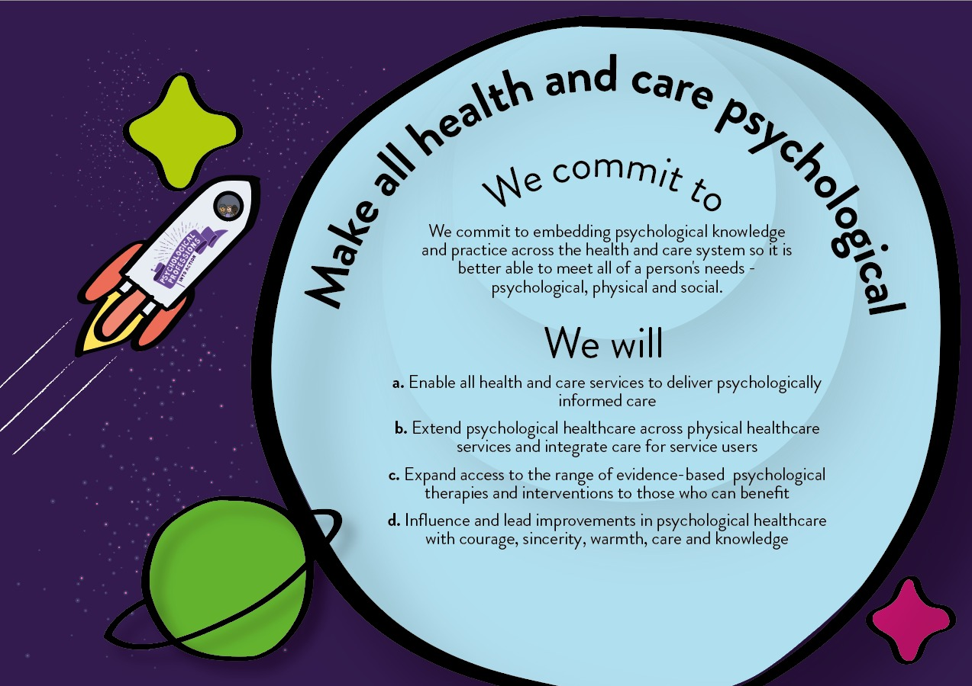
Psychological Professions Vision for England 2019-24
#PsychologicalProfessionsWeek2023
#PPWeek23

Slide 8
Psychological Professions Week 2023
- PPN Regional Events
PPN regional events are aimed at PPN members, the public and wider stakeholders so they can come together to celebrate the psychological professions. The sessions will be an opportunity to learn, engage, influence and drive strategic ambitions to develop the professional group for the benefit of patients and the public. Throughout the week, 16 PPN regionally led virtual and in-person events will be held and topics will include:
The Growth of the Psychological Professions and Implications for the Future
Shifting the Profile of our Workforce – supporting aspiring psychologists
Equality, Diversity and Inclusion focussed events
Psychological Professions Integrated Care Systems Workforce Leads events
Psychological Professions Communities of Practice led events
Psychological Professions and physical health focussed events
Psychological Skills Transfer: an approach to optimise learning implementation.
Find out more and register for sessions: PPWeek23 Programme For more information visit: www.ppn.nhs.uk
#PsychologicalProfessionsWeek2023
#PPWeek23

Slide 9
Key dates
25 September 2023 : Psychological Professions Week 2023 Communications Commence
9 October 2023: Registrations open for PPN Regional Events and PPN National In-person Conference (PPWeek23 Programme)
6 November 2023: 'One week to go' communications
13 – 17 November 2023: Psychological Professions Week 2023!
#PsychologicalProfessionsWeek2023
#PPWeek23

Slide 10
Audience
Everyone is welcome to mark Psychological Professions Week 2023 across England and join the PPNs 4th annual conference and regional events!
Our audiences include:
Psychological professionals – qualified, training and aspiring
Experts by Experience and people with lived experience
Policymakers
Education, workforce and career leads and teams
NHS commissioned service providers
Members of the public interested in the psychological professions and NHS services.
#PsychologicalProfessionsWeek2023
#PPWeek23

Slide 11
How to help?
We need your help to encourage colleagues, organisations and partners to mark Psychological Professions Week 2023.
You can help us do this by:
Developing creative and authentic local content to promote Psychological Professions Week across your platforms.
This can include profiling and telling the stories of psychological professionals, service users who have benefited from their services, sharing job and career opportunities that are available, creating blogs, posting on social media, developing local news stories, running virtual or face to face celebratory events.
#PsychologicalProfessionsWeek2023
#PPWeek23

Slide 12
How to help?
You can help us do this by:
Sharing, via your channels, networks and social media, the details of Psychological Professions Week 2023, regional events, PPN websites, key messages, communication assets and membership links.
Don’t forget to share your activity and celebrations with us. You can also tag relevant regional PPN accounts on Twitter posts:
@PPNEngland @PPNEast @LondonPPN @PPNMidlands
@NEandY_PPN @NWPPN @se_ppn @swppn
Please use the hashtag #PPWeek23 or #PsychologicalProfessionsWeek2023 in all posts.
#PsychologicalProfessionsWeek2023
#PPWeek23

Slide 13
Key messages
Psychological Professions Week 2023 is taking place 13-17 November 2023
The week is led by the Psychological Professions Network and aims to celebrate the impact and highlight the potential of the psychological professions.
Join in Psychological Professions Week 2023 by attending one or more of the PPN regional sessions, a local event, or organise an activity to mark the week locally.
View the PPN regional events programme and how to register at PPWeek23 Programme
The PPN National Conference will be held in-person in London on Wednesday 15 November 2023.
The theme is ‘Unite, Inspire, and Transform: integrating psychologically informed practice into physical health and care.’
Register at Psychological Professions Week 2023 In-person Conference
All PPN events are free!
It is FREE to become a member of Psychological Professions Network, visit www.ppn.nhs.uk.
#PsychologicalProfessionsWeek2023
#PPWeek23

Slide 14
Assets
Using the link to the PPN website, you’ll find one central hub for all the Psychological Professions Week 2023 assets:
GIF
Logo
Social Card Quote Templates
Email signatures
Poster
Copy
#PsychologicalProfessionsWeek2023
#PPWeek23

Slide 15
Further information
For further information or queries, please contact your regional PPN.
PPN - England
PPN - East of England
PPN - London
PPN - Midlands
PPN - North East and Yorkshire
PPN - North West
PPN - South East
PPN - South West
If you require information about Psychological Professions Week 2023, or this communications pack, please contact spnt.ppnengland@nhs.net.
#PsychologicalProfessionsWeek2023
#PPWeek23

