Slide 1

Integrating employment advisors into an IAPT service: Local example in north Cumbria
Phil Salmon
Senior Employment Advisor
Richard Thwaites
CBT Therapist/ Consultant Clinical Psychologist

Slide 2
History from 2018
£47.7 million invested in 40% of IAPT services to evaluate combined employment support and psychological therapy;
Project led by Work & Health Unit (WHU) sponsored by Dept of Health and Social Care ( DHSC) & Department for Work and Pensions (DWP);
Funding initially allocated for 3 years (April 2018 to March 2021)

Slide 3
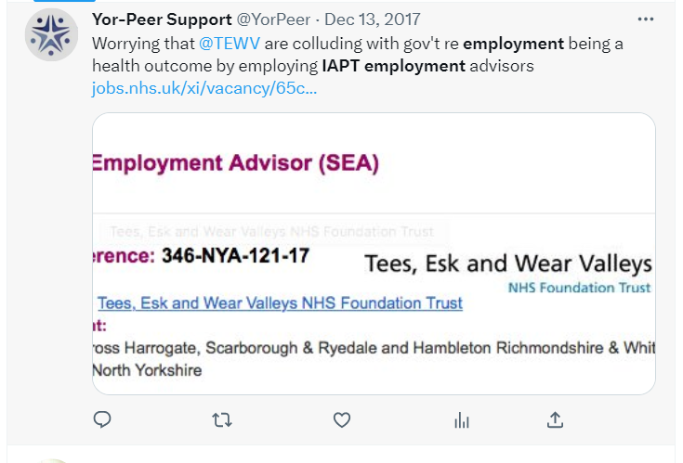
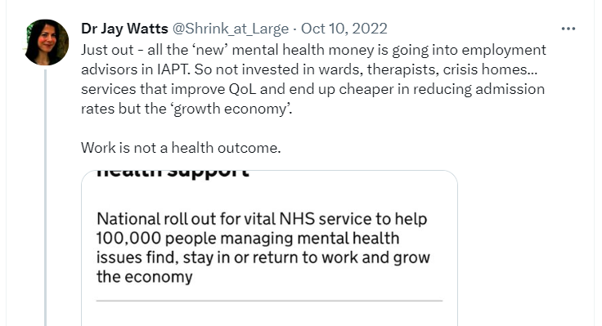
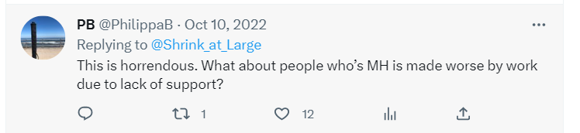
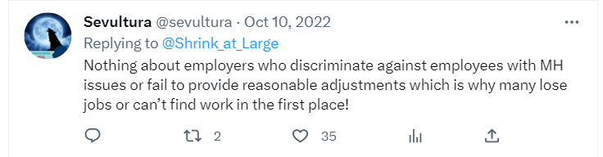
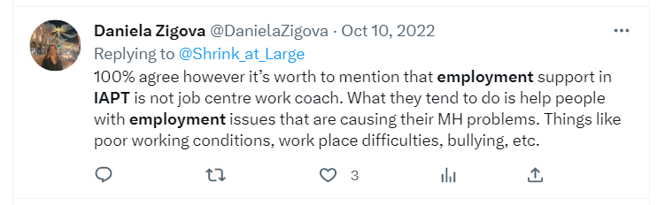
Attitudes towards integrated employment advisors

Slide 4
Our stance
It is not for any member of our staff to tell a patient what their goals or aimed for ‘health outcomes’ are
Patient can choose to have goals that include getting a job, staying in work, leaving work, getting a new job. It is all their choice. They can choose to not discuss work.
If they want to access an EA, they can, if they don’t want to they don’t need to.
In IAPT since the start, we have always seen some people who want support to get a first job or want help to stay in their job or want to get a different job that pays them more.
Integrated EA is not some form of neoliberal state campaign of control in our service! But our job is to help our patients make the changes they choose to make, and for many of those they want to think about where they work or want to earn more money to support their family. We haven’t got the luxury of seeing this as a philosophical debate as some do.

Slide 5
What do Employment advisors offer?
Personalised and tailored support responsive to the individual’s employment situation.
Focus on helping people Find Work, Retain Work and Return to Work.
Flexible approach, often more than one KPO is being worked on at a time (e.g. looking for a new job whilst working to improve current job conditions).
Timely support throughout period of clinical involvement with First Step clinician.

Slide 6
What does this help look like?
First EA session is information gathering – what’s the person’s situation and what are their employment goals.
Work together to develop action plan – short term and longer term goals.
Job search may include support to write/improve CV, learning to use job search sites, exploring transferable skills and alternative career options.
Job retention may involve EA making contact with the person’s manager/employer, coaching person to prepare for meetings, attending meetings with patient, providing advice around rights and responsibilities, signposting to legal advice if required.
Returning to work can involve supporting person to negotiate terms around returning to work, details of phased return, reasonable adjustments, potential changes to role if appropriate.

Slide 7
Outcomes to date
2368 referrals to EAs since March 2019.
43% of discharged patients achieved KPOs and Positive Outcomes
33% of those are New Job Outcomes
16% Retained Job
16% Returned to Work
33% Other positive outcomes (e.g. further education, training, voluntary work).

Slide 8
Key learning from our service
Staff will have varying attitudes towards EA integration. Some of our most sceptical therapists are now our biggest referrers and now see the role as fundamental to the service.
The more thoroughly embedded in the team the EAs are, the better the integration.
We involve EAs in wider team meetings, champion roles and relevant training opportunities as well as working out of the same clinical and administrative work sites.
Communication is key – allowing open and frequent discussion between EAs and clinical staff supports better patient care and coordinated input.
Repetition – clinical staff are extremely busy and it’s useful to repeat information, share good news stories etc to stay on their radar.

Slide 9
Case study
Patient working full time but disliked job and wanted to find another role.
Patient felt that they were being singled out and discriminated against at work.
On further exploration it seemed that the employer wasn’t acting unfairly.
Patient was interpreting innocuous actions as personal attacks.
Discussed regularly with Therapist who had observed same.
Therapist provided psychological input around reframing work interactions, EA was able to reinforce this from an employment perspective.
Patient’s perception of work improved and they ended up staying in the role.
Key point: EA and HI regular communication improved outcome for patient’s MH and work situation.

Slide 10
FEEDBACK
The help, support and guidance that I received from XX during my issues with my previous employer, and with finding my current position, has been greatly appreciated. XX has a great listening ear and would always be interested in what I was informing him about.
Both the therapist and the employment advisor provided invaluable support during what was a very difficult and stressful period in my working life. I would like to extend my thanks to them both for all the support and assistance provided during that time.
Having a conversation about my personal and professional situation with a impartial person was key to my recovery. This person had patience, empathy and listening skills and offered coherent advice to support my well being.
After 11 years in post just looking for other work was daunting, my adviser made it easier to cope with applying for jobs and always showed interest in my applications, thank you.
I would like to let you know that I feel extremely grateful with the given opportunity of having been accompanied by two great professionals all throughout this period when things felt really gloomy. I am still working with the EA advisor who with her excellent and formidable knowledge is orientating me towards new horizons.
I cannot fault the help, support, advice and listening skills of both my therapist and employment advisor. They have helped me come out of a toxic environment and turned my life around. Absolute credit to your organisation and the NHS. A big big thank you from the bottom of my heart to them both and your service.

Slide 11
Key considerations
Consider factors influencing recruitment and retention of Employment Advisors
What would full integration look like in your service?
Plans for shared care pathway on patient information systems?
How are you going to share clinical risk info and manage it?

