Slide 1


The Oliver McGowan Mandatory Training in Learning Disability and Autism Programme 2022/23

Slide 2
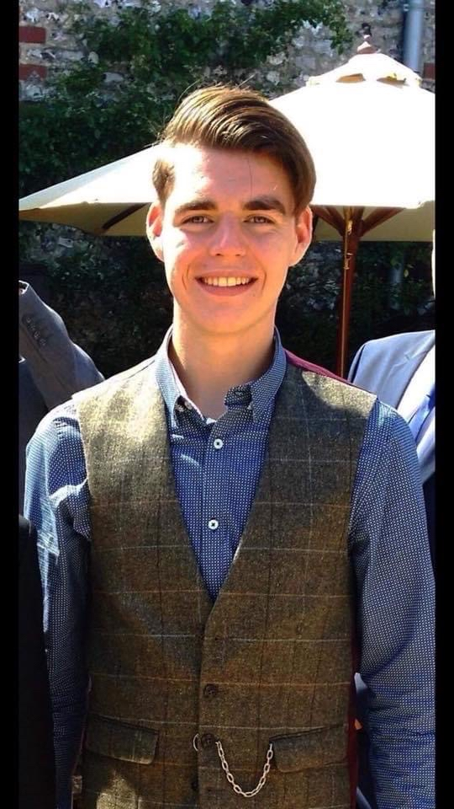
Oliver’s Campaign
Paula McGowan OBE, Oliver’s Mother
#OliversCampaign

Slide 3
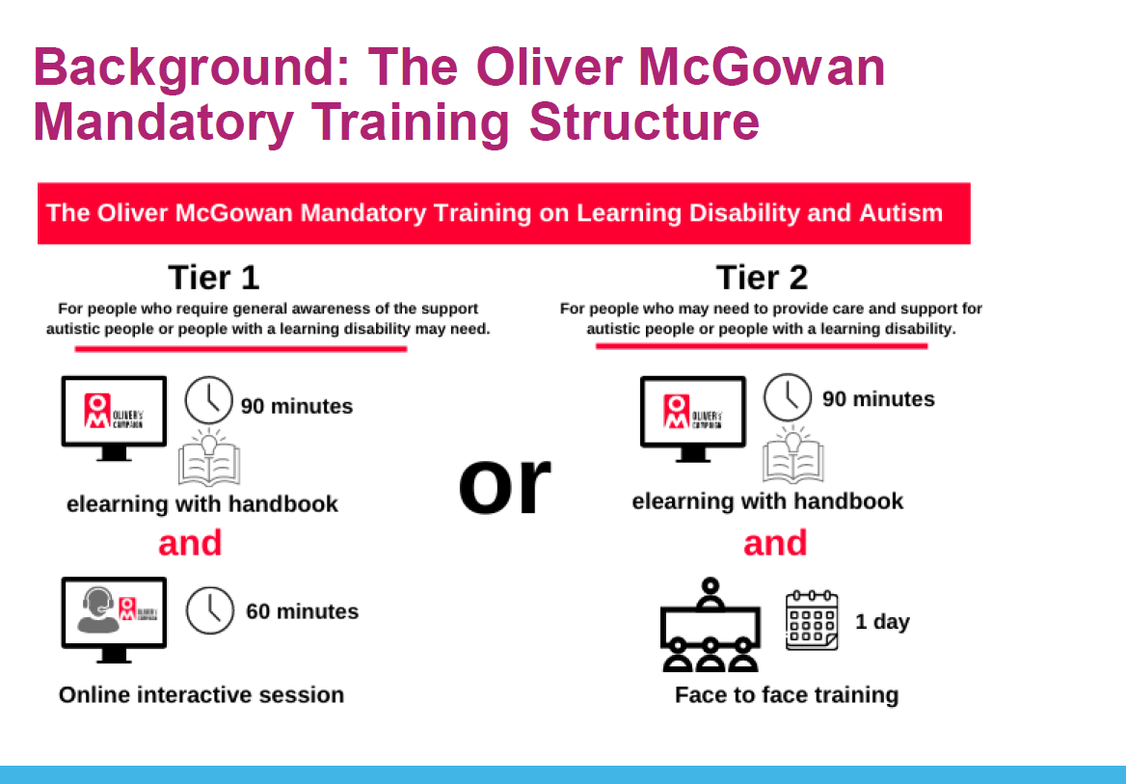

Slide 4
North West
Year 1 Delivery Model
Building Capacity within all three ICBs
Investment in System coordination within each ICB
7 providers have been identified for year 1. Collaborative and dispersed plans encouraged:
GM ICB - Wrightington, Wigan and Leigh Teaching Hospitals NHS Foundation Trust
GM ICB - The Breightmet Centre for Autism
C&M ICB - Liverpool Heart and Chest Hospital NHS Foundation Trust
C&M ICB - Wirral Community NHS Foundation Trust
L&SC ICB- Lancashire & South Cumbria NHS Foundation Trust
L&SC ICB - L&SC Primary Care Training Hub
NWAS
This approach will enable us to build capacity to deliver Oliver's training across the breath of services across the northwest
#OliversCampaign

Slide 5

Actions and next steps
Phase 1 fully in Delivery phase
Continuation of Project Delivery Groups & Regional Steering Group.
Onboarding new ICB leads.
Awaiting Funding for 23/24
Launch of scoping for 23/24 based on a hybrid approach for Phase 2
#OliversCampaign

Slide 6

Close
#OliversCampaign

