Slide 1

NICE Guidelines for Depression
Talking Therapies Leadership and Innovation Spring Forum 2023
Edward Watkins, PhD
e.r.watkins@exeter.ac.uk

Slide 2
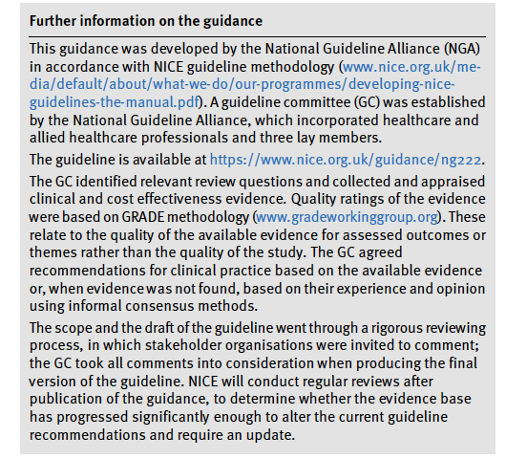
NICE GUIDELINES FOR DEPRESSION 2022 PROCESS
Practical guidance & summary at:
https://cks.nice.org.uk/topics/depression/.
Guideline at https://www.nice.org.uk/guidance/ng222
A priori questions determined at start, literature reviews conducted to find relevant clinical trials, examined in pairwise, network meta-analyses, health economic analyses and interpreted in light of clinical expertise

Slide 3
New classification into less severe and more severe depression to reduce ambiguity in clinical decisions
More severe = severe and moderate depression (as an indicator, PHQ-9>=16)
Less severe = mild and sub-threshold depression (as an indicator, PHQ9<16)
Notes:
Here focus on elements related to talking therapies

Slide 4
REVIEW QUESTIONS
For adults with a new episode of (a) less severe / (b) more severe depression, what are the relative benefits and harms of psychological, psychosocial, pharmacological and physical interventions alone or in combination? [not just first episode, less severe, 142 RCTs, n=20,633; more severe, 534 RCTs, n = 89,286]
For adults whose depression has responded to treatment, what are the relative benefits and harms of psychological, psychosocial, pharmacological and physical interventions for preventing relapse (including maintenance treatment)?
What are the relative benefits and harms of further-line psychological, psychosocial, pharmacological and physical interventions (alone or in combination), for adults with depression showing an inadequate response to at least one previous intervention for the current episode?
For adults with chronic depression or persistent subthreshold depression symptoms what are the relative benefits and harms of first-line treatment or relapse prevention with psychological, psychosocial, pharmacological and physical interventions (alone or in combination)?

Slide 5
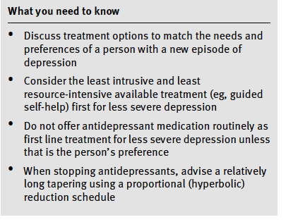
KEY RECOMMENDATIONS NICE GUIDELINES FOR DEPRESSION 2022

Slide 6
NICE GUIDELINES FOR DEPRESSION 2022 REVIEW QUESTIONS
For adults with a new episode of (a) less severe / (b) more severe depression, what are the relative benefits and harms of psychological, psychosocial, pharmacological and physical interventions alone or in combination? [not just first episode, less severe, 142 RCTs, n=20,633; more severe, 534 RCTs, n = 89,286]
For adults whose depression has responded to treatment, what are the relative benefits and harms of psychological, psychosocial, pharmacological and physical interventions for preventing relapse (including maintenance treatment)?
What are the relative benefits and harms of further-line psychological, psychosocial, pharmacological and physical interventions (alone or in combination), for adults with depression showing an inadequate response to at least one previous intervention for the current episode?
For adults with chronic depression or persistent subthreshold depression symptoms what are the relative benefits and harms of first-line treatment or relapse prevention with psychological, psychosocial, pharmacological and physical interventions (alone or in combination)?

Slide 7
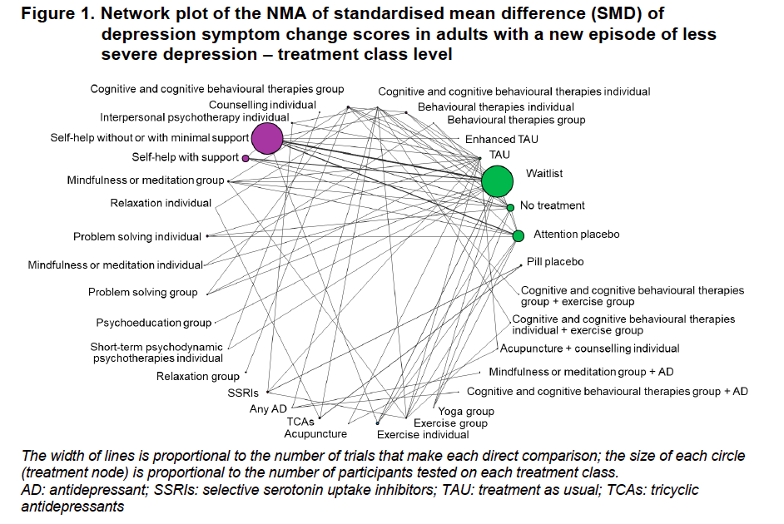

Slide 8
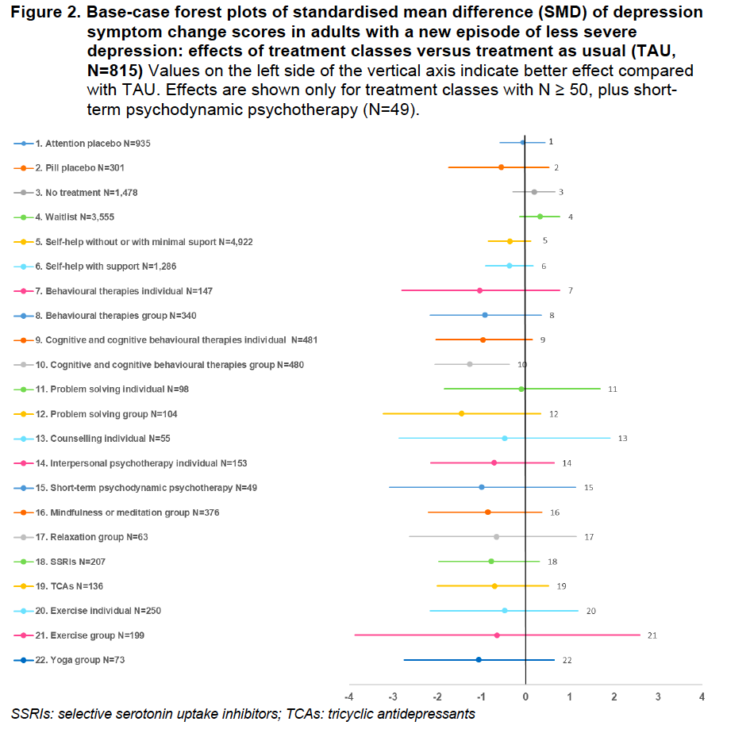

Slide 9
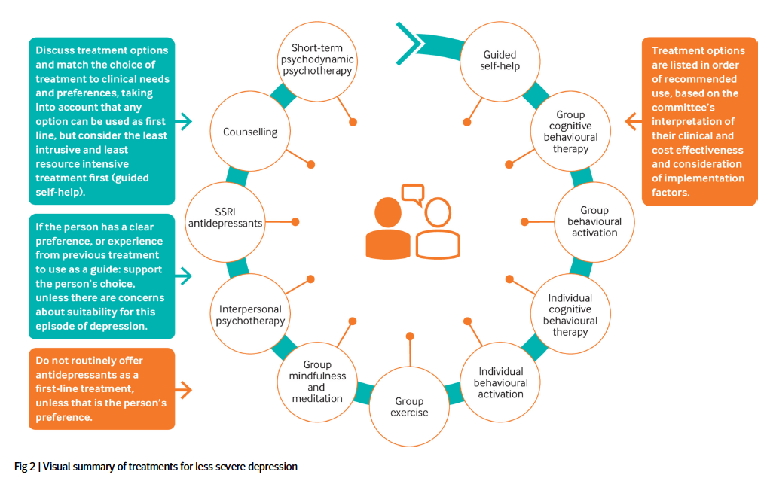
KEY RECOMMENDATIONS FOR LESS SEVERE DEPRESSION
For information about treatment options please refer to NICE’s guideline on depression in adults, table 1

Slide 10
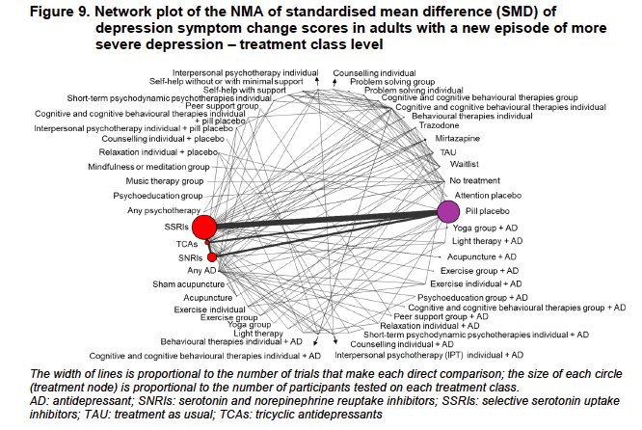

Slide 11
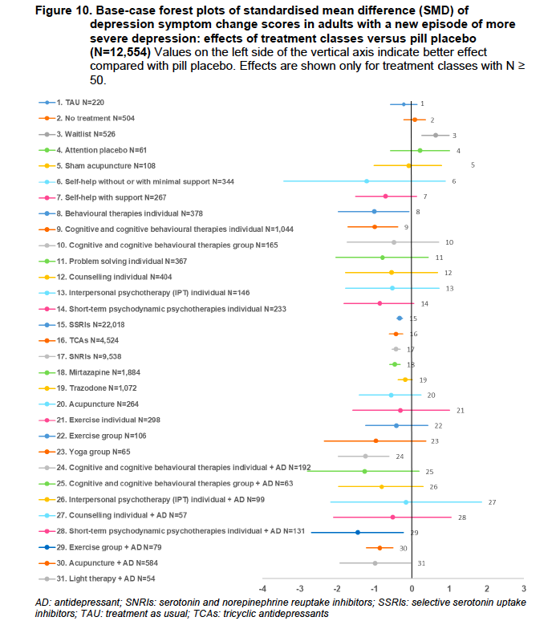

Slide 12
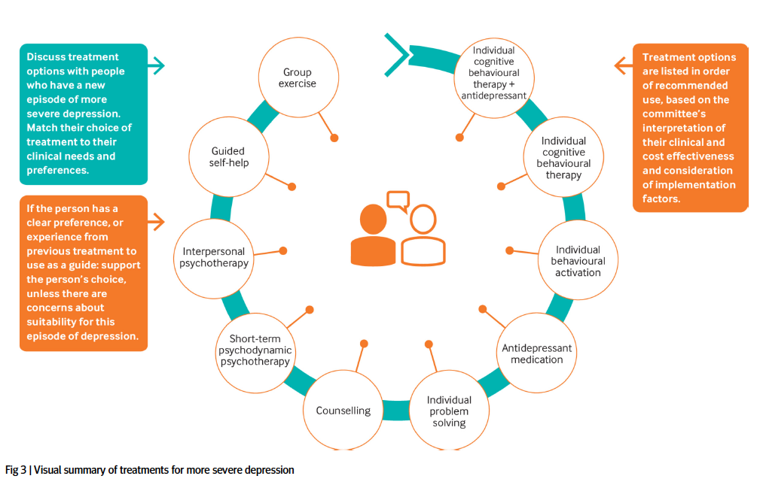
KEY RECOMMENDATIONS FOR MORE SEVERE DEPRESSION
For information about treatment options please refer to NICE’s guideline on depression in adults, table 2

Slide 13
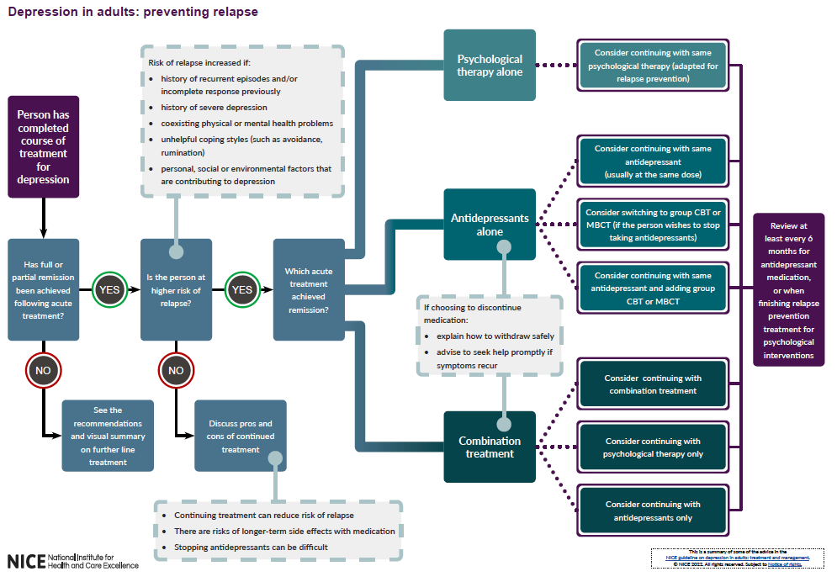
KEY RECOMMENDATIONS FOR RELAPSE PREVENTION
>= 4 sessions with relapse prevention component
8 sessions over 2-3 months, option of more in next 12 months

Slide 14
1.8.7 Relapse prevention components include:
reviewing what lessons and insights were learnt in therapy and what was helpful in therapy
making concrete plans to maintain progress beyond the end of therapy including plans to consolidate any changes made to stay well and to continue to practice useful strategies
identifying stressful circumstances, triggering events, warning signs (such as anxiety or poor sleep), or unhelpful behaviours (such as avoidance or rumination) that have preceded worsening of symptoms and personal or social functioning, and making detailed contingency plans of what to do if each of these re-occur
making plans for any anticipated challenging events over the next 12 months, including life changes and anniversaries of difficult events. [2022]

Slide 15
KEY RECOMMENDATIONS FOR CHRONIC DEPRESSION
1.10.2 For people who present with chronic depressive symptoms that significantly impair personal and social functioning and who have not received previous treatment for depression, treatment options include:
CBT or SSRIs or SNRIs or TCAs or combination therapy with CBT and either an SSRI or a TCA.
Discuss the options with the person and reach a shared decision on treatment choice, based on their clinical needs and preferences (see also the recommendations on choice of treatments). [2022]
1.10.3 For people with chronic depressive symptoms, offer cognitive behavioural treatment that:
• has a focus on chronic depressive symptoms
• covers related maintaining processes, including avoidance, rumination and
interpersonal difficulties. [2022]

Slide 16
IMPLEMENTATION
Commissioners and service managers should ensure that people can express a preference for treatments recommended by NICE, that these treatments are available in a timely manner, particularly in severe depression, and that services be monitored to ensure equality of access, provision, outcomes and experience.
To implement the guideline fully, the whole range of psychological treatments (NICE’s guideline on depression in adults, table 1 and table 2) need to be provided between Talking Therapies programme and community and hospital mental health teams.

Slide 17
Thank you
Edward Watkins, PhD
e.r.watkins@exeter.ac.uk

Slide 18
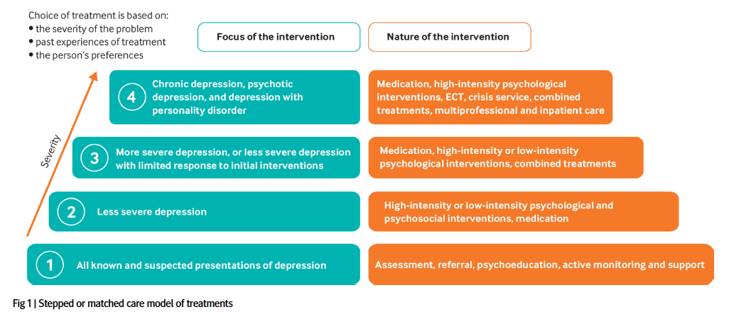
STEPPED OR MATCHED CARE MODEL

Slide 19
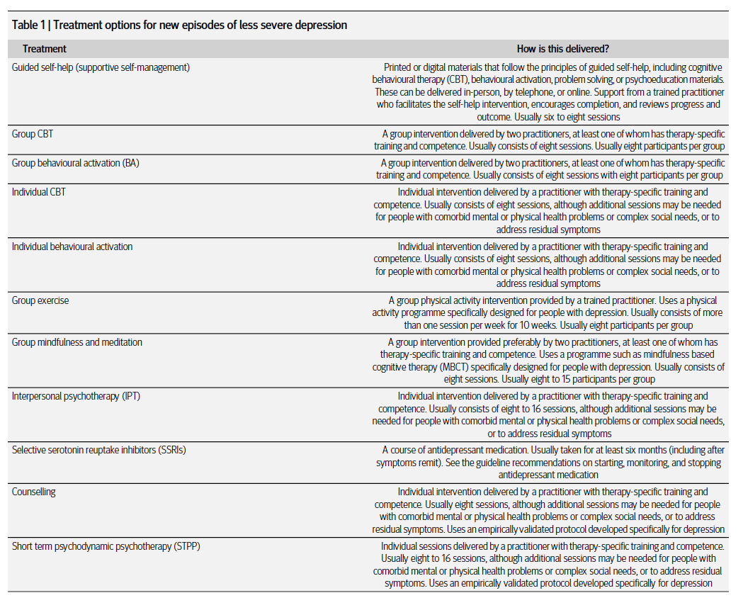

Slide 20
