Slide 1
Talking Therapies Spring Leadership and Innovation Forum, Tuesday 18th April 2023, 9:30am – 13:00pm
Chaired by:
Dr Christina Fitzgerald, Consultant Clinical Psychologist and Clinical Lead for NHS Talking Therapies
Andrew Beck, Consultant Clinical Psychologist and Head of Clinical Health Psychology

Slide 2
Housekeeping
Please ensure all cameras and microphones are off for the duration of the forum.
Please put any comments or questions in the chat, and these will be
responded to after each session.
All slides will be available and circulated across the network post event.
The session will be recorded and circulated across the network post event. Please contact Rhianna Murray (rhianna.murray@hee.nhs.uk) if you do not consent.

Slide 3
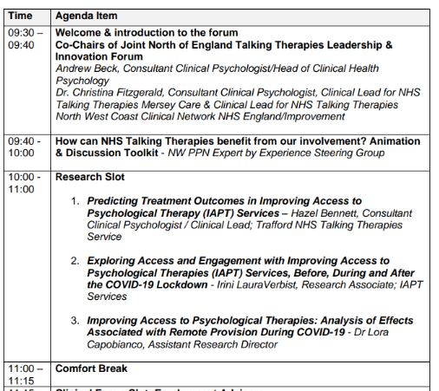
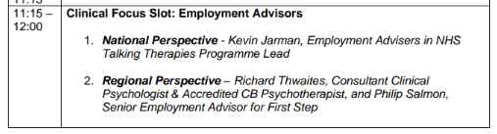
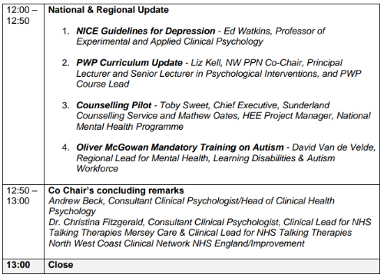
Agenda

