Slide 1
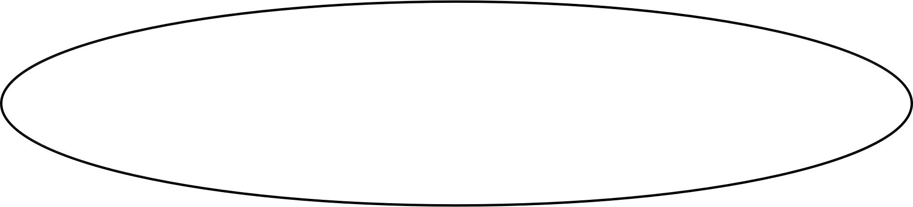


Improving access to psychological therapies
Analysis of effects associated with remote provision during COVID-19
Dr. Lora Capobianco
CAPOBIANCO, L, VERBIST I, HEAL C, HUEY, D, & WELLS, A (2022)

Slide 2

IAPT &
COVID-19
COVID-19
Immediate impact on service delivery.
IAPT published guidance on the delivery of remote therapy treatment (NHS England and NHS Improvement, 2020).
Remote Therapy
Issues regarding practicalities of remote therapy (technology, confidentiality, therapeutic relationships).
Previous reviews (i.e Berryhill et al., 2019) suggest remote therapy may be as effective as face to face therapy.
CAPOBIANCO ET AL (2022)
Remote Therapy During COVID-19 in IAPT
Previous research (i.e., Saunders & Allen, 2021; Nguyen et al., 2022) found that remote therapy in IAPT was associated with a decrease in symptoms of anxiety and depression.

Slide 3

Research Questions
01
What are the characteristics of those undergoing remote therapy in IAPT during Covid and Pre Covid?
02
What effect on anxiety and depression symptoms are associated with remote delivery of therapy?
03
How do the effect compare with those associated with face to face therapy delivery prior to COVID-19?
CAPOBIANCO ET AL (2022)

Slide 4

Methods
Design
Patients Included
Retrospective cohort and benchmark comparison of remote therapy across 4 IAPT services in Greater Manchester
Intention to treat approach (all patients with one attended appointment were included, providing a more pragmatic definition of entering treatment
COVID-19 & Benchmark Sample
Patients who entered treatment on or after March 23 2020 and discharged on/before 26 November 2020. Benchmark sample was from face-to-face therapy delivered March 2019 - March 2020
CAPOBIANCO ET AL (2022)

Slide 5

Data Analysis
Utilized GAD-7 and PHQ-9, routinely collected outcomes in IAPT to assess symptoms of anxiety and depression.
Ran a mixed model with a fixed effect to assess change over time.
To compare change in outcome between remote therapy and face to face we conducted a mixed effects model and pre-specified confounders including: age, gender, therapy category, and therapist category.
As a sensitivity analysis we repeated this analysis but adjusting for PHQ9/GAD7 severity and the variables found to be significantly different between groups at baseline (after adjusting significance level for multiple testing using a Bonferroni correction).
CAPOBIANCO ET AL (2022)

Slide 6
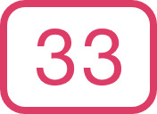

Results
Sample Overivew
Remote
64.8%
61.8%
43.6%
Average age
Female
White
In employment
In
Person
61.8%
64.8%
46.7%
CAPOBIANCO ET AL (2022)
Average age
Female
White
In employment
Step 2
Step 3
Step 3+
25%
66%
8%

Slide 7
Results
Sample Overivew
Remote Therapy
In Person
Mixed
Anxiety
Depression
Adjustment Disorder
CAPOBIANCO ET AL (2022)
Personality Disorder
Other
Not Stated
0%
25%
50%
75%

Slide 8






Results
Sample Overivew
Attendance During COVID
Attendance Pre COVID
5515 patients attended at least one session
2553 (46%) attended at least two sessions
9199 patients attended at least one session
4625 (46%) attended at least two sessions
median number of therapy sessions attended
median number of therapy sessions attended
CAPOBIANCO ET AL (2022)
Days from entry to end of treatment (median, IQR)
Days from entry to end of treatment (median, IQR)
Days from referral to 1st session (median, IQR)
Days from referral to 1st session (median, IQR)

Slide 9
Results
Sample Overivew
Reason for End of Treatment
Remote Therapy
In Person
Completed Treatment
Discharged (Mutual Agreement)
Dropped Out
Referred to Other Therapy
Declined IAPT
CAPOBIANCO ET AL (2022)
Stepped up/down
Other
Not Known
0%
10%
20%
30%
40%

Slide 10

Results
Remote Therapy Change in Anxiety & Depression Symptoms (During COVID-19)
Remote therapy significantly reduced symptoms of anxiety and depression over time.
Remote therapy associated with an average reduction in 0.062 units a day on GAD-7 and 0.067 units a day on the PHQ-9
1.86
average unit reduction on GAD-7 per month
2.01
average unit reduction on PHQ-9 per month
CAPOBIANCO ET AL (2022)
months of treatment (13 weeks weekly treatment) to cross cut off
3.33
3.8
months of treatment (11 weeks weekly treatment) to cross cut off

Slide 11
Results
In Person Therapy Change in Anxiety & Depression Symptoms (Pre COVID-19)
In-person therapy delivered in the 12 months prior to COVID-19 associated with a significant reduction in symptoms of anxiety and depression over time.
Remote therapy associated with an average reduction in 0.039 units a day on GAD-7 and 0.042 units a day on the PHQ-9
1.17
average unit reduction on GAD-7 per month
1.26
average unit reduction on PHQ-9 per month
CAPOBIANCO ET AL (2022)
months of treatment (22 weeks weekly treatment) to cross cut off
5.5
5
months of treatment (20 weeks weekly treatment) to cross cut off

Slide 12
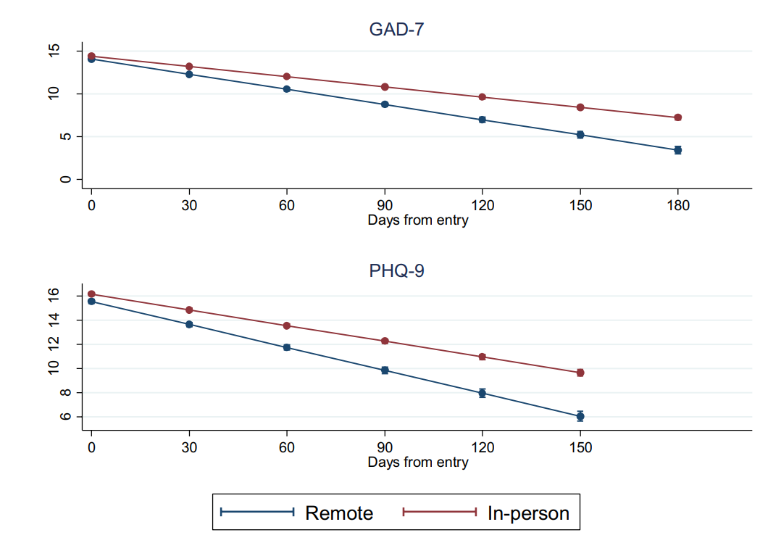
Results
Remote Therapy vs Pre COVID-19 Benchmark
Is the reduction over time greater in remote therapy or face to face?
Patients who receive remote therapy during COVID-19 had a greater reduction in anxiety and depression symptoms. Results remain unchanged when analyses controlled for baseline severity and demographic variables found to differ at baseline.
Rate of change is depicted in Figure.
CAPOBIANCO ET AL (2022)
Reproduced from Capobianco et al (2022)

Slide 13
Results
Minimal Clinically Important Change
GAD-7 Reduction between first and last session
PHQ-9 Reduction between first and last session
N. Sessions | Pre COVID N M (SD) | Pre COVID N M (SD) | During COVID N M (SD) | During COVID N M (SD)
2 | 757 | 1.3(4.3) | 541 | 1.5 (4.3)
3 | 659 | 2.4 (5.1) | 433 | 2.5 (5.2)
4-6 | 1323 | 4.8 (5.7) | 829 | 4.3 (5.7)
7-9 | 1039 | 6.9 (5.5) | 498 | 7.0 (5.6)
10+ | 1036 | 7.0 (5.8) | 451 | 7.0 (5.4)
N. Sessions | Pre COVID N M (SD) | Pre COVID N M (SD) | During COVID N M (SD) | During COVID N M (SD)
2 | 761 | 1.4 (4.5) | 541 | 1.6 (4.9)
3 | 660 | 2.8 (5.5) | 438 | 2.9 (5.6)
4-6 | 1328 | 5.1 (5.63) | 832 | 4.8 (6.3)
7-9 | 1042 | 7.3 (6.2) | 499 | 6.9 (6.2)
10+ | 1310 | 7.7 (6.4) | 452 | 7.1 (6.1)
CAPOBIANCO ET AL (2022)

Slide 14
What does this all mean for IAPT?
Service Provision
Dropouts from Treatment
Decrease in Symptoms
Remote therapy was not associated with variation in service provision and uptake.
Remote therapy appeared to reduce number of days from referral to first session and may be associated with faster access to treatment
Remains unclear due to poor data reporting by therapists as 36% did not have a reason for end of treatment listed
Both remote therapy and face to face therapy were associated with a decrease in symptoms over time. Patients who received remote therapy had a greater reduction in symptoms than face to face.
CAPOBIANCO ET AL (2022)

Slide 15

Symptom Change
Minimum Clinically Important Difference
Significant reduction in symptoms over time
Change over time only resulted in an average 3 point change on both measures.
Clinical improvement was slow.
Remote therapy rate of improvement equates to 1.49 unit decrease on GAD-7 per month, and 1.58 unit decrease on PHQ-9 per moth.
This would average 16 and 15 weeks to cross the cut off on GAD-7 and PHQ-9 compared with 28 and 24 weeks in face to face
Patient do not appear to be receiving the required length of time to reach required cut off
During COVID-19, 50.9% met MCID on GAD-7 and 47.5% met MCID on PHQ-9
Pre COVID-19 55.3% met MCID on GAD-7 and 51.7% met MCID on PHQ-9, which does not occur until 4-6 treatment sessions, and the median number of sessions attended is two.
CAPOBIANCO ET AL (2022)

Slide 16

Clinical Implications
Effect of Remote Therapy
Remote therapy was associated with improvements in outcomes similar to face-to-face pre-COVID- 19 level, however the data was variable
Treatment Length
It appears in order to meet target cut offs for clinical improvement more time would be required in both face to face and remote therapy
CAPOBIANCO ET AL (2022)
Rate of Change
Remote therapy time did appear to be associated with more rapid change in symptoms compared with the face-to-face pre-COVID-19 therapy time, but questions must remain concerning how effective the treatment element is and how much time is needed to realize an adequate dose

Slide 17

Questions or comments?
Email Address
lora.capobianco@gmmh.nhs.uk
Website
www.adept-ru.com
CAPOBIANCO ET AL (2022)

Slide 18
