Slide 1
Employment Advisers in NHS Talking Therapies – National Perspective
Kevin Jarman
EA in NHS Taking Therapies Lead
Joint Work & Health Unit
Talking Therapies Leadership and Innovation Spring Forum 2023
18 April 2023

Slide 2

Context
What is Employment Advisers (EAs) in NHS Talking Therapies?
The original IAPT Layard / Clark model stated that IAPT services should provide employment support.
Initially, due to a lack of ringfenced funding investment in employment support was patchy, with many IAPT services not offering employment support.
The Joint Work & Health Unit has invested over £84 million to enable NHS Talking Therapies providers in 40% of the NHS in England to recruit 400 new EAs to work alongside therapists to provide combined psychological treatment and employment support to all IAPT clients who choose to receive this combined offer.
EAs started to come into post in June 2017.
In the last four years over 120,000 people have started employment support within our EA in NHS Talking Therapies sites.
With funding of up to £122million available during this Spending Review period (April 2022 – March 2025) we will enable all NHS Talking Therapies providers to offer combined psychological treatment and employment support to all clients who wish to take up this combined offer.
We will increase the employment support capacity to 1,100 WTE by 01 April 2024
This will enable around 100,000 people per year to receive combined employment support and talking therapies from 2024/25, this is equivalent to around 15% of those who complete treatment.

Slide 3

Why EAs in NHS Talking Therapies?
Work is good for mental health providing meaningful activity and can guard against poverty.
In 2014, RAND Europe estimated that offering vocational support inspired by IPS principles in primary care could have a £1.59 return for every £1 invested. Evaluation of EA in NHS Talking Therapies suggests £2.31 return for every £1.
Evaluation of our work has found that clients who received the combined psychological treatment and employment support had better mental health outcomes than those who received treatment alone. They were significantly better for those who were out of work and those off sick at assessment.
The out of work and those who were long term sick at assessment saw the greatest improvement in employment outcomes.
For clients who were in work on entry to NHS Talking Therapies, longitudinal analysis identified positive outcomes:
    Improved job retention
    reduced presenteeism
    improved relationships with colleagues and managers

Slide 4
Key Features of EA in NHS Talking Therapies Employment Support
Employment Support is available to all NHS Talking Therapies clients irrespective of whether they are out of work or in work, or whether you are off sick or working
EAs empower clients to set employment goals, we require clients, therapists and EAs to draw up action plans to meet these identified goals.
EAs provide information, advice and guidance to support the client to attain their employment goals and improve their mental health
EAs are flexible. A client looking to get back to work from sickness can decide to leave their current job and do something else.
EAs work with Job Centre Plus to make sure NHS Talking Therapies clients are receiving the benefits they are entitled to and that JCP staff are aware of what NHS Talking Therapies can offer their clients and how to support clients to self-refer for psychological treatment
EAs work with housing associations, food banks, Citizens Advice Bureaus, debt counsellors and other support organisations to ensure that NHS Talking Therapies clients receive support to improve their physical living situations
Senior Employment Advisers work in all EA in NHS Talking Therapies sites to lead the employment support team, ensure that employment support is effectively embedded within the NHS Talking Therapies providers and is well placed within the local employment support architecture.

Slide 5
Training of EAs and establishing an EA qualification
In 2019 we trained over 300 EAs at Liverpool John Moore’s University, our SEAs received Supervision Training.
We have since developed a 12 module training package that is delivered locally
The training is designed to support EAs to provide employment support in a NHS Talking Therapies setting, understand the importance of Risk Management and Safeguarding, work effectively with therapists, provide quality employment interventions, it includes Money Guiders training, that is particularly important given the current cost of living crisis.
We are currently working with Skills for Justice to establish a Level 4 Qualification for EAs, the following is underway and is fully funded:
Development of the EA qualification to be hosted by SfJ (completed by 01 June 2023)
Providing Level 3 Assessors Training for all SEAs (225) to assess the competence of EAs to enable the EAs to be qualified (delivered by March 2025)
Providing Level 4 Training 25/30 Employment Support Managers and SEAs to undertake quality assurance of the qualification assessments (delivered by March 2025)

Slide 6

Next Steps & joint work to be undertaken with Health Education England
We have held preliminary meetings with representatives of Health Education England to look at what needs to be done to establish the EA qualification.
We need assistance to:
Support us and SfJ to develop the infrastructure to deliver the qualification
Help identify Qualification Centres
Take responsibility for the EA qualification post 31 March 2025
Establish funding mechanisms for the EA qualification activity beyond 31 March 2025.

Slide 7
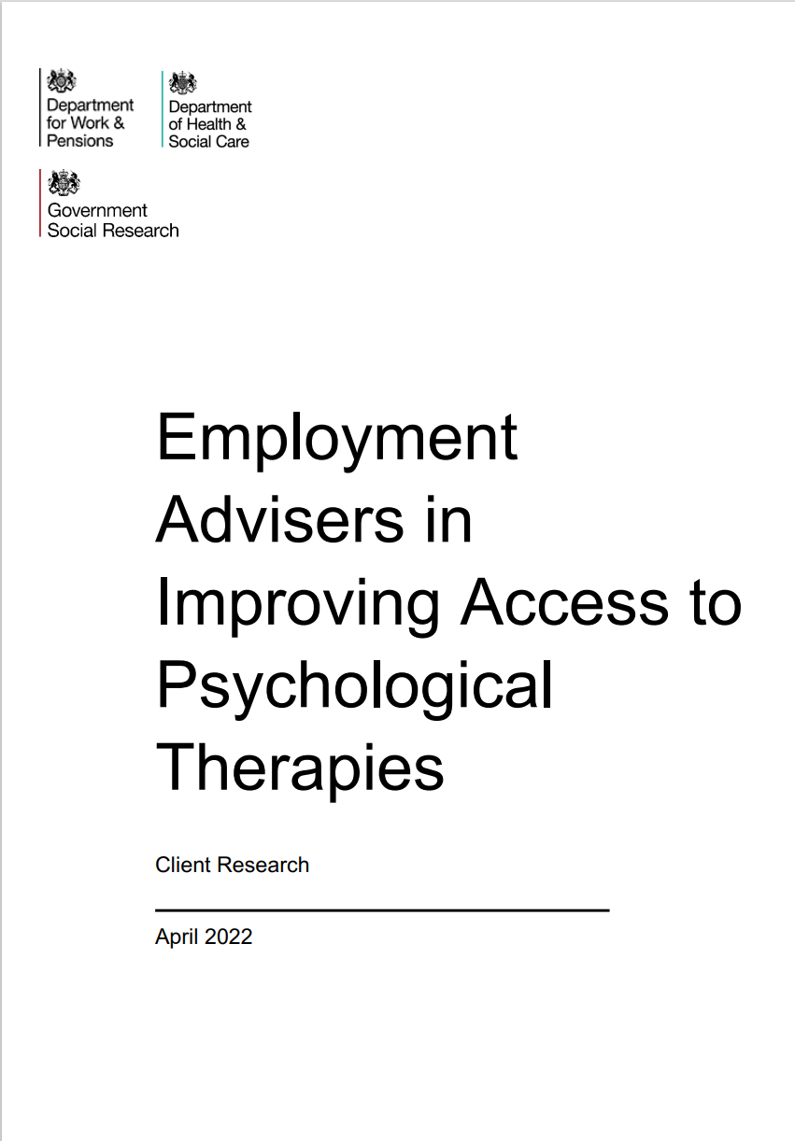

Evaluation and Contact Details
Published evaluation reports can be found at:
Employment advisers in improving access to psychological therapies - GOV.UK (www.gov.uk)
For further information on EA in NHS Talking Therapies contact:
Training & Qualification Lead:
Brigid Lowe:
brigid.lowe@dwp.gov.uk
National Lead:
Kevin Jarman: kevin.jarman@dwp.gov.uk

