Slide 1

Psychological Professions Week 2022
Communication Pack
14 November 2022 – 18 November 2022
#PsychologicalProfessionsWeek2022
#PPWeek22

Slide 2
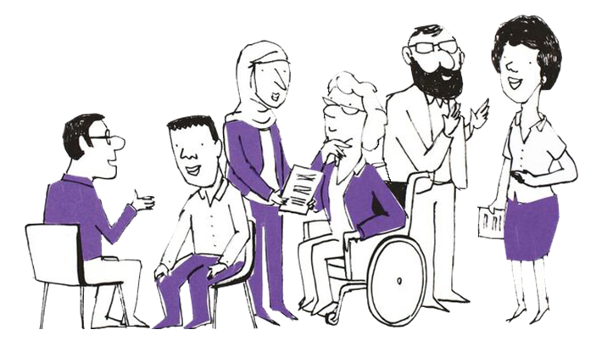
What are the Psychological Professions?
In England, the psychological professions are a diverse group of professions whose work is informed by the disciplines of psychology and psychological therapy. They work with people to prevent and alleviate psychological and emotional distress, manage mental health and wellbeing, and empower individuals and communities to improve their lives.
The psychological professions include psychologists, psychological therapists and psychological practitioners. Read more about the range of occupations Health Careers website.
Our Vision
To transform lives and communities by extending and embedding
psychological knowledge and practice across the whole of health and care.
#PsychologicalProfessionsWeek2022
#PPWeek22

Slide 3
Background
The NHS Long Term Plan set out ambitious proposals to expand access to psychological therapies and interventions in England at a faster pace than ever before. Delivering this transformation will require a ‘step-change’ in our workforce - expanding in numbers, but also investing in our staff and supporting them to work differently. The psychological professions workforce alone will need to grow by at least 60 per cent between March 2020 and April 2024.
To drive and enable this ambition, Health Education England commissioned Psychological Professions Networks (PPNs) nationally and across each of the 7 regions in England. The PPNs provide a joined-up voice for the psychological professions in workforce planning and development, and to support excellence in practice. Currently the PPNs have over 12,500 members.
On the second week of November since 2020, PPNs have shared the impact and value of the psychological professions during Psychological Professions Week.
#PsychologicalProfessionsWeek2022
#PPWeek22

Slide 4
Psychological Professions Week 2022 - Objectives
Raise awareness of the psychological professions including careers, opportunities and the workforce growth ambitions
Engage a diverse audience mix to attend the PPN Conference virtual sessions and regional events during 14-18 November 2022
Increase membership of the PPNs
Encourage health service organisations (mental health and physical heath), education providers, professional bodies and organisations to celebrate Psychological Professions Week by holding their own events and communications.
#PsychologicalProfessionsWeek2022
#PPWeek22

Slide 5
Psychological Professions Week 2022
- 3rd Annual PPN Conference
The PPN Conference is aimed at PPN members and wider stakeholders so they can come together to celebrate the psychological professions, as well as drive strategic ambitions to develop the professional group for the benefit of patients and the public.
During the week, the virtual sessions will be informative and thought-provoking, featuring keynote speakers, panel discussions and regionally led events, including:
How to enter and develop a career in the psychological professions
Equality, Inclusion & Diversity within the professions
Psychological practice in physical healthcare
Public involvement - adding value and transforming lives (a session co-produced by service users and carers)
Register at: www.PPWeek22.com For more information visit: www.ppn.nhs.uk
#PsychologicalProfessionsWeek2022
#PPWeek22

Slide 6
Key dates
28 September: Psychological Professions Week Communications Commence
3 October 2022: Registrations open for PPN Conference
www.PPWeek22.com
7 November 2022: 'One week to go' communications
14 – 18 November 2022: Psychological Professions Week 2022!
#PsychologicalProfessionsWeek2022
#PPWeek22

Slide 7
Audience
Everyone is welcome to mark Psychological Professions Week 2022 across England and join the PPNs' 3rd annual conference!
Target audiences include:
Psychological professionals – current, training and aspiring
Experts by Experience and people with lived experience
Policymakers
Education, workforce and career leads and teams
Mental health service providers
Members of the public interested in the psychological professions and mental health services.
#PsychologicalProfessionsWeek2022
#PPWeek22

Slide 8
How to help?
We need your help to encourage colleagues, organisations and partners to mark Psychological Professions Week 2022.
You can help us do this by:
Developing creative and authentic local content to promote Psychological Professions Week across your platforms - This can include profiling and telling the stories of psychological professionals and service users who have been benefited from their services, sharing career opportunities and jobs available, creating blogs, developing local news stories, running celebratory virtual or face to face events,
Sharing, via your channels and networks, details of Psychological Professions Week 2022, regional events, PPN websites, key messages, communication assets and membership links.
#PsychologicalProfessionsWeek2022
#PPWeek22

Slide 9
Assets
Using the link to the PPN England website, you’ll find one central hub for all the Psychological Professions Week 2022 assets:
GIF
Logo
Social Card Quote Templates
Email signatures
Poster
Copy
Don’t forget to share your activity and celebrations with us. You can also tag relevant regional PPN accounts on Twitter posts:
@PPNEngland @PPNEast @LondonPPN @PPNMidlands
@NEandY_PPN @NWPPN @se_ppn @swppn
Please use the hashtag #PPWeek22 or #PsychologicalProfessionsWeek2022 in all posts.
#PsychologicalProfessionsWeek2022
#PPWeek22

Slide 10
Key messages
Psychological Professions Week 2022 is taking place 14-18 November 2022
The week is led by the Psychological Professions Network and aims to celebrate the impact and highlight the potential of the psychological professions
Join in Psychological Professions Week 2022 by registering for the PPN Conference (from 3 October) at www.PPWeek22.com. Attend one or more of the PPN Conference virtual sessions, a local event, or organise an activity to mark the week locally.
The PPN Conference is free and virtual, including:
exploring how you can get into and develop your career within the psychological professions
showcasing how people with lived experience have helped shape the professions and the services they deliver so the high-quality care can be delivered for service users, their families and carers
exploring what the future holds and contribute towards growing and developing the psychological professions across England.
It is FREE to become a member of Psychological Professions Network, visit www.ppn.nhs.uk.
#PsychologicalProfessionsWeek2022
#PPWeek22

Slide 11
Further information
For further information or queries, please contact your regional PPN.
If you require information about Psychological Professions Week 2022, or this communications pack, please contact spnt.ppnengland@nhs.net .
PPN - England
PPN - East of England
PPN - London
PPN - Midlands
PPN - North East and Yorkshire
PPN - North West
PPN - South East
PPN - South West
#PsychologicalProfessionsWeek2022
#PPWeek22

